Slide 1

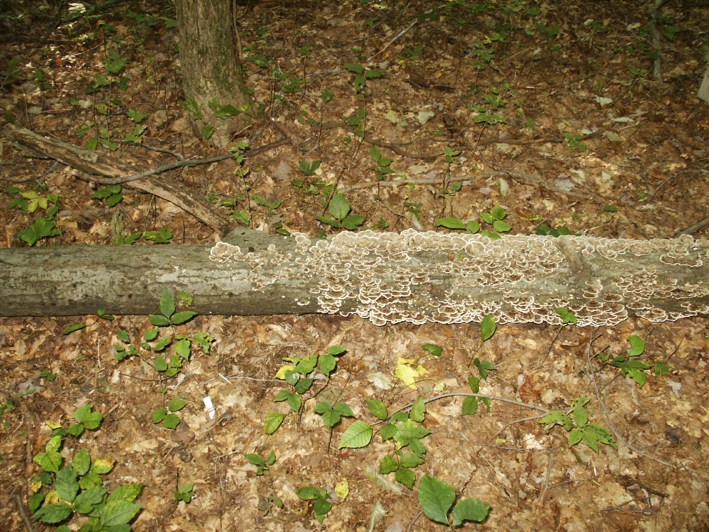
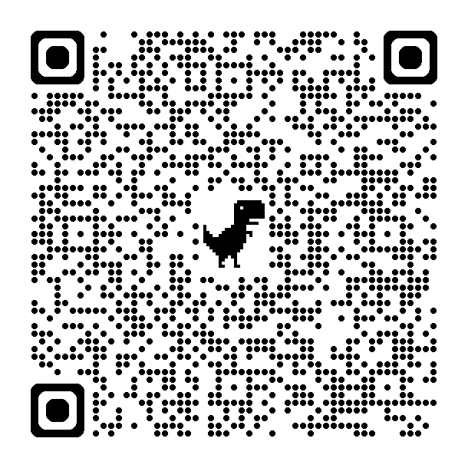
Fall 2024 Seminar Series
Monday, October 7th in 101 Neuroscience Engineering Collaboration Building
Megan Rúa
Wright State Ur Microbial Musings: “Missives from my Sabbatical”
Hosted by Lynn Hartzler, PhD
Please join us in person in 101 NEC or online at
https://wright.webex.com/wright/j.php?MTID=mb580b8bc55ea8f8153b733e4e0a6ae3c
1:25-2:20 PM

