Slide 1
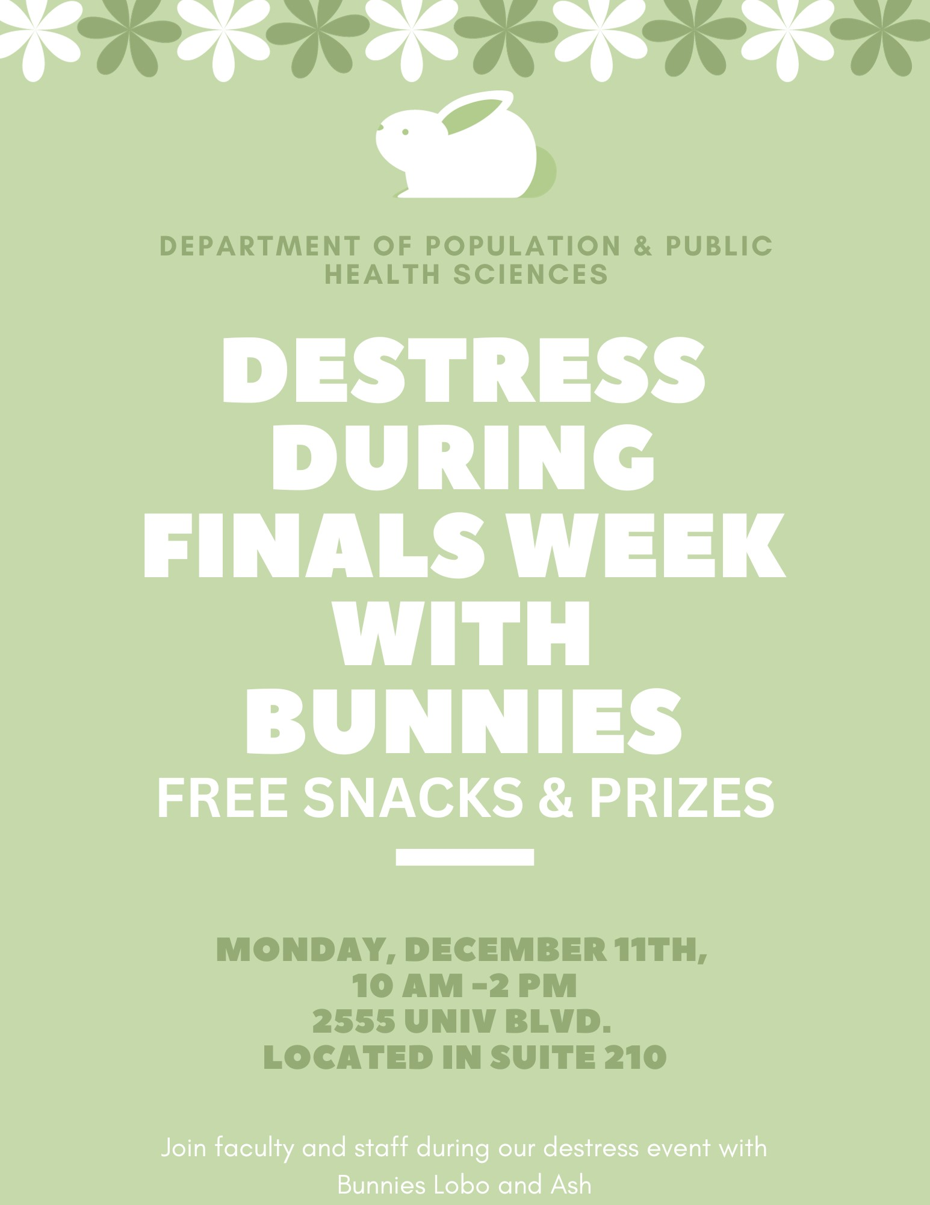
Department of Population & Public Health Sciences
Destress with Bunnies
during Exam Week
Free snacks & prizes!
Tuesday, April 23rd
12:00 pm - 2:00 pm
2555 University Blvd. - Suite 210

