Slide 1
Enrollment Update
Faculty Senate
January 23, 2023

Slide 2
Enrollment & Application Numbers

Slide 3
Spring 2023: New Enrollments
Note: Includes new First-Time, Transfer and Graduate students for both Dayton and Lake campuses as of Day 7 for the term indicated. Institutional Research and Effectiveness

Slide 4
Spring 2023: Continuing Enrollments
A total of 10,798 students were enrolled at Wright State University as of the Fall 2022 census.
Of those, 698 graduated Fall 2022.
Of the remaining 10,100 students who did not graduate, a total of 8,693 (86%) were enrolled at Wright State for Spring 2023.
Note: Includes students for both Dayton and Lake campuses as of Day 7 for the Spring 2023 term. Institutional Research and Effectiveness

Slide 5
Spring 2023: Continuing Enrollments
Breakdown of the 1,407 students not enrolled for Spring 2023
Count/percentage and average GPA by student level
Student level | Count | Percentage | Average GPA
College Credit Plus | 347* | 25% | 3.53
Undergraduate | 852 | 61% | 2.00
Graduate/professional | 208 | 15% | 3.05
Total | 1,407 | 100% | 2.55
* College Credit Plus registrations were ongoing and not yet complete by Day 7 of the Spring term.
Note: Includes students for both Dayton and Lake campuses as of Day 7 for the Spring 2023 term. Institutional Research and Effectiveness

Slide 6
Spring 2023: Continuing Enrollments
Breakdown of the 1,407 students not enrolled for Spring 2023
Count/percentage by college
Student level | Count | Percentage
Coll of Health Ed & Human Services (CHEH) | 195 | 14%
College of Engineerg & Computer Sci (CECS) | 224 | 16%
College of Graduate Prog and Hon St (GRD5) | 11 | 1%
College of Liberal Arts (COLA) | 143 | 10%
College of Science & Mathematics (COSM) | 143 | 10%
Lake Campus (LAKE) | 136 | 10%
Provost Non-Academic (PVN5) | 7 | 0%
Raj Soin College of Business (RSCB) | 163 | 12%
Retention (RETN)/Undecided | 373 | 27%
School of Medicine (SOMD) | 12 | 1%
Total | 1,407 | 100%
Note: Includes students for both Dayton and Lake campuses as of Day 7 for the Spring 2023 term. Institutional Research and Effectiveness

Slide 7
Spring 2023: Continuing Enrollments
Breakdown of the 1,407 students not enrolled for Spring 2023
Balance Owed | Count | Percentage
No | 962 | 68%
Yes | 445 | 32%
Total | 1,407 | 100%
Note: Includes students for both Dayton and Lake campuses as of Day 7 for the Spring 2023 term. Institutional Research and Effectiveness

Slide 8
Fall 2023: Applications
Note: Includes new First-Time, Transfer and Graduate students for both Dayton and Lake campuses as of 32 Weeks Prior to the term indicated. Institutional Research and Effectiveness

Slide 9
Recruitment Efforts

Slide 10
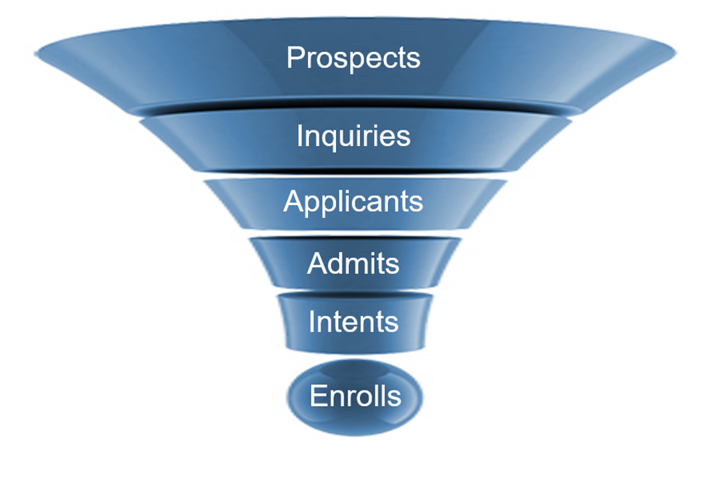
Building the Enrollment Funnel
Enhanced Student Search Strategy
    Increased Volume
    Predictive Modeling
Engaging Non-Responders
Launched New Financial Aid Initiatives
    Take Flight
    President’s and Deans’ Scholars
    Revised Merit Awards
Embarking on Partnerships
    Amazon
    AU-ABC
    Local School Districts

Slide 11



Building the Enrollment Funnel
Enhanced Student Search Strategy
    Increased Volume
    Predictive Modeling
Engaging Non-Responders
Launched New Financial Aid Initiatives
    Take Flight
    President’s and Deans’ Scholars
    Revised Merit Awards
Embarking on Partnerships
    Amazon
    AU-ABC
    Local School Districts

Slide 12
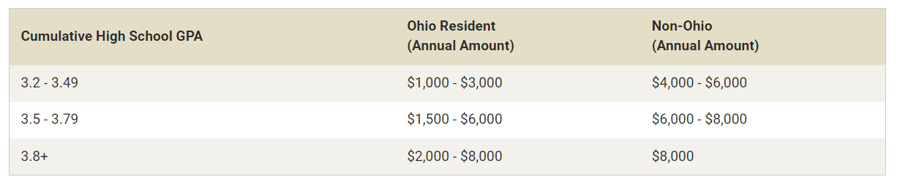
Revised Merit Awards

Slide 13


Building the Enrollment Funnel
Enhanced Student Search Strategy
    Increased Volume
    Predictive Modeling
Engaging Non-Responders
Launched New Financial Aid Initiatives
    Take Flight
    President’s and Deans’ Scholars
    Revised Merit Awards
Embarking on Partnerships
    Amazon
    AU-ABC
    Local School Districts

Slide 14
Faculty Support

Slide 15



Opportunities for Engagement
Raider Open House: January 28
    Nearly 500 registrants
    >50% of senior registrants have already been admitted
Admitted Student Notecards: February
President’s and Dean’s Scholars Event: March 11
    Students and parents
    Interviews, activities, tours
Admitted Student Night: April 5
Signing Day: May 2

Slide 16
Questions

