Slide 1
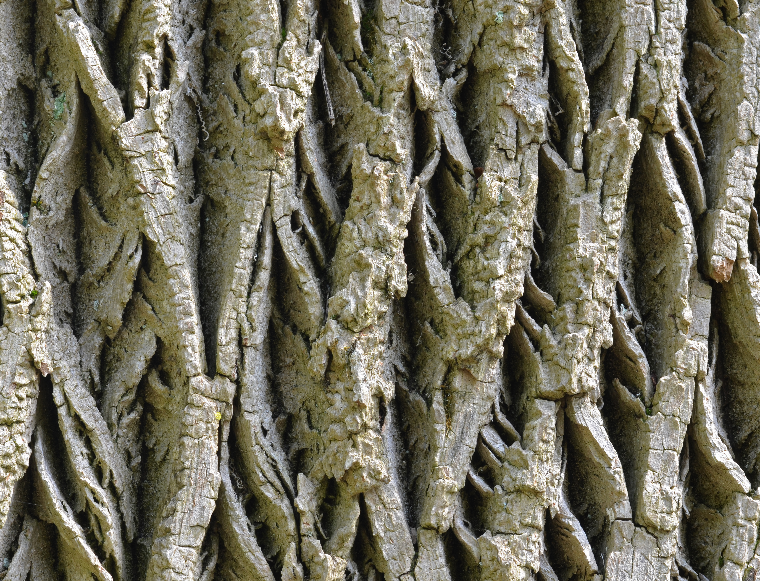
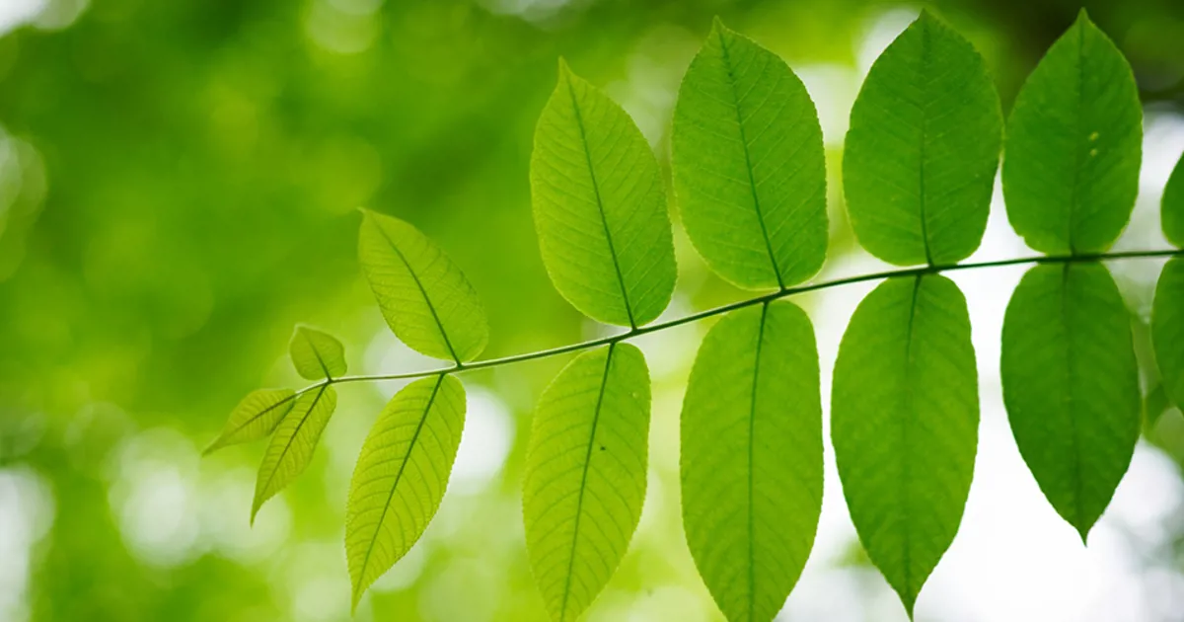
Ash Tree Rescue at Wright State University
Don Cipollini and Olivia Johnson
A report of the University Buildings and Grounds Committee

Slide 2
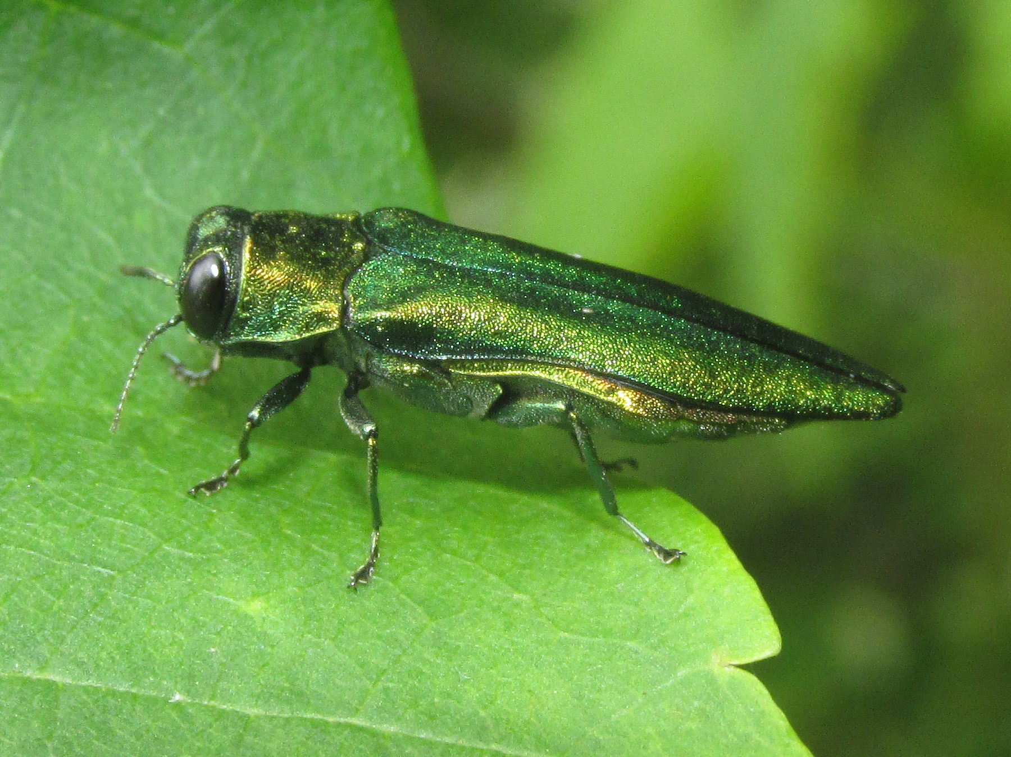
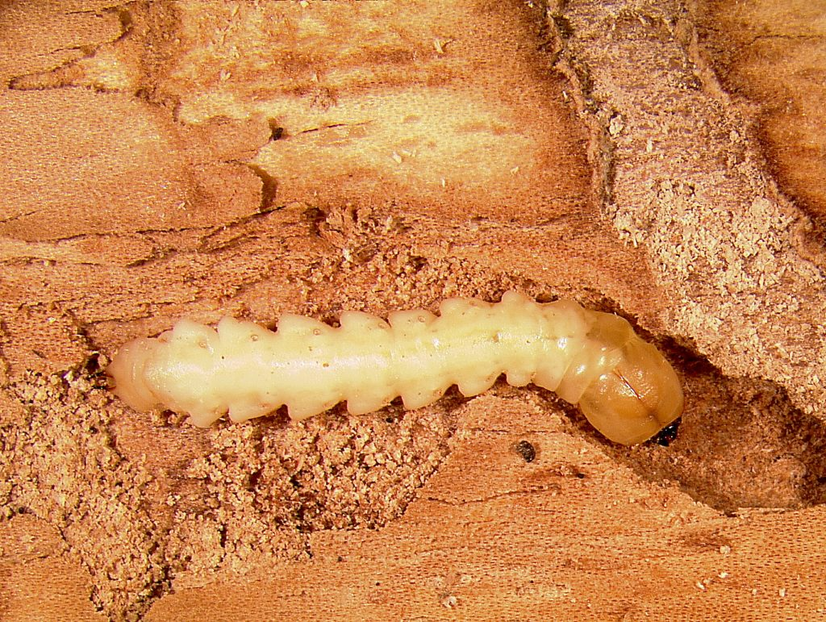
Emerald Ash Borer
Arrived on campus ~2012
Nearly all mature susceptible white and green ashes in woods are now dead

Slide 3
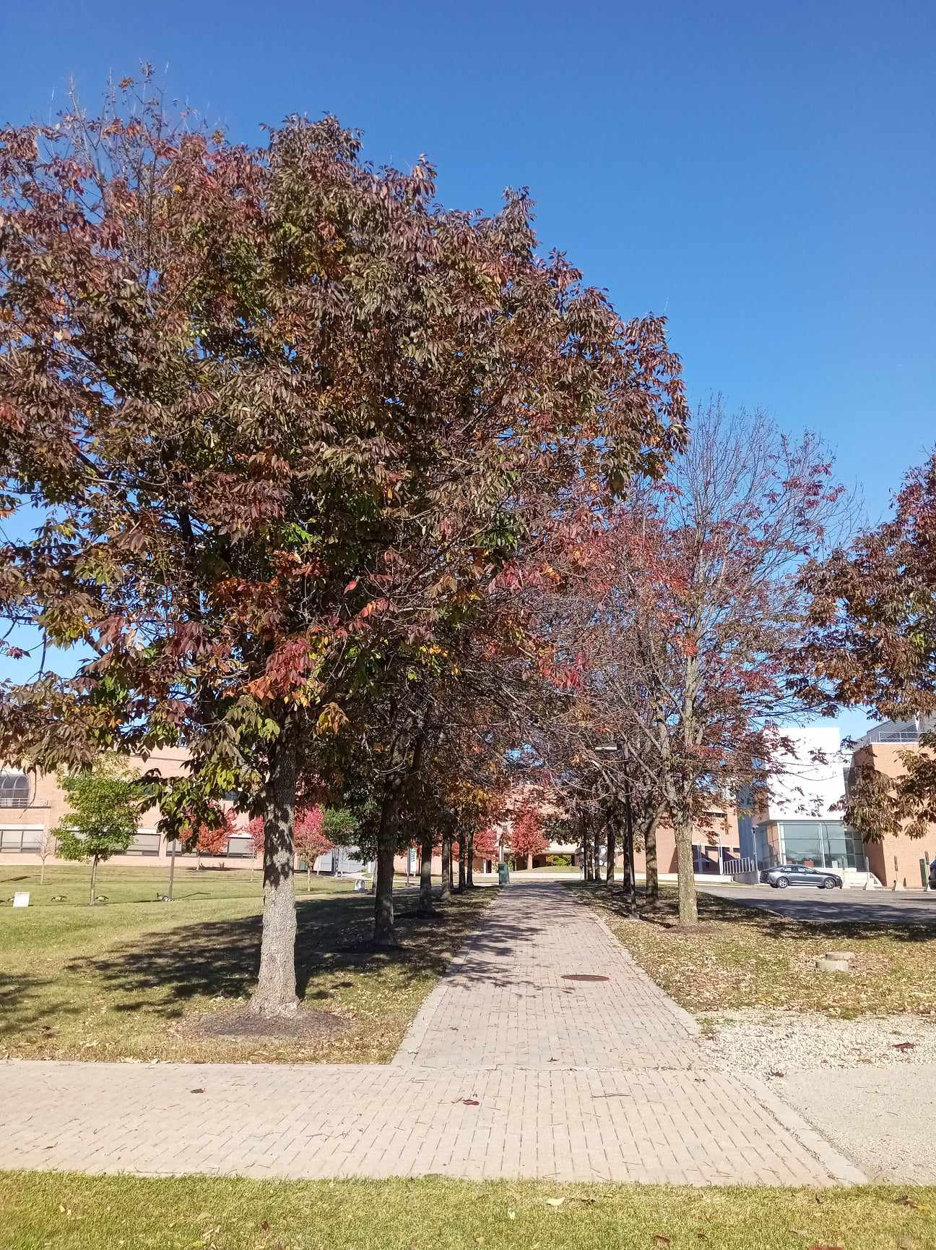
Campus Ash Trees
Mostly white ash, of one or two varieties
Pesticide treated on a rotation since ~2008
Trunk injections or root drenches
Treatments abandoned at some point over pandemic

Slide 4
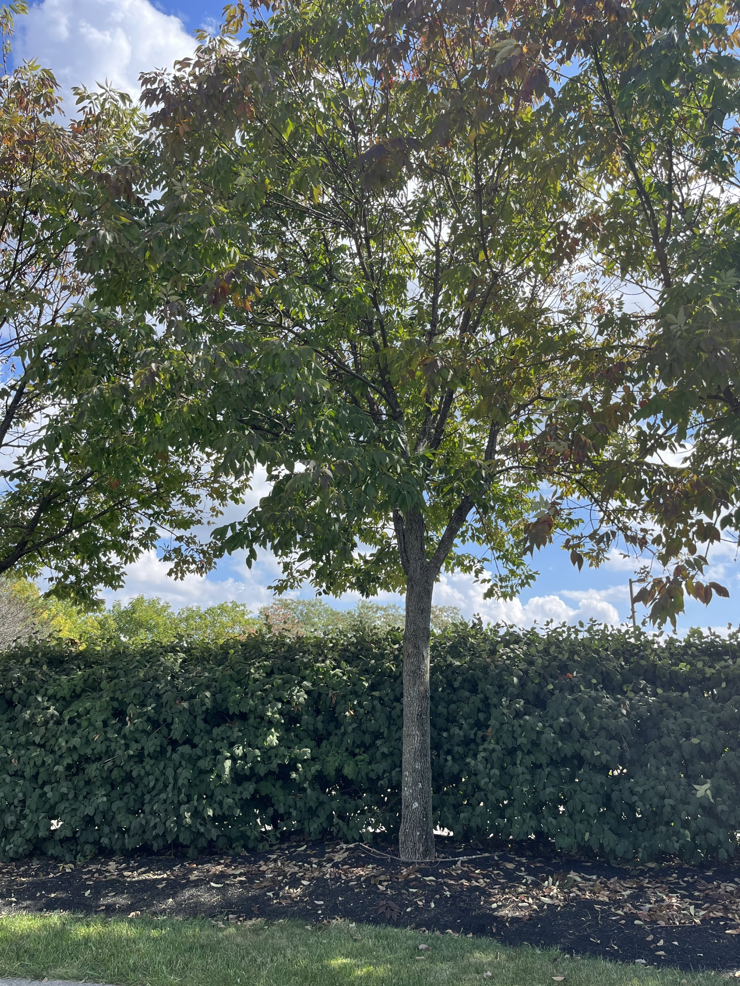
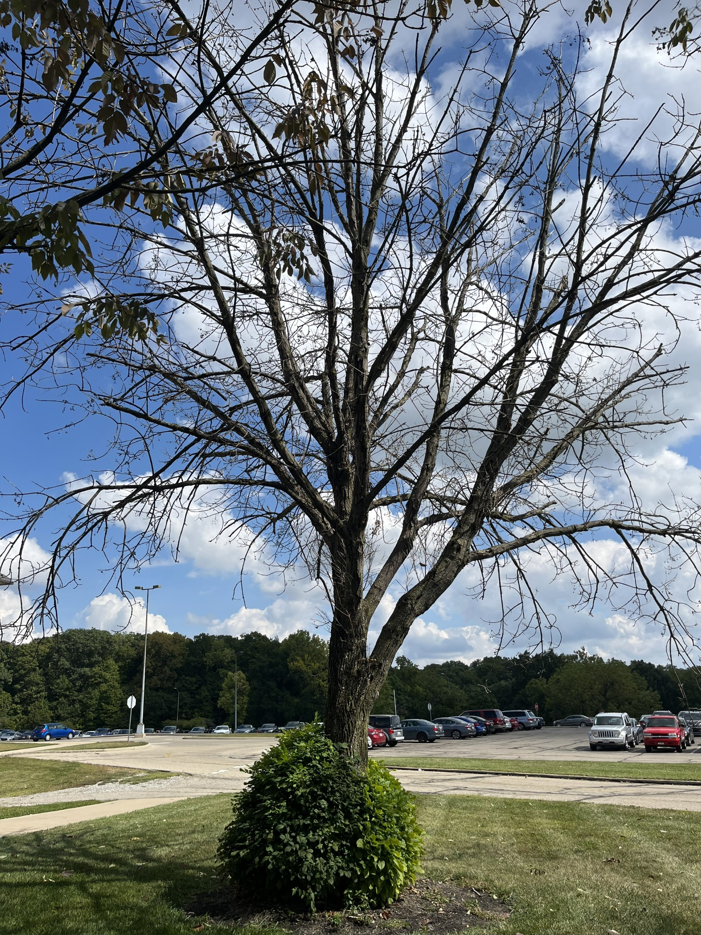
Trees currently range widely in health

Slide 5
Canopy Health Scale
Ash (Fraxinus spp.) mortality, regeneration, and seed bank dynamics in mixed hardwood forests following invasion by emerald ash borer (Agrilus planipennis) - Scientific Figure on ResearchGate. Available from: https://www.researchgate.net/figure/Pictorial-representation-of-the-1-5-ash-decline-rating-scale-with-1-indicating-a-healthy_fig3_271960197 [accessed 10 Oct, 2023]

Slide 6
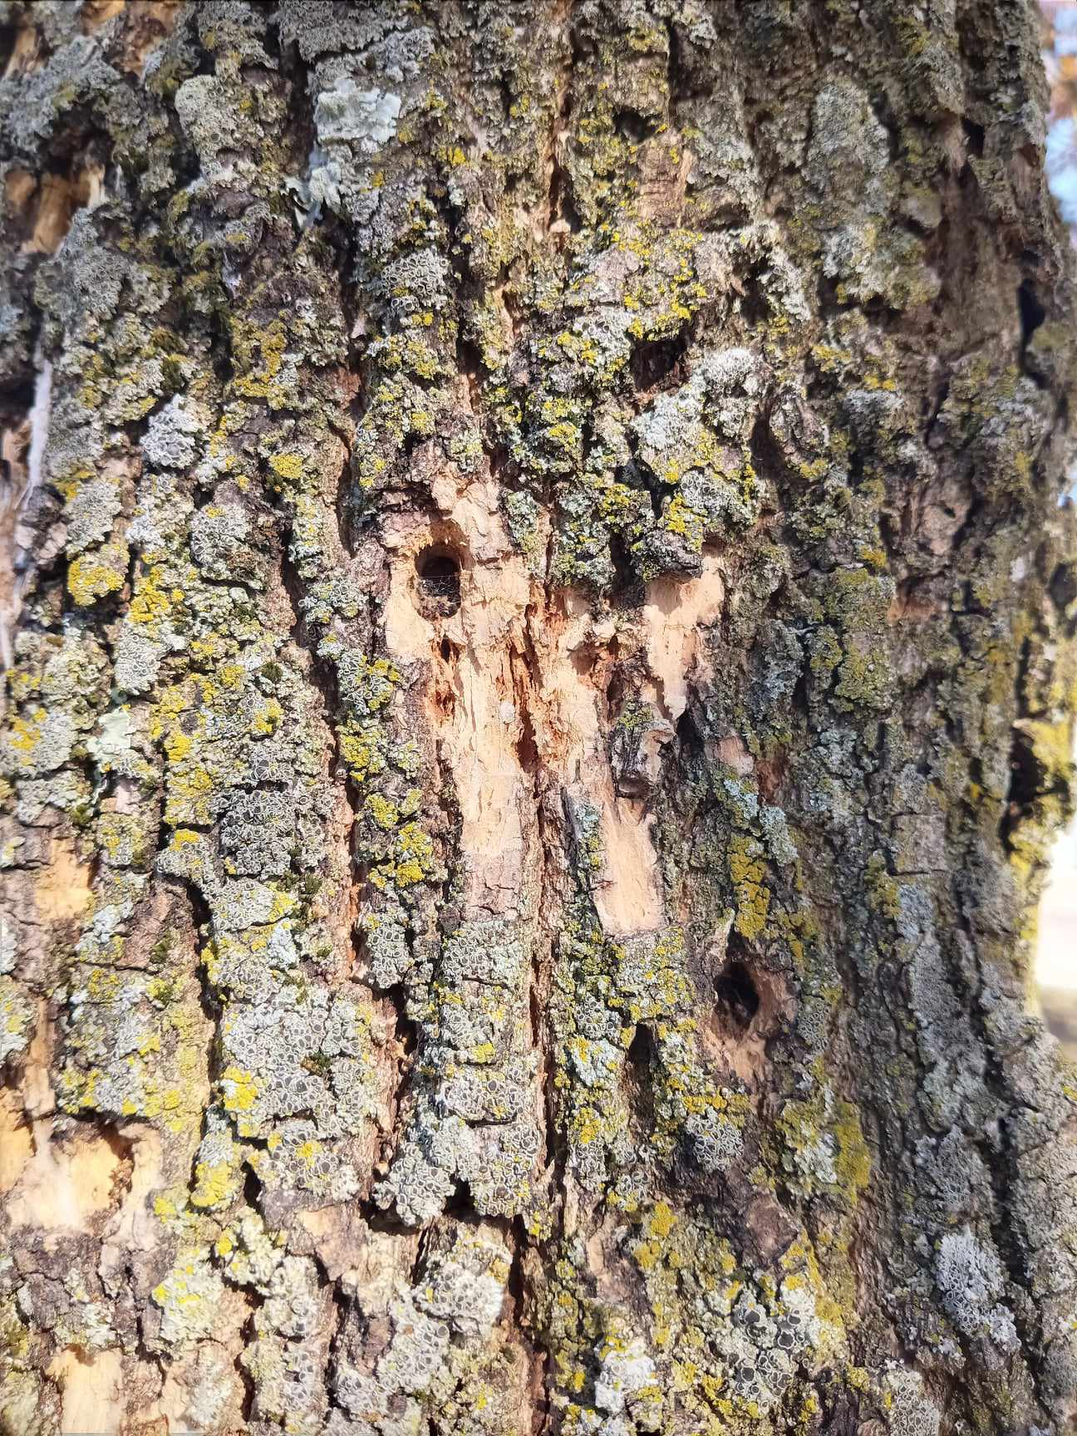
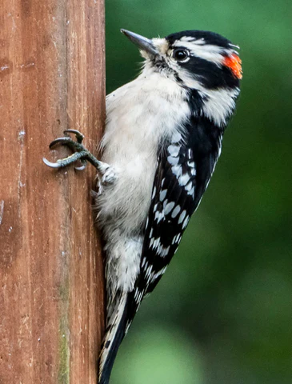

Slide 7
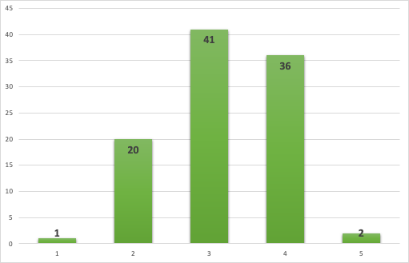
Frequency Distribution of Tree Ranks
Savable
Not savable
(based on 100 trees; we have since surveyed 127 trees)

Slide 8
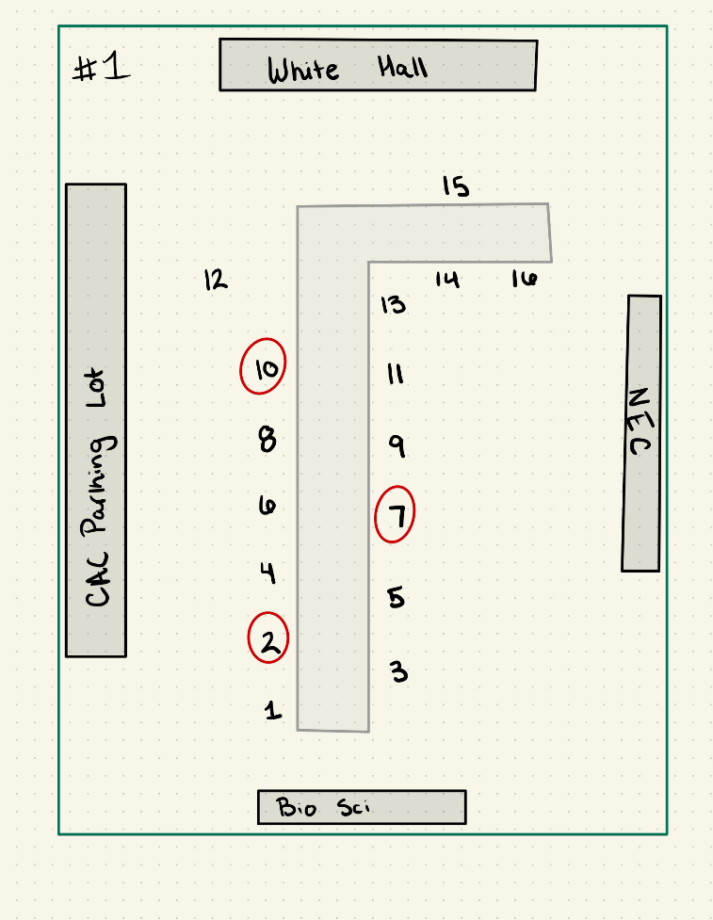
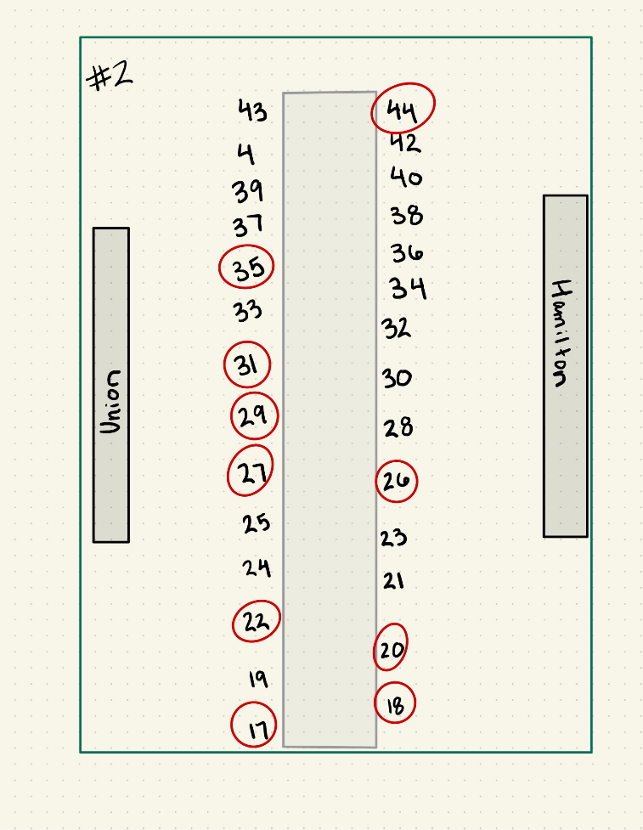
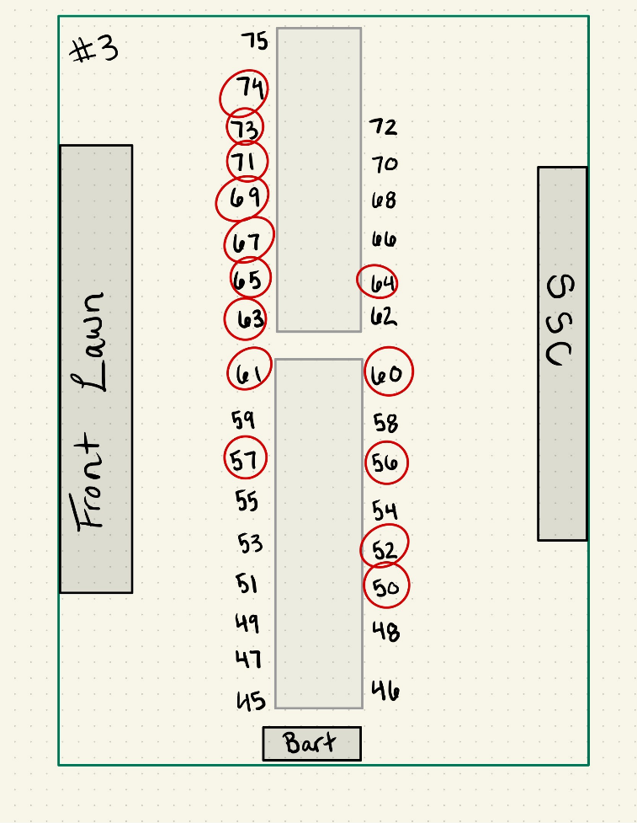

Slide 9
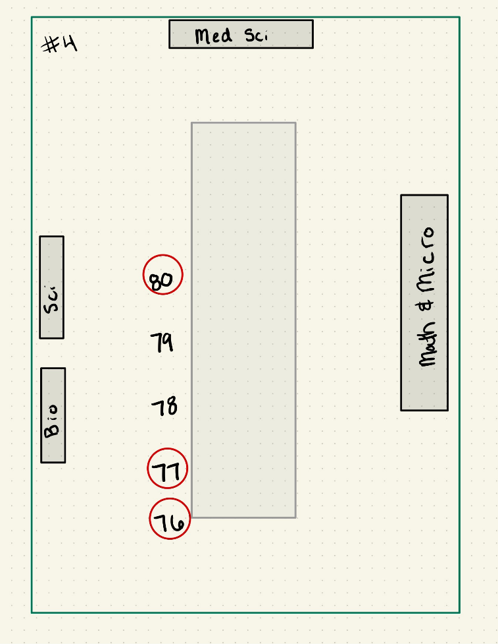
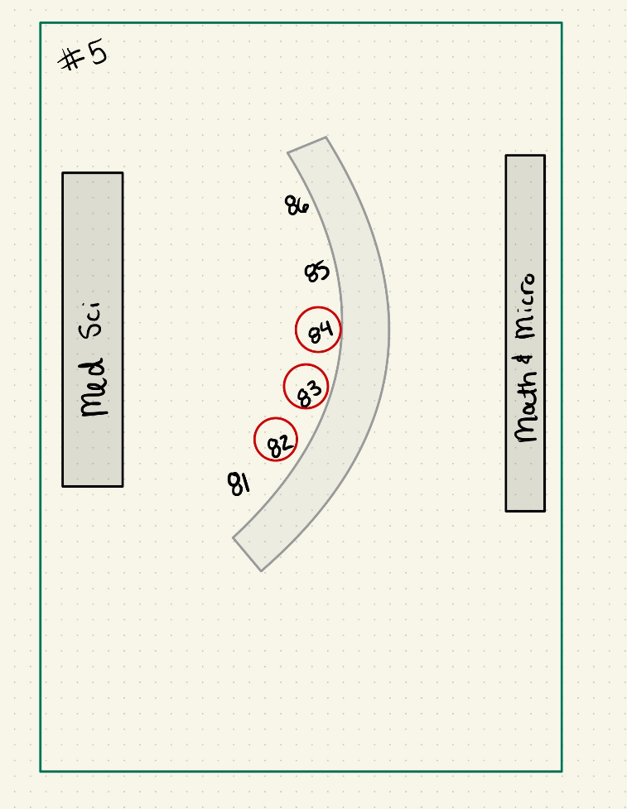
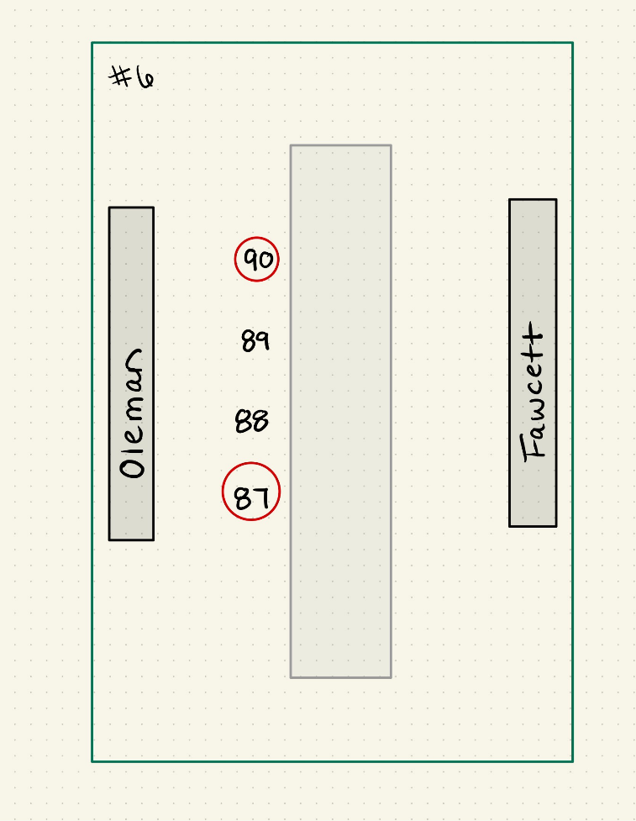

Slide 10
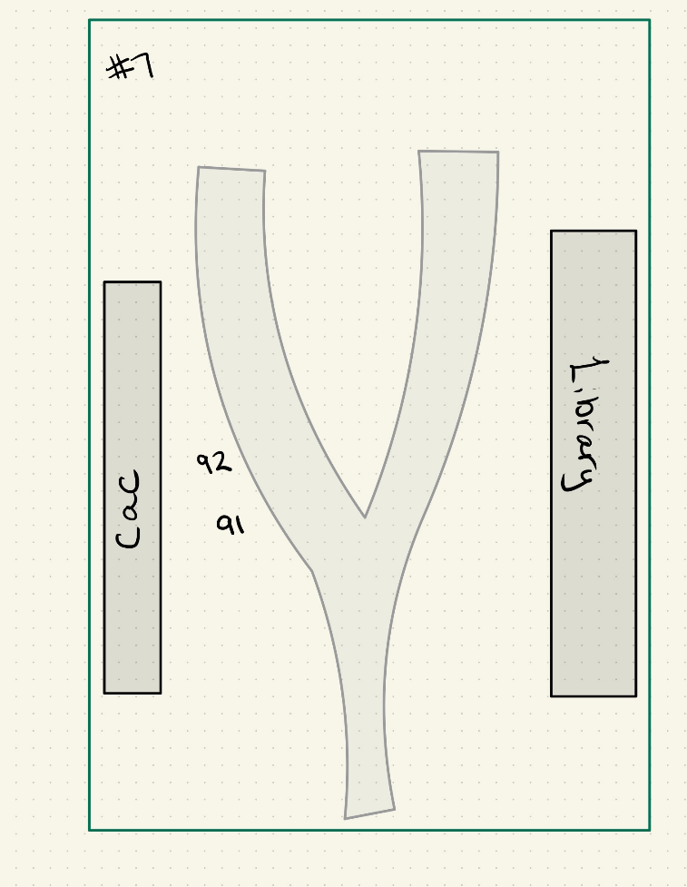
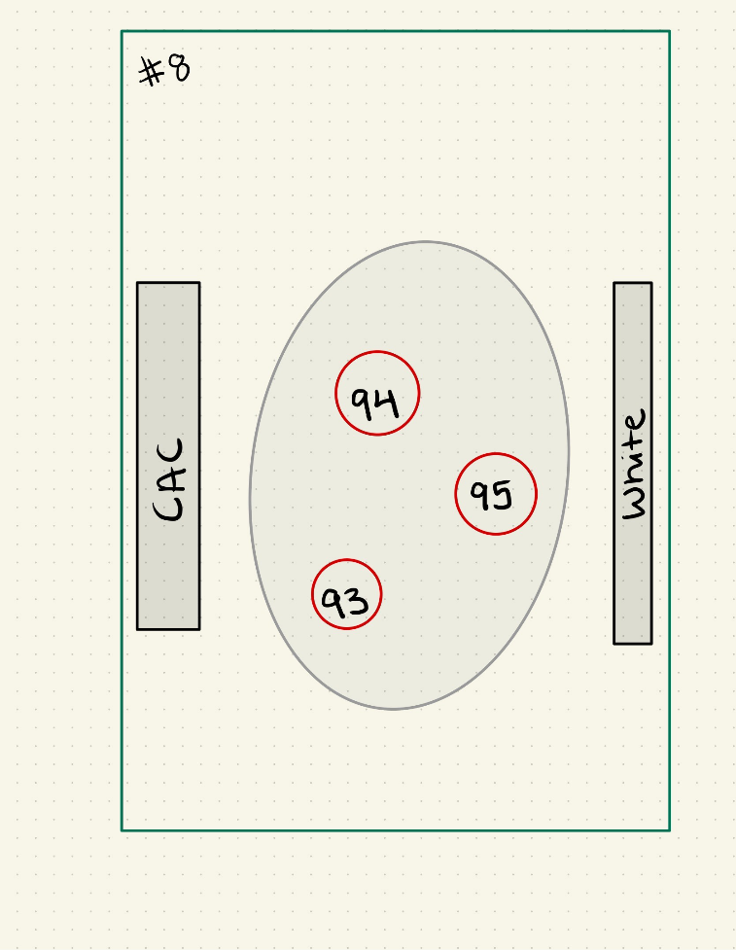
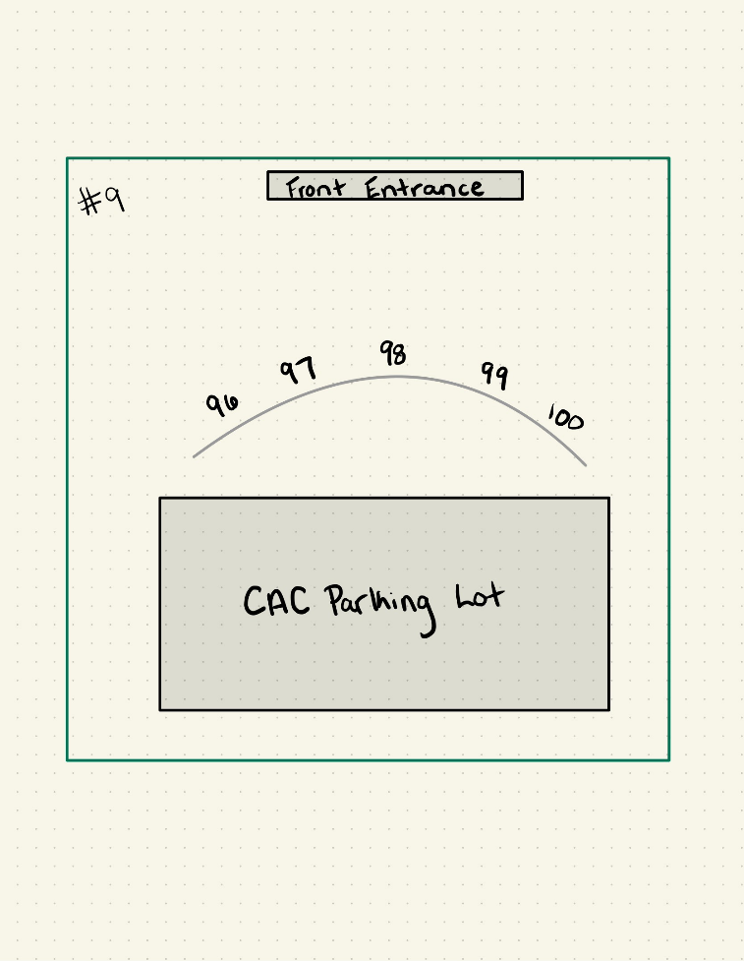

Slide 11
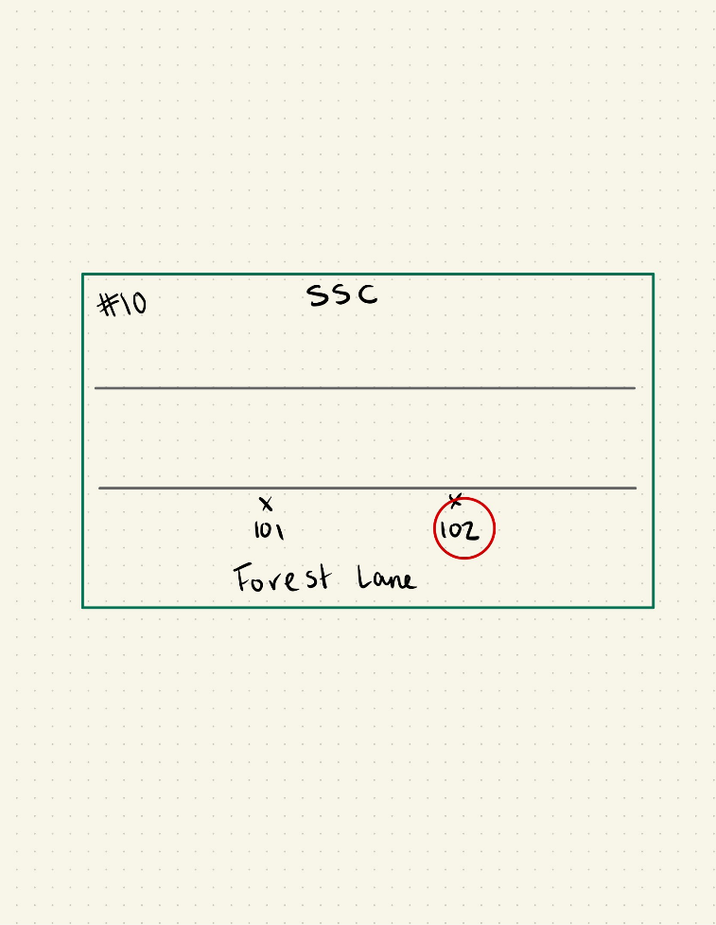
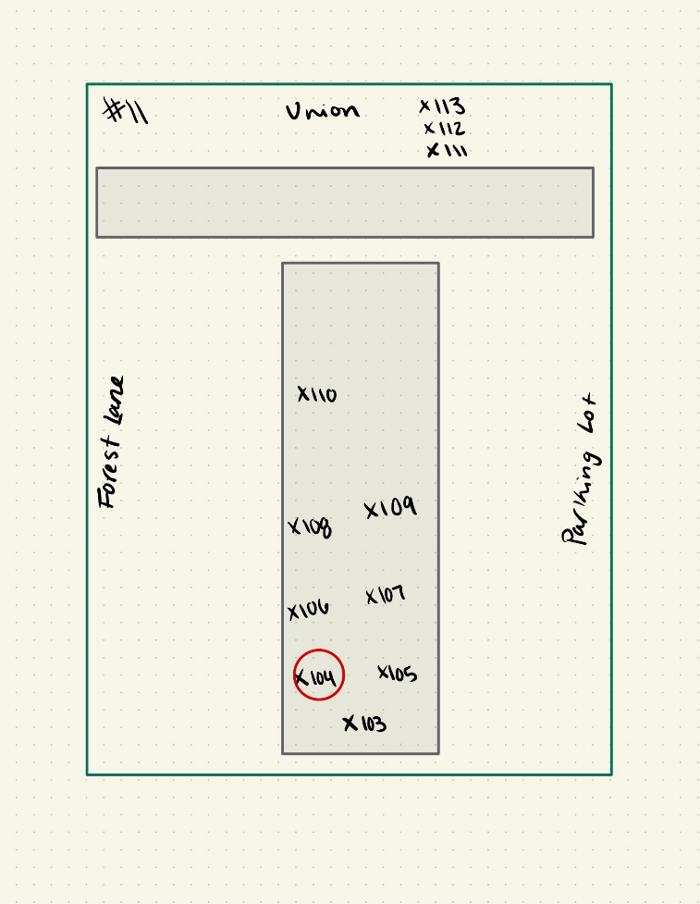

Slide 12
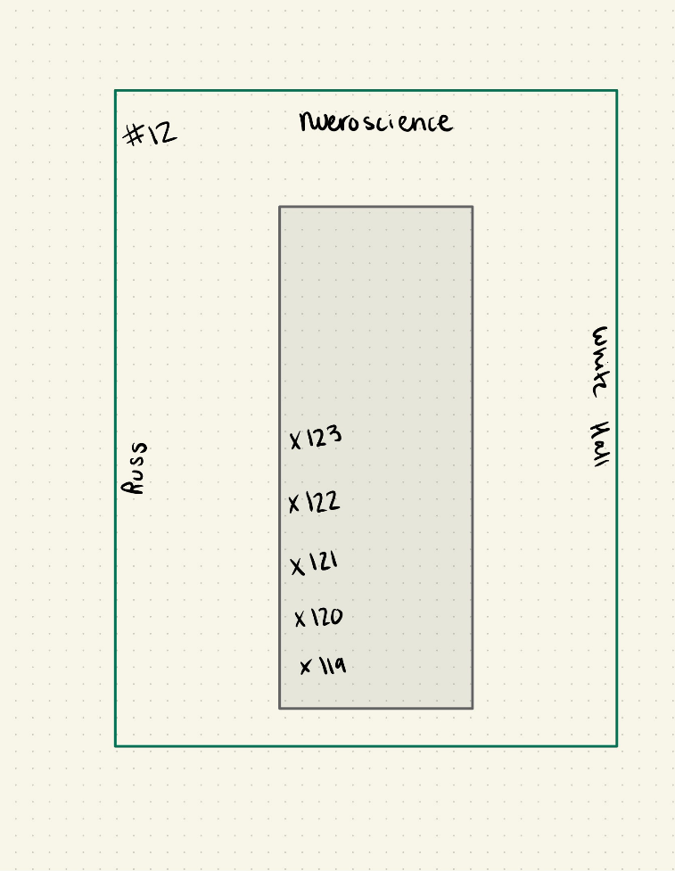
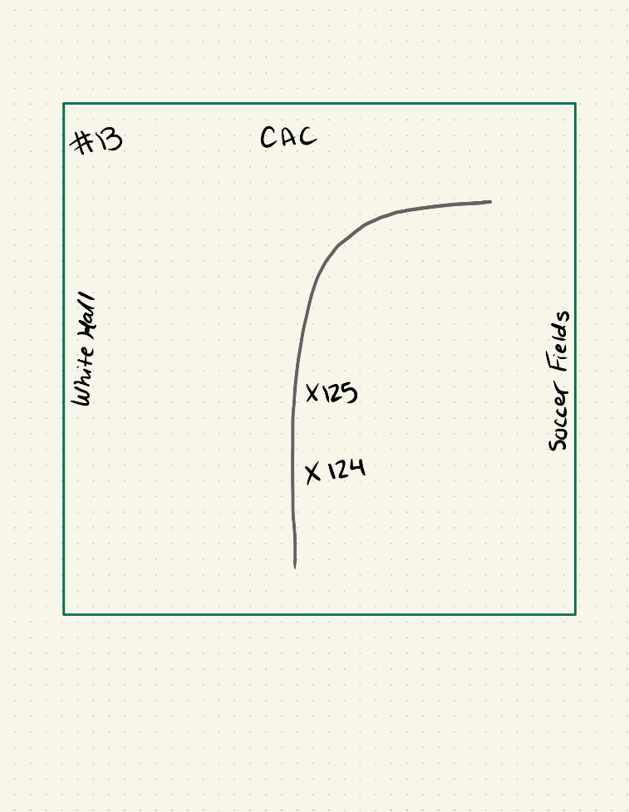

Slide 13
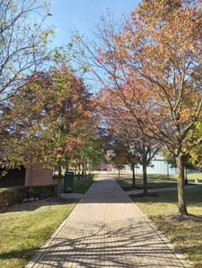
Key Points!
All trees are infested
All trees will die without treatment
If nothing is done, we will lose a substantial amount of mature tree canopy and the variety of ecosystem services the trees provide (water retention, temperature moderation, carbon sequestration, aesthetics, etc.)

Slide 14
Costs and Benefits
Cost to treat savable trees=$6490
Annual benefits from savable trees= $6428
Cost to remove unsavable trees=$4626
Cost to remove trees if left untreated=$7236
Costs to replace unsavable trees =$5700
Cost to replace trees if left untreated=$15,000
Remove and Replace unsavable trees=$10,326
Remove and Replace all trees=$22,326
Cost to treat savable trees + cost to remove unsavable trees + cost to replace unsavable trees ~ $16,816

Slide 15
Recommended Replacement Trees
Don Cipollini and Olivia Johnson

Slide 16
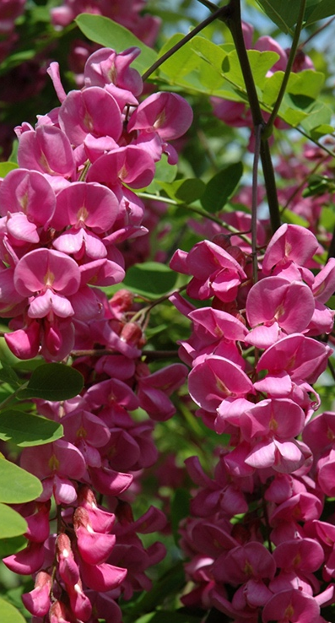
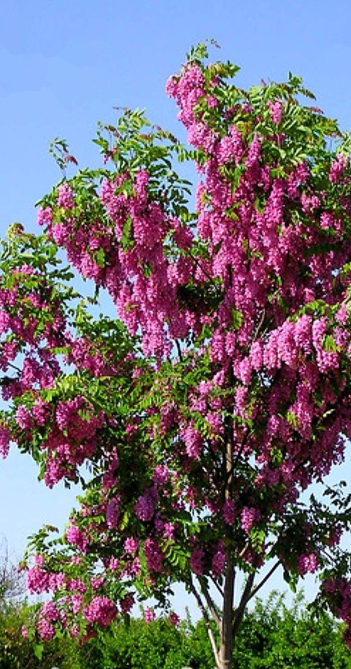
Purple Robe Black Locust Robinia pseudoacacia
Offers large amounts of shade
Dangling purple blooms in spring
Medium tree height (30-40 feet)

Slide 17
References
https://int.entm.purdue.edu/ext/treecomputer/index.php?page=tutorials/costsAndInfestation.php&section=6
https://www.urbantreealliance.org/eab-costs/

