Slide 1
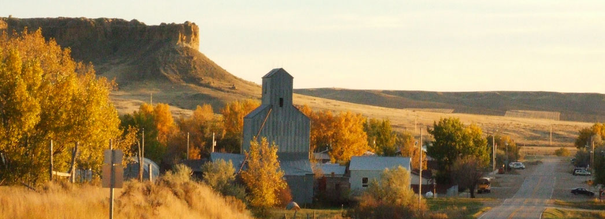



SUICIDE PREVENTION: FOSTERING HOPE AS AN INTERPERSONAL ENDEAVOR.
Adjunct Professor, University of Ottawa, Canada
University of Coimbra, Portugal and University of Malta, Malta
Dr. John R. Cutcliffe
RMN, RGN, RN, BSc(Hon), PhD.

Slide 2

DISCLOSURE STATEMENT:
Dr. John Cutcliffe confirms and asserts that I have no conflict of interest or commercial support related to this presentation.

Slide 3

1.Participants will be able to articulate the key aspects of interpersonally-focused care of the suicidal person.
2.Participants will be able to identify specific skills, attitudes and knowledge associated with form of care.
3. Participants will be able to discuss the limitations of current care of the suicidal person practices.

Slide 4
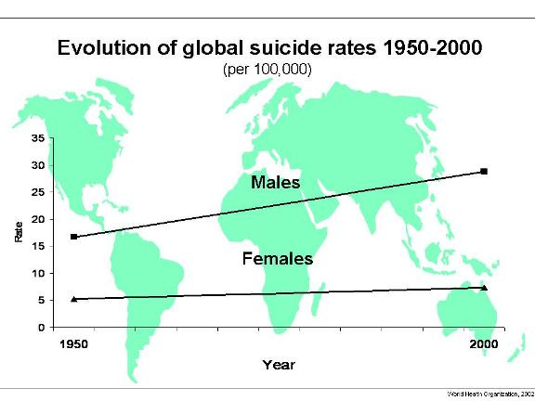
http://www.who.int/mental_health/prevention/suicide/evolution/en/index.html recovered 2014

Slide 5
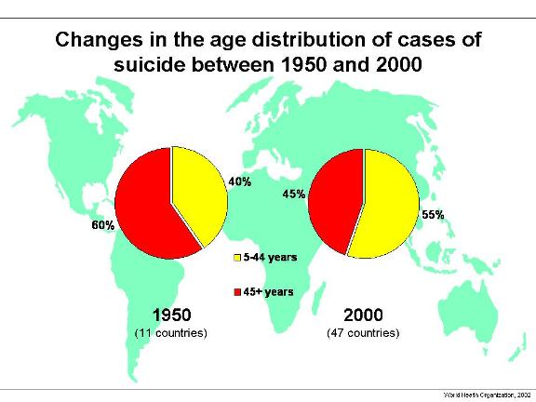
http://www.who.int/mental_health/prevention/suicide/changes/en/index.html recovered 2014

Slide 6
CDC (recovered 2014) National Suicide Statistics At A Glance

Slide 7
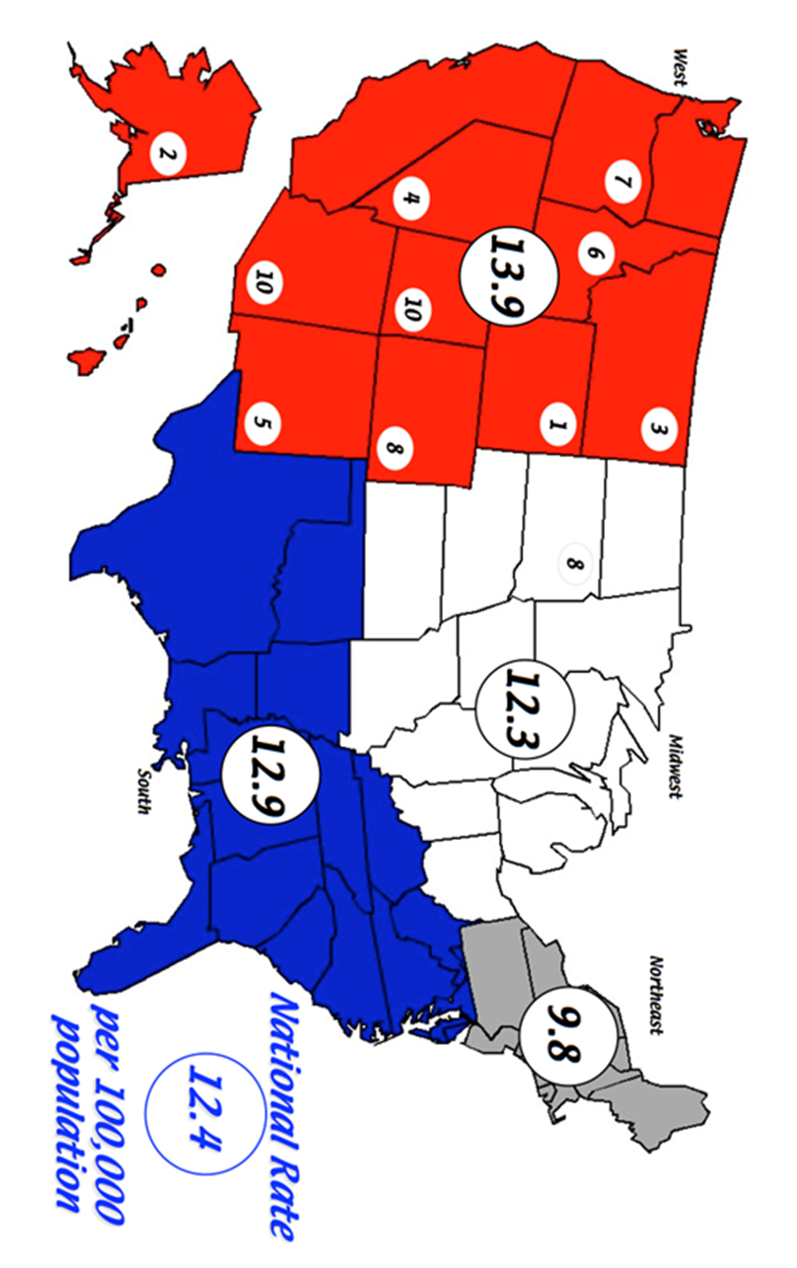
Suicide Rates in Rural USA.
McIntosh (2014) USA suicide: epidemiology in “Routledge International Handbook of Clinical Suicide Research” (Eds. J. Cutcliffe et al., Routledge, London).

Slide 8
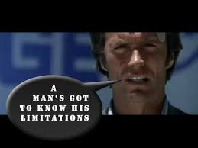
Limitations of current approaches.

Slide 9

Defensive and custodial practices.

Slide 10
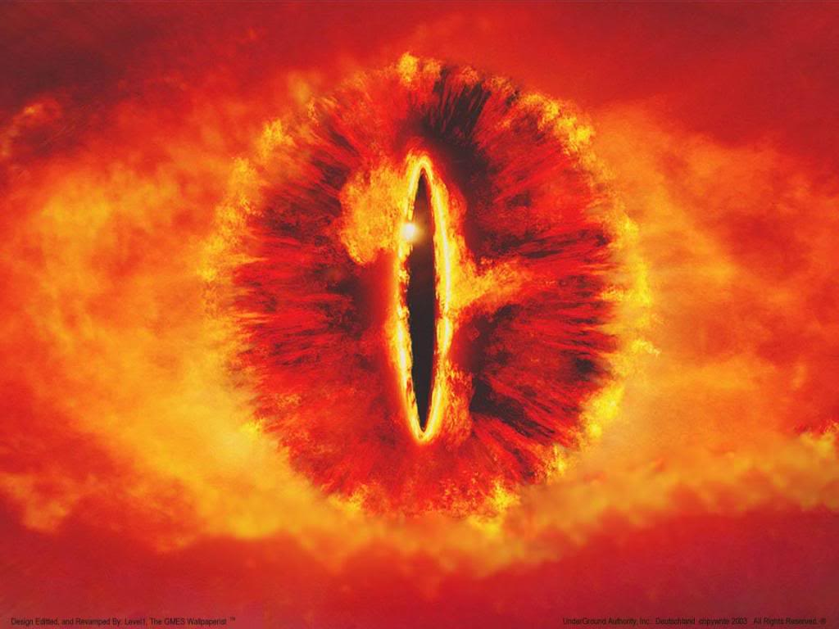
Observations are concerned: with meeting the needs of the organization.
2) With preventing a person from causing physical harm to him or herself.
3) Serve the need of avoiding, off-setting or ‘side-stepping’ potential litigation.

Slide 11

4) They are concerned with the physical integrity of the person and do little (or nothing) to address the genesis of the person’s suicidal thoughts or feelings.
5) They provide little (or nothing) in the way of addressing, relieving or helping the suicidal person’s ‘psychache’, or the pervasive sense of hopelessness and thus do little (or nothing) to address the emotional, psychological or spiritual needs and well-being of the suicidal person.
4)

Slide 12
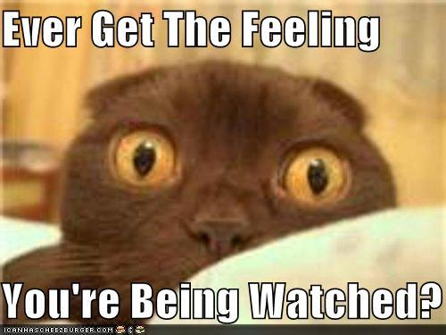
OBSERVATIONS: is there any evidence that they work?
There is very little empirical evidence that supports the use of observations for suicidal people
‘Being under’ certain levels of observation reduces the number of suicide attempts; lessen the suicidal thoughts, decrease hopelessness, lessen the psychache?
No randomized control trial – comparing close observation against units with no constant observation and the effects on rates of suicide.

Slide 13
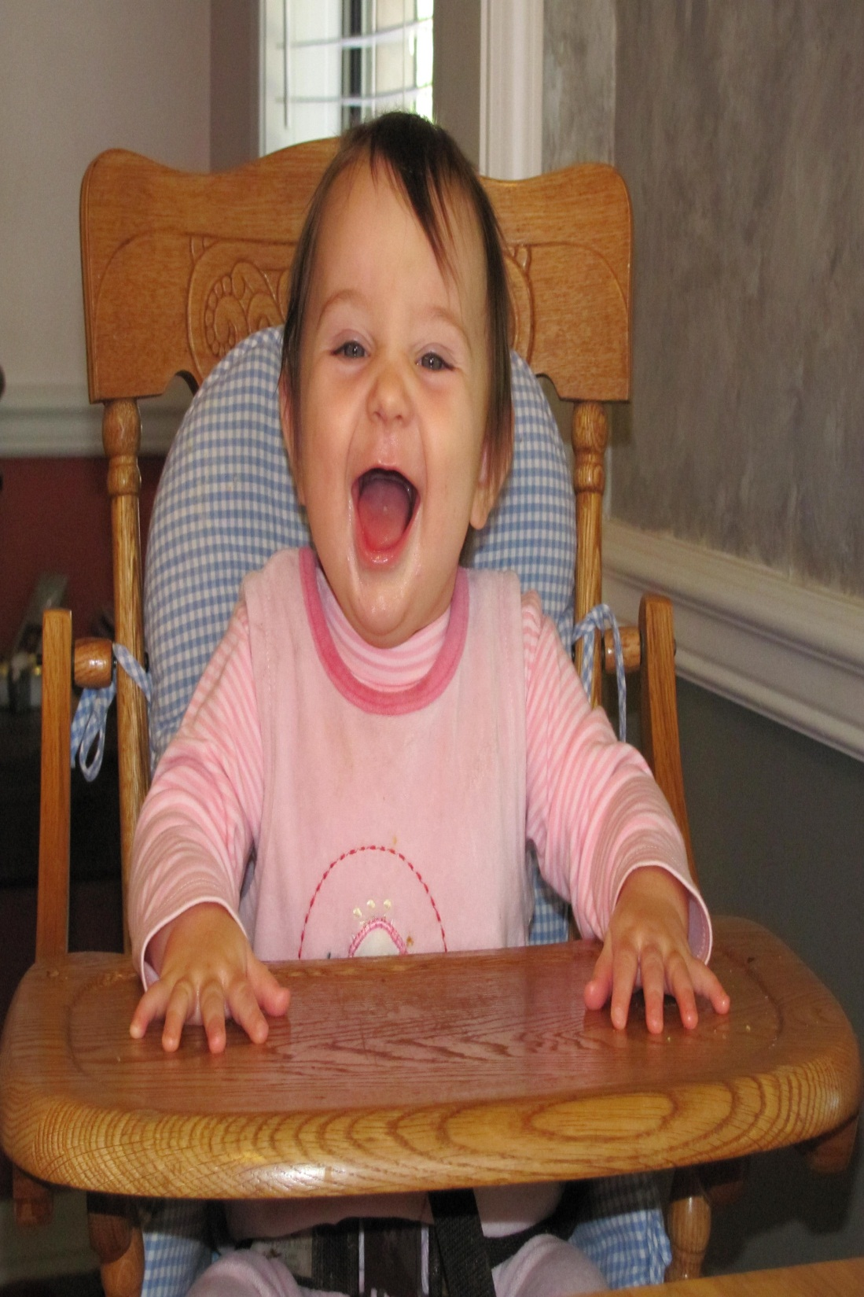

Observations – not therapeutic?
Therapeutic ??
Observations – therapeutic?

Slide 14

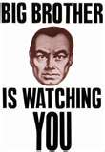


privacy

Slide 15


Observations = low skill activity
Who does the observations

Slide 16
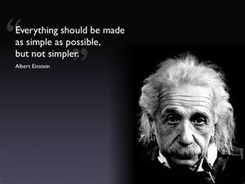
Defensive practices have, at best, a limited usefulness (and efficacy) in providing care to the suicidal person.
Even if we were to invoke simplistic forms of logic, it would appear to be counter-intuitive (and an ill-advised choice) to ‘treat’ or ‘care’ for people with sophisticated, complex, multi-dimensional problems by preventing the physical means of attempting suicide, and hoping that the suicidal person spontaneously resolves whatever problems (and psychache) that ushered them towards suicide in the first instance.

Slide 17




THE ROLE OF MEDICATION

Slide 18


Rate of prescription of SSRIs.
18.5 million
8.2 million
1999 2005

Slide 19

Rate of prescription of SSRIs.
14.5 million
3.2 million
1981 2000

Slide 20

Rate of prescription of SSRIs.
Olson & Marcus (2009) over 200% increase.
National Center for Health Statistics (NCHS), increased by almost 400% between 1988–1994 and 2005–2008.
1988 2008

Slide 21


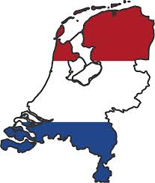
Rate of prescription of SSRIs.
1987 - 2006 +

Slide 22
Kahn et al., 2000; 2001 See also Kirsch, Deacon, Huedo-Medina et al., 2008; Antonuccio, Burns and Danton (2002); Moncrieff, Wessely, & Hardy (1998).

Slide 23
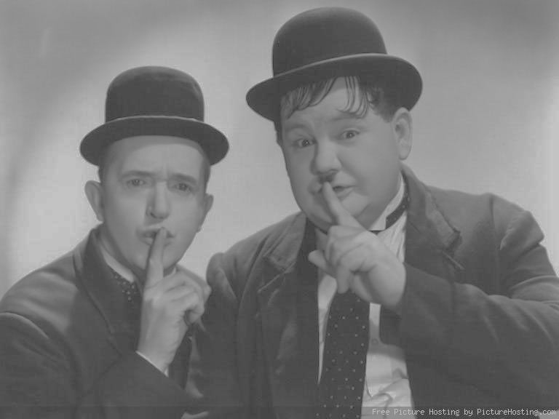
“Over the past decades the rate of completed suicide has remained quite stable, and that of suicide attempts seems to have increased.
These are puzzling observations, since (it is often purported) that depression the major precursor of suicide and antidepressants have been used increasingly in the treatment of depression.
These observations have not attracted sufficient attention, possibly because they do not accord with consensus opinions about depression treatment in psychiatry today.” (van Praag, 2005, p254)

Slide 24
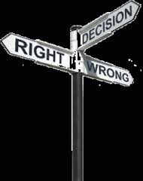

Slide 25
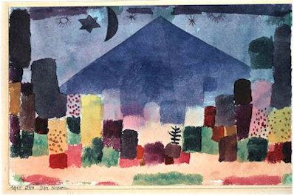
AESCHI WORKING GROUP MEETING THE SUICIDAL PERSON.
New perspectives for the clinician: A movement for improving the therapeutic approach to the suicidal person

Slide 26

GUIDELINES FOR CLINICIANS:
1. THE GOAL FOR THE CLINICIAN MUST BE TO REACH, TOGETHER WITH THE PATIENT, A SHARED UNDERSTANDING OF THE PATIENT’S SUICIDALITY.

Slide 27
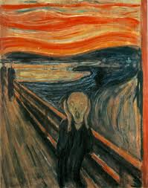
2. THE CLINICIAN SHOULD BE AWARE THAT MOST PATIENTS SUFFER FROM A STATE OF MENTAL PAIN OR ANGUISH AND A TOTAL LOSS OF SELF RESPECT.

Slide 28
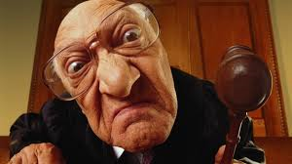
3. THE INTERVIEWER’S ATTITUDE SHOULD BE NON-JUDGMENTAL AND SUPPORTIVE. FOR THIS THE CLINICIAN MUST BE OPEN TO LISTEN TO THE PATIENT..

Slide 29

.
4. A SUICIDAL CRISIS IS NOT JUST DETERMINED BY THE PRESENT, IT HAS A HISTORY.
SUICIDE AND ATTEMPTED SUICIDE ARE INHERENTLY RELATED TO BIOGRAPHICAL, OR LIFE-CAREER ASPECTS, AND THE CLINICIAN SHOULD AIM AT UNDERSTANDING THEM IN THIS CONTEXT.

Slide 30
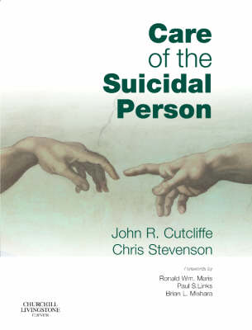

Slide 31
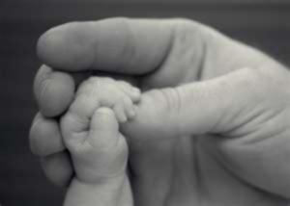
Engagement connection
Core variable, ‘Re-connecting the person
with humanity’.
This parsimonious theory describes and explains a three stage healing process consisting of the sub-core variables:
‘Reflecting an image of humanity’,
‘Guiding the individual back to humanity’ and
‘Learning to live’.

Slide 32

Experiencing intense, warm, care-based human to human contact.
Communicated…that they cared about the suicidal person; that the individual mattered.
Experiencing this had a profound effect on them.
Direct countering action on their perspectives and constricted thoughts.
Not alone; perhaps not as disconnected from humanity as they believed.

Slide 33

Implicitly challenging suicidal constructs as a result of encountering contrary experiences.
Suicidal people - constricted constructs.
“Systematically misconstrue his or her experience in a negative way”.
P/MH nurses implicitly challenged these constructs; mostly as a result of what the nurse is and what they did rather than what they said.
P/MH nurses careful not to engage in too much challenge early on; explicit challenge early in the ‘recovery’ process = increased sense of psychological pressure.

Slide 34

Nurturing insight and understanding.
Insight and understanding regarding sense of control.
Increased sense of control over their suicidal thoughts + feelings.
Suicidal person learns that he/she is not as irremediably disconnected from humanity as he/she once thought.
New awareness - person’s increased need for help.

Slide 35

Participant‘s constricted way of thinking/experiencing was different to the person’s pre-suicidal patterns of thinking.
Pre-suicidal beliefs more hopeful, felt life was worth living …sense of feeling connected to or part of, humanity.
Supporting and strengthening pre-suicidal beliefs.
P/MH nurses attempt to help guide the person back to these more hopeful, more connected beliefs; supporting and encouraging the person in re-framing his/her constricted thoughts. Helping the person re-construct a more connected and hopeful construct of the world and his/her place in it.

Slide 36
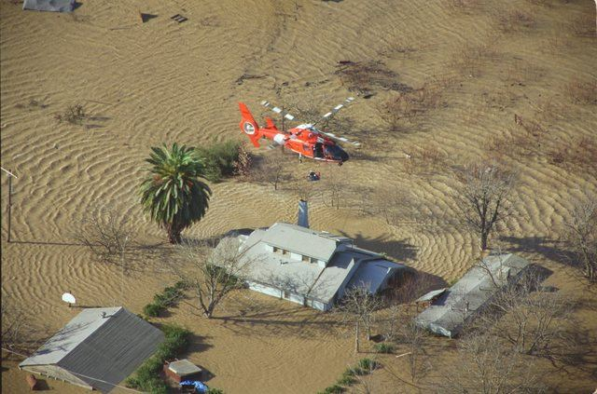
Encountering a novel interpersonal, helping relationship.
Gained a sense of relief by being able to talk about their feelings, thoughts and experiences.
Qualitative different relationship with the nurse, as opposed to his/her family and friends, that allowed for freedom to express, to talk frankly, and as a result, experience a sense of emancipation.
Freedom to reflect and talk with an experienced ‘professional’, in a non-judgmental atmosphere, was experienced as giving a sense of security; the nurse has faced such situations before, knows what to do and has helped resolve similar situations previously.

Slide 37

Accommodating an existential crisis, past, present and future.
Existential crisis - rather than dismissing the suicidality, it had to be made sense of.
For these participants, this was going to be a lengthy and complex process.
In making sense of their experience of suicidality, the participants were able to feel more connected with humanity.
Furthermore, trying to make sense of these events was fundamentally a very ‘human’ thing to do.
Participants begin to ‘pick up the threads’ of their life and in essence, they learn how to live again.
Important process of ‘making sense’ of their suicidality; this shifted the sense of the existential crisis from ‘what do I have to live for’ to ‘how do I go on living in the context of surviving a suicide attempt?’

Slide 38

Going on in the context set by the existential relationship with suicide.
Discovering more and more that life could still be worth living involved re-visiting many factors.
Re-investing in the ordinariness of their pre-suicide life was an immensely powerful process.
In so doing, the re-connection with humanity occurs, since living out an ordinary life was regarded as ultimately, a human activity.

Slide 39

Trust in the Psych nurse is the bridge that helps the person learn to re-connect with and trust humanity.
Through gaining trust in the nurse, the person is then re-connecting with a person; taking the first tentative steps towards re-connecting with the wider community of ‘humanity’. In other words, the professional is the ‘bridge’ or ‘emissary’
that helps the person
re-connect with
humanity.

Slide 40





Slide 41



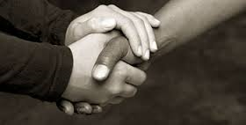
Engagement and the therapeutic alliance in practical terms.

Slide 42
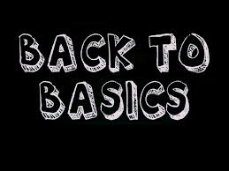
Engagement and the therapeutic alliance – basic assumption – convey hope.

Slide 43

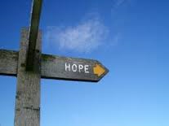
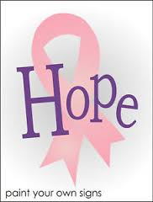

If one wishes to help reduce the risk of suicide, one should decrease the person’s sense of hopelessness; in other words, help such people feel more hopeful.
However, at this moment in time, there is currently no extant theory to inform P/MH nurses how to inspire hope in suicidal clients.
Notes:
Red ribbon symbolizes solidarity with people suffering from AIDS disease. International organizations like Red Cross and Red Crescent Society carry out actions all over the globe to bring help and hope to these people.
The plain Red Cross or Red Crescent flag is primarily used to identify medical units of military forces as provided by the 1864 and subsequent Geneva conventions, although national governments may authorize Red Cross or Red Crescent societies to use the flags provided there is no possibility of confusion with the primary use of the flag. The convention also allows the various international Red Cross organizations (ICRC and IFRC) to use the symbols. Therefore, the plain Red Cross is not a unique identifier of the ICRC.
The basic right to use the Red Cross and Red Crescent flags does not derive
The Red Crescent, the Muslim version of the Red Cross, is depicted as having the upper and lower tips of the crescent to the viewers left. In French Naval Commander du Payrat's publication "Album des Pavillons Nationaux et des Marques Distinctives" the tips of the crescent are to the viewer's right. I observed news photos from Iraq on more than one occasion showing what appear the be field ambulances with the Red Crescent displayed on the side of the vehicle and the crescent's tips are to the viewer's right. Tru Pope, 22 July 2003
Blue star = coloncancer symbol, pink ribbon = breast cancer symbol

Slide 44
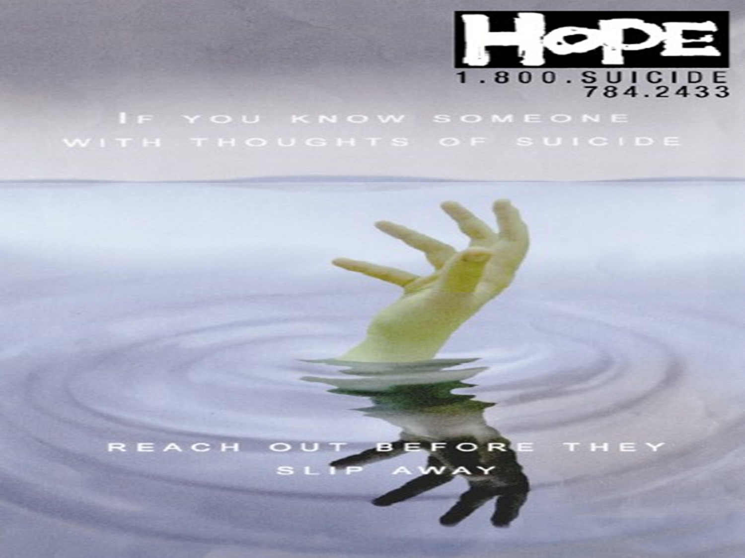
Hope inspiration appears to be bound up with the necessary and sufficient human qualities in the nurse and the projection of
these into the
environment (and client).

Slide 45

The research that does exist across different substantive areas appears to indicate that there might be common or shared basic psychosocial processes of hope inspiration, and thus the probability of a formal grounded theory (Glaser, 1978, 2001) and this allows for idiosyncratic psychosocial processes for each substantive area.

Slide 46

Accepting the axiomatic complexity and multi-dimensionality of suicide, and at the same time, the undeniable fact that suicide is a human drama, played out in the everyday lives, minds, brains and interactions of people, it may not be entirely surprising that, for P/MH nurses at any rate, caring for suicidal people must be an interpersonal endeavor; and one personified by
talking and listening.

Slide 47

“As important as the biological treatment of hopelessness is, any treatment of a suicidal patient that relies solely on impersonal therapies (e.g. psychoactive medication, seclusion, restraint, and 15 minute checks (observations) may be second rate….Many psychiatrists argue that the
heart of the treatment of suicidal individuals
is the relationship of the therapists and the patient”. (Maris et al., 2000 ,p13)

Slide 48

“To understand suicide we must understand suffering and psychological pain and various thresholds for enduring it; to treat suicidal people (and prevent suicide) we must address and then soften and reduce the psychache that drives it.” (Shneidman, 1997, p29).

Slide 49

“Improving guidelines and training around procedures like close observation and seclusion can bring appreciable benefits but positive change may not be sustained until underlying attitudes are addressed and consideration given to what
P/MH nurses think they should
best be doing and are capable
of doing.”
“…..Denying the ability (to take one’s own life) without addressing the desire must be a major reason why service users find Close Observation unhelpful. Observation without interaction is a cold comfort.” Campbell (Campbell, 2006 p276).

Slide 50
Questions….. Comments……. criticisms….

