Slide 1
Moat and faculty dining area
by
Jim Menart
Chair, University Buildings and Ground Committee
Faculty Senate Meeting
Wright State University January 26, 2015

Slide 2
Moat

Slide 3
Reasons for Removing Moat
Cost to operate
Cost to operate is approximately $23,000 per year (this does not include water or electric)
Water Consumption – no cost est. = 46,000 gallons to fill at a 16” depth, plus a daily loss of approximately 3-4” daily (approx 10-12%) or 4,600 – 5520 gallons daily.
If the pool is full for 125 days that’s 46,000 + 575,000 gallons or 621,000 minimum gallons per season up to 46,000 + 690,000 or 736,000 gallons per season.
Electrical consumption for filter pumps and motors – no cost estimate
Annual preparation (clean, preparation and paint) = $12,000.00
Approximately 5 man hours per day/cleaning (est. 500 MH/season) = $7,415.00 (this is 500 man hours taken away from other maintenance work on campus).
Approximately 120 man hours water treatment staff = $2,300.00
Chemical Shock Treatments estimated costs = $1,500.00
Some may consider it an eyesore during winter time
Moat is filled with water about 125 days out of the year

Slide 4
Reasons for Keeping Moat
May be a Wright State landmark
Alumni may think of the moat when they think of Wright State
Some students like the moat
Student government
Like the moat, but do realize the practicality of the costs involved
Web survey
Results on next slide

Slide 5
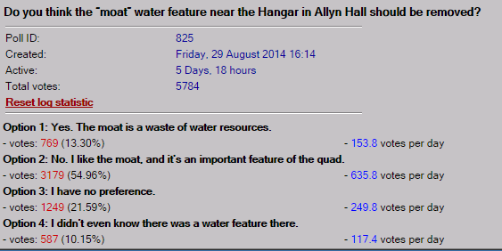
Reasons for Keeping Moat Cont.
Web Survey

Slide 6
Options for Replacing Moat
Major choices
Extend brick walkway over moat
Extend Allyn Hall deck
Make a new deck that is halfway between the Allyn Hall deck and ground levels
Just cut opening in Moat wall and refinish Moat bottom surface
Least expensive option
Put up a stage
Need to do something with the remaining moat area
Extend the Hanger eating area
This option may indicate any moat plans should wait
Minor choices
Put eating tables in new area
Make access for food vendors in new area
Put a roof over new area
Radiant heaters in ground to eliminate snow
Ramps instead of steps

Slide 7
Satellite View of Wright State Moat
From Google Maps, January 25, 2015

Slide 8
Satellite View of Wright State Amphitheater
From Google Maps, January 25, 2015

Slide 9
Faculty Dining Area

Slide 10
What is the Proposal?
Place for faculty and staff to eat that is not open to students
Thinking about a sit down restaurant type place where faculty order from menu
Buffet is option, but this does not seem to be the best option
May only be operational during lunch hours
11:00 am to 2:00 pm
For non-lunch hours, room is used for something else
May also want to think about faculty/staff lounge areas

Slide 11
Reasons For
Give faculty a place to interact
Place to bring employee candidates
Place to bring business associates
Place to bring potential graduate students
Faculty perk
Reasons Against
Cost
Space
Think about multiple use spaces

Slide 12
Possible Locations
Cambiar Room – 153 Student Union
This room is currently marked faculty dining
In the past this was faculty dining
Currently used for meetings
Could be part time dining and part time conference
Small
Elizabeth Dixon Hearth Lounge in Student Union
Would need to use about half this area
Rathskeller - 008 Student Union
Students may have prayer services here
Explorer room – 103 Student Union
Currently a conference room
Could be part time dining room and part time conference room
Small

Slide 13
First Floor of Student Union

Slide 14
Lower Level Student Union

Slide 15
Possible Locations Cont.
Some part of fourth floor of library
Understand they are moving out
Could be a large dining area, but food service may have to be added
Could use a catering option
Library storage room in basement of Medical Science Building
Understand they are moving out
Could be a large dining area but food service would have to be added

Slide 16
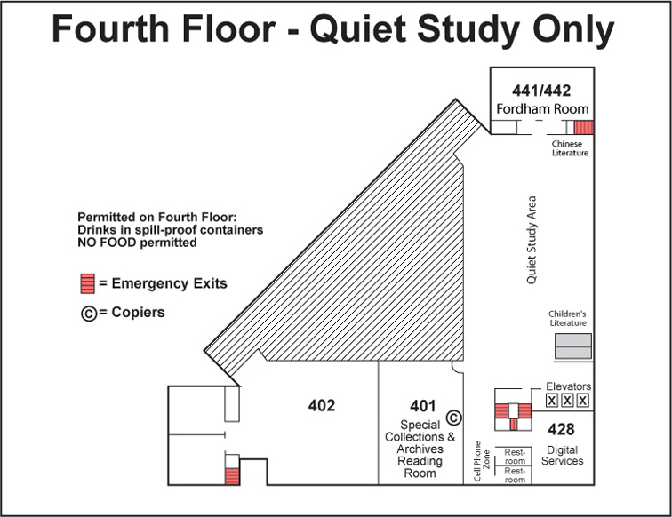
Fourth Floor of Library

Slide 17
Thank You

