Slide 1
How to Update Your Address on Wings Express

Slide 2
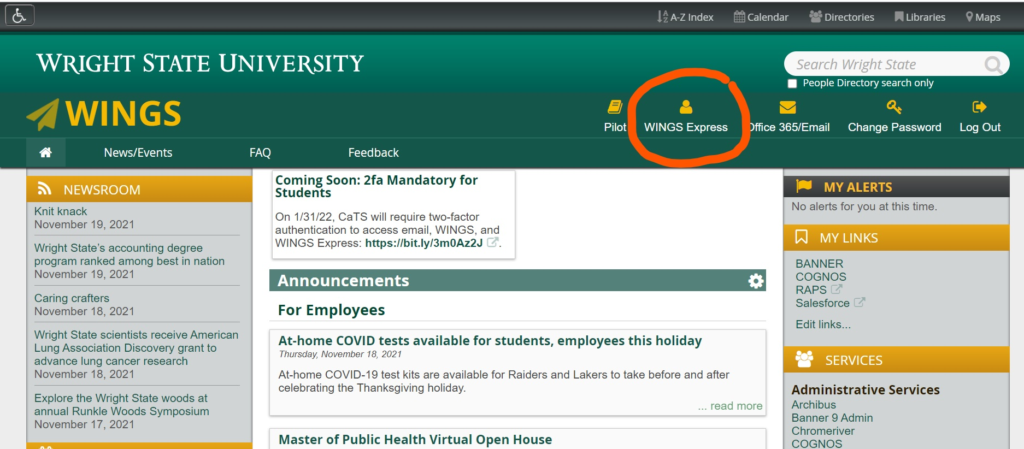
Log Into Wings Express https://portal.wright.edu/home

Slide 3
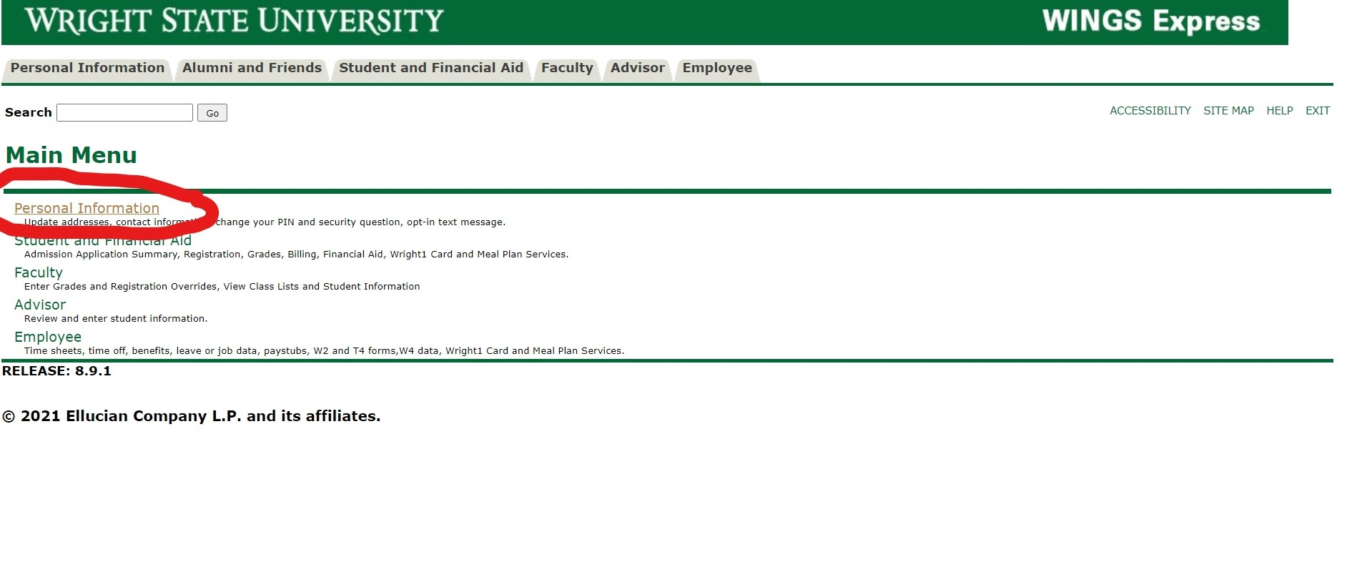
Click on “Personal Information”

Slide 4
Need your UID & “W” Number?
Log into your admissions portal (https://wright.edu/apply)
Select “Access Your Student Portal” under “Next Steps” to get your computer account credentials (WINGS, WINGS Express, and Wright State email log in).

Slide 5
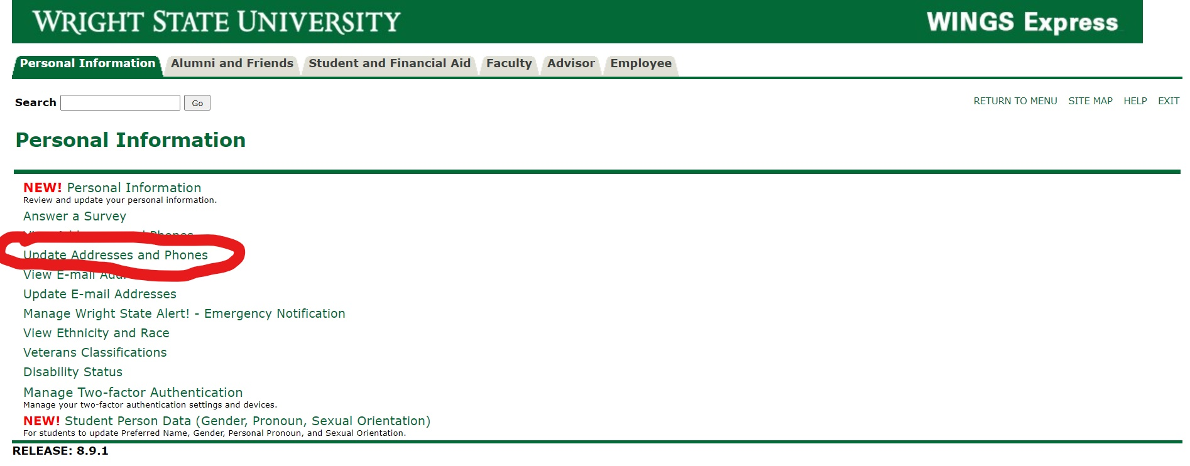
Click on “Update Addresses and Phones

Slide 6
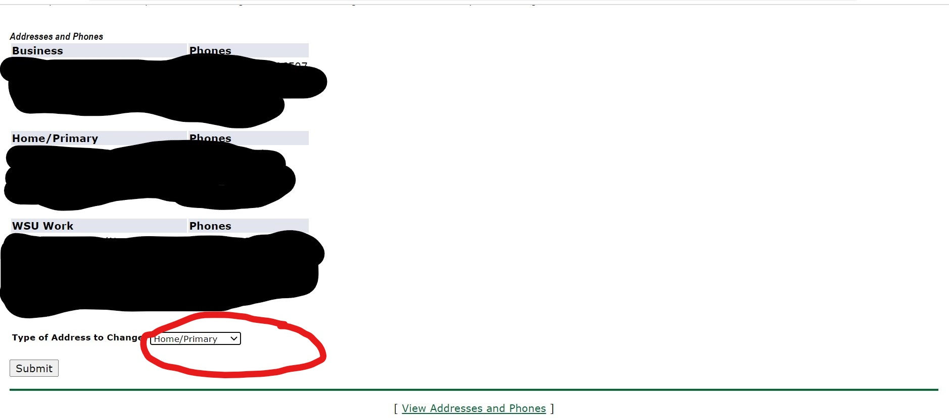
Select the Type of Address to Change -Pick “Home/Primary”

Slide 7
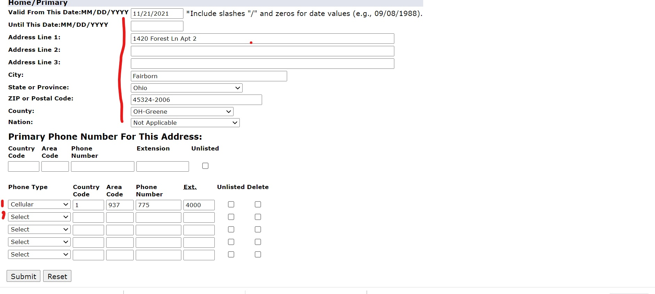
Follow this format -Must put address items on correct boxes

Slide 8
Correct Format for Your Address
Your address should follow the format below.
Make sure you put the info on the correct lines
Your Name
3640 Colonel Glenn Hwy. Dayton, OH 45435 USA

