Slide 1
Wright State PowerPoint Templates
Please use this template to create presentations using the Wright State Brand

Slide 2



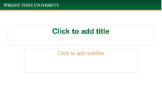



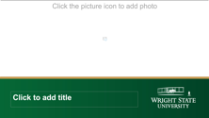
What the template includes
7 Cover Designs
2 Inside Slide Designs
Click the picture icon to add photo
Click the picture icon to add photo
These cover designs have the option of adding a photo.

Slide 3

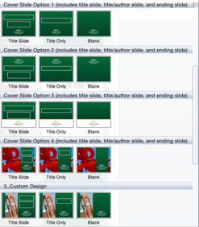
How to choose a slide design
Click on the right arrow beside the New Slide option at the top left

Slide 4
How to change a background
If you pick a slide and want to choose another available background
Click on Layout at the top left

Slide 5
Text Color
Wright State colors are recommended and only for headings (not body copy)
Included in recent color palette in PPT
Wright State Green formula
Red: 2; Green: 105; Blue: 55
HEX: 026937
Wright State Gold formula
Red: 206; Green: 160; Blue: 82
HEX: CEA052

Slide 6
Text Style and Size
Arial is Wright State’s chosen font for electronic needs
Font size and style can be changed, if needed (such as bold or italics)

Slide 7



Photos for Cover Slides
If you want a specific photo for your cover slide, please contact the Office of Marketing.

Slide 17

This is a photo example.

Slide 21

This is a photo example.

Slide 25

This is a photo example.

