Slide 1
Wright State / Premier Health PowerPoint Templates
Please use this template to create presentations using the Wright State + Premier Health Brands

Slide 2

What the template includes
6 Cover Designs
5 Inside Slide Designs
3 Logo Slide Designs

Slide 3

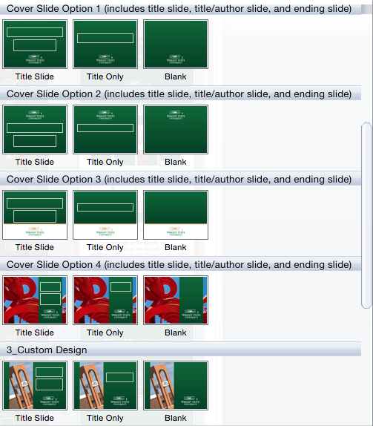
How to choose a slide design
Click on the right arrow beside the New Slide option at the top left

Slide 4
How to change a background
If you pick a slide and want to choose another available background
Click on Layout at the top left

Slide 5
Text Color
Wright State or Premier colors are recommended and only for headings (not body copy)
Included in recent color palette in PPT
Wright State Green formula
Red: 4; Green: 160; Blue: 56
HEX: 046A38
Wright State Gold formula
Red: 203; Green: 160; Blue: 82
HEX: CBA052
Premier Blue
Red: 0; Green: 118; Blue: 191
HEX: 0076C0
Premier Scrub Blue
Red: 0; Green: 60; Blue: 112
HEX: 003C70

Slide 6
Text Style and Size
Arial is Wright State’s chosen font for electronic needs
Font size and style can be changed, if needed (such as bold or italics)

Slide 10
Title of Presentation
Author or Date

Slide 11
Title of Presentation

