Slide 1

Topic 3: Aligning Assessment with Objectives and Outcomes
Course Design Institute 2022

Slide 2






Do You Agree?
What matters is measured, and what’s measured matters.

Slide 3

Measuring Student Learning
Educators are expected to evaluate student learning and assign a correct grade.
Course outcomes and objectives provide us with a standard by which we can assess students’ learning.
They also provide us with a means of evaluating our courses’ effectiveness, contribute to academic program review, and serve as the basis for continuous improvement.

Slide 4

Industrial Age Assessment
Our present academic system was created to meet the needs of the Industrial Age, when businesses began to demand workers who possessed a uniform skill set and could reliably perform the same job for many years.

Slide 5

Past Practice is Not Always Best Practice
Traditional systems for grading and assessment continue to operate under industrial model:
Educators present the course content, assess students’ performance levels, and move on.
Students move through their degree programs like products rolling off an assembly line.
Industrial age assessment measures students’ ability to pass a test, not whether they can apply their knowledge outside the classroom.
Exams may generate grades, but they might not provide a reliable assessment of students’ learning.

Slide 6

Are We There Yet?
As we discussed yesterday, when you’re planning to take a road trip, you first decide on a destination and then plan your route.
The same is true of planning instruction. You know where you’re starting, you decide where you want to be at the end, and then plan how to get from Point A to Point B.
But how do you know when you’ve arrived at your destination?
In other words, how do you know students have learned what you taught?

Slide 7

Formative and Summative
Assessments serve two purposes:
Formative assessments measure learning in progress, providing feedback to students and allowing the faculty member and student to make adjustments to both teaching and learning in order to achieve a successful outcome.
Summative assessments, on the other hand, measure learning at the completion of a course or module of study. They might include tests, final exams, performance tasks, or research papers.
“When the cook tastes the soup, that’s formative; when the guests taste the soup, that’s summative.”

Slide 8

Beyond Grades
When we only determine our students’ level of mastery in our courses after the final exam, we’ve missed crucial opportunities to teach.
Genuine formative assessment is a powerful tool to guide our instruction.
Students who perform poorly on a formative assessment can receive additional instruction or be given a second chance to improve their work so that they can prove that they’ve truly learned what we’ve taught.

Slide 9

Choosing Assessments
The next step in the course development process is to look back at your outcomes and match each one with the right type of assessment.
How do you decide which type of assessment to employ?
Objectives may apply to a portion of the course content, but outcomes apply to students’ learning across the entire course.
Therefore, we might use formative assessment to evaluate objectives because it gives us a chance to check students’ understanding or skill proficiency and provide supplementary instruction to those who have not yet met expectations.
We would use a summative assessment to evaluate outcomes, usually at the end of the course.

Slide 10

Example Assessments
Formative Assessments
Summative Assessments
Quiz
Reflective essay
Precis or response paper
Exit slip
Problem set
Skills observation
Exam (midterm, final, end-of-unit)
Project
Performance task
Practicum
Portfolio
Presentation
Research paper
Reflective paper
Any assessment can be formative or summative depending on how it is employed.

Slide 11

Authenticity
Multiple-choice exams are convenient because online tools make it easy to generate grades. Our textbook publishers generously offer question banks to make the task of writing exams even easier.
However, exams should not be our only means of measuring students’ learning. After all, it matters very little if students can commit hundreds of facts to short-term memory only to forget them the week after they scrape a passing grade on an exam.
High-quality assessments provide a meaningful, authentic measurement of students’ acquisition of course content.
Our priority should be to determine whether students have mastered the core concepts of the course and can apply their newfound knowledge, skills, or understanding within a context like those they will encounter outside class.

Slide 12




Disciplinary Expertise
Faculty members’ disciplinary expertise is the best resource when selecting and designing assessments to measure students’ learning.
There is no one-size-fits-all approach to assessment because our disciplines vary so widely. Even within a discipline, expectations for proficiency differ between levels and courses.

Slide 13
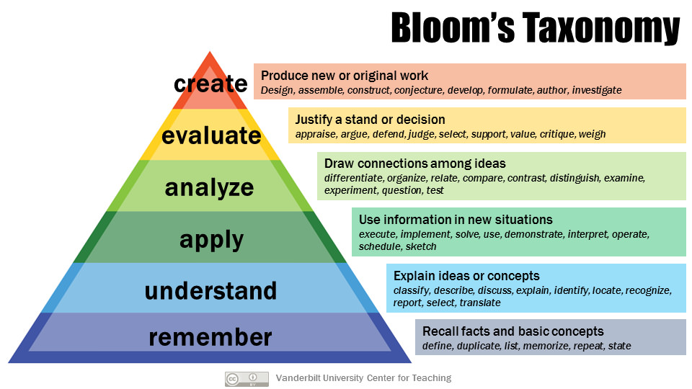
We can refer to Bloom’s Taxonomy to determine appropriate assessments.

Slide 14
Review: Performance Levels
Advanced and graduate-level courses should be associated with the highest levels of the taxonomy (orange and red).
Intermediate courses align with the middle levels of the taxonomy apply to (green).
Introductory or beginning-level courses may align with the lowest levels of the taxonomy apply to (purple and blue).
Alternatively, the lowest levels could describe learning at the beginning of a course, working toward the highest levels by the end of the term.
Creating
Evaluating
Analyzing
Applying
Understanding
Remembering

Slide 15
Review: Active Verbs from Bloom’s Taxonomy
ADVANCED LEVEL / HIGHEST
Creating: assemble, compose, construct, create, design, develop, express, formulate
Evaluating: appraise, argue, defend, judge, select, support, value, evaluate
Analyzing: compare, contrast, criticize, differentiate, discriminate, distinguish, examine, experiment, question, test
Applying: choose, demonstrate, dramatize, employ, illustrate, interpret, operate, schedule, sketch, solve, use, write
Understanding: classify, describe, discuss, explain, identify, locate, recognize, report, select, translate, paraphrase
Remembering: define, duplicate, list, memorize, recall, repeat, reproduce, state
ENTRY LEVEL / LOWEST
Most multiple-choice exams measure understanding and remembering.

Slide 16

Assessment Workshop: Instructions
Example
Outcome: utilize primary and secondary sources when writing about historical events, demonstrating knowledge of sound disciplinary practices in historical scholarship.
Assessment Options:
Assign students to write a 5-page paper about [insert topic] utilizing primary and secondary sources and demonstrating sound disciplinary practices in historical scholarship.
Create an exam with questions about proper use of primary and secondary sources and sound disciplinary practices in historical scholarship.
Assign students to evaluate a written work of historical scholarship and identify instances of improper use of sources or inadvisable disciplinary practices, explaining what was wrong, why it was wrong, and how the scholar could rectify the errors.
Look at the objectives and outcomes you’ve created for your course
Consider how you could assess your students’ achievement in each area.
Enter your ideas on the template provided.

