Slide 1
Topic 2: Student-Centered Teaching and Learning
2022 Course Design Institute
Wright State University

Slide 2
What does the phrase “college-ready” mean to you?

Slide 3
Student-Ready

Slide 4
Roots of US Higher Education
The original colonial colleges (today’s Ivy League) were established by religious groups to train young men for the ministry, later adding law and medicine, and relying on the classical European model.
We should recognize the dual purpose of the education offered at these institutions: to prepare students for specific careers in religion, law, and medicine while also offering a liberal arts education.
A college education was quite rare in the early days of the US. Only about one in one thousand people earned a degree, and as of 1775, there were fewer than 3000 college graduates in a population of 2.5 million.

Slide 5
State Universities: Land-Grants and Normal Schools
The Morrill Act of 1862 established land-grant universities in each state. Its purpose was “educating the common rural American” and included research into agriculture and the “mechanical arts” (engineering) to “promote the liberal and practical education of the industrial classes in several pursuits and professions in life.”
The Industrial Age created a demand for specialization in the sciences and a better-educated workforce.
The 1800s also saw the establishment of stated-funded Normal Schools to provide one or two years of training to aspiring teachers. These institutions eventually became teacher’s colleges by the 1950s, growing into state universities today and often joining state university systems alongside land-grant universities.

Slide 6
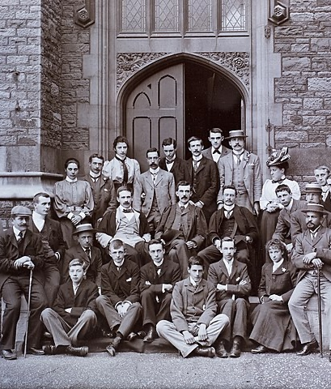
Changing Student Identities
Despite the move toward broader access and expanded fields of study brought about through the Morrill Act and Normal Schools, college students remained predominantly male, White, Christian, affluent, 18-22 years old, financially dependent on their parents, single, and childless.
Admission was limited to “well-rounded,” academically high-achieving students who were deemed to be “college-ready.”
The higher education landscape changed again with the GI Bill of 1944, the Brown vs. the Board of Education Supreme Court decision in 1954, the establishment of federal student loans in 1958, and evolving social norms and student demographics.
This Photo by Unknown Author is licensed under CC BY-SA

Slide 7
Changing Student Demographics

Slide 8
Looking Beneath College-Readiness
Students with the highest levels of college-readiness share a set of characteristics linked to wealth and race. They are:
More likely to be White
Graduates of high schools located in relatively affluent neighborhoods
Financially secure
Have at least one parent who graduated from college
Our higher education system is stratified into a very small “upper track dominated by the White and wealthy, and a lower track that disproportionately serves those students who are members of racial and ethnic minority groups or from families of modest means.” (Carnivale, 2020)

Slide 9
From The Myth of the College-Ready Student
“Colleges and universities, for the most part, have been equipped to serve one fairly narrow population of students, which institutions have conveniently defined as college-ready. Meanwhile, for decades, higher education has passively accepted the conventional wisdom that minority, low-income, and first-generation students disproportionately underperform other students because they are the unfortunate casualties of inadequate systems – low-achieving public school systems, poor neighborhoods, unsophisticated households – that leave them woefully unprepared for college success.”
Byron White, Vice President and Chief Diversity Officer, Cleveland State University, Inside Higher Ed, March 21, 2016
Notes:
Turn and talk question – respond to this statement

Slide 10
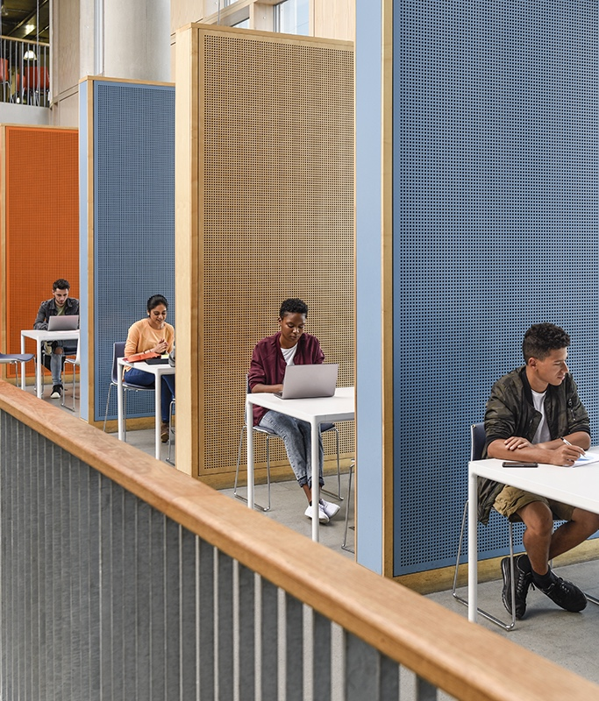
In Other Words
Students do not underperform because they come to us with disadvantages compared to their “college-ready” peers.
They underperform because our system was built to serve a very narrow segment of society that no longer reflects the identities of our present students.

Slide 11
FAFSA Statistics
According to data from Federal Student Aid, of those who filed a FAFSA for the 2020-21 academic year:
63 percent are female students and 37 percent are male students.
47 percent are first-generation college students.
11 percent are 18 years old or younger, and 41 percent are age 25 or older.
13 percent are pursuing a graduate or professional degree.
24 percent have never attended college before.
48 percent are considered dependent students, while 52 percent are independent students.
https://www.bankrate.com/loans/student-loans/fafsa-statistics/#filing

Slide 12
FAFSA Criteria for Independent Student Status
Age 24 or older
Married
Veteran or active-duty member of the armed forces
Ward of the court or state, orphan, or in foster care since age 13
Has legal dependents other than a spouse
Emancipated minor
Homeless or at risk of being homeless
https://californiacompetes.org/publications/student-parents

Slide 13
Student Identity Profile
Descriptor | Dependent (48%) | Independent (52%)
Median age | 20 years | 29 years
Has dependent children | n/a | 50%
Is a single parent | n/a | 27%
Lives at or below the poverty line | 17% | 42%
Lives at or below 200% of the poverty line | 36% | 66%
Works 20+ hours/week | 39% | 57%
Attends part-time | 19% | 44%
Completes 4-year degree within 6 years | 56% | 33%

Slide 14
Who is an “average” student?
Then (“traditional” students)
Now
Dependent
18-22 years old
Relatively affluent
White
Strong academic background
Childless
Independent
Over age 25
Low- or lower-income
Diverse race or ethnicity
Average academic background
Single parent
It’s our responsibility as educators to teach the students in our classrooms, not the students we think we have (or think we ought to have).

Slide 15
Dispelling Assumptions
Given the changing identities of our students, we can no longer assume they have developed the skills associated with “college readiness” by the time they enter our classrooms.
We cannot presume they have participated in meaningful co-curricular activities, have experienced a comprehensive high school curriculum, or can afford to pay for extras like project supplies.
Most of our students are just one $400 car repair crisis away from non-completion of their degrees. They do not have a social or financial safety net. They’re just regular, everyday people doing their utmost to improve their futures through higher education.

Slide 16
Discussion
What are your thoughts or reactions to the information we’ve looked at together?
What questions do you have?

Slide 17
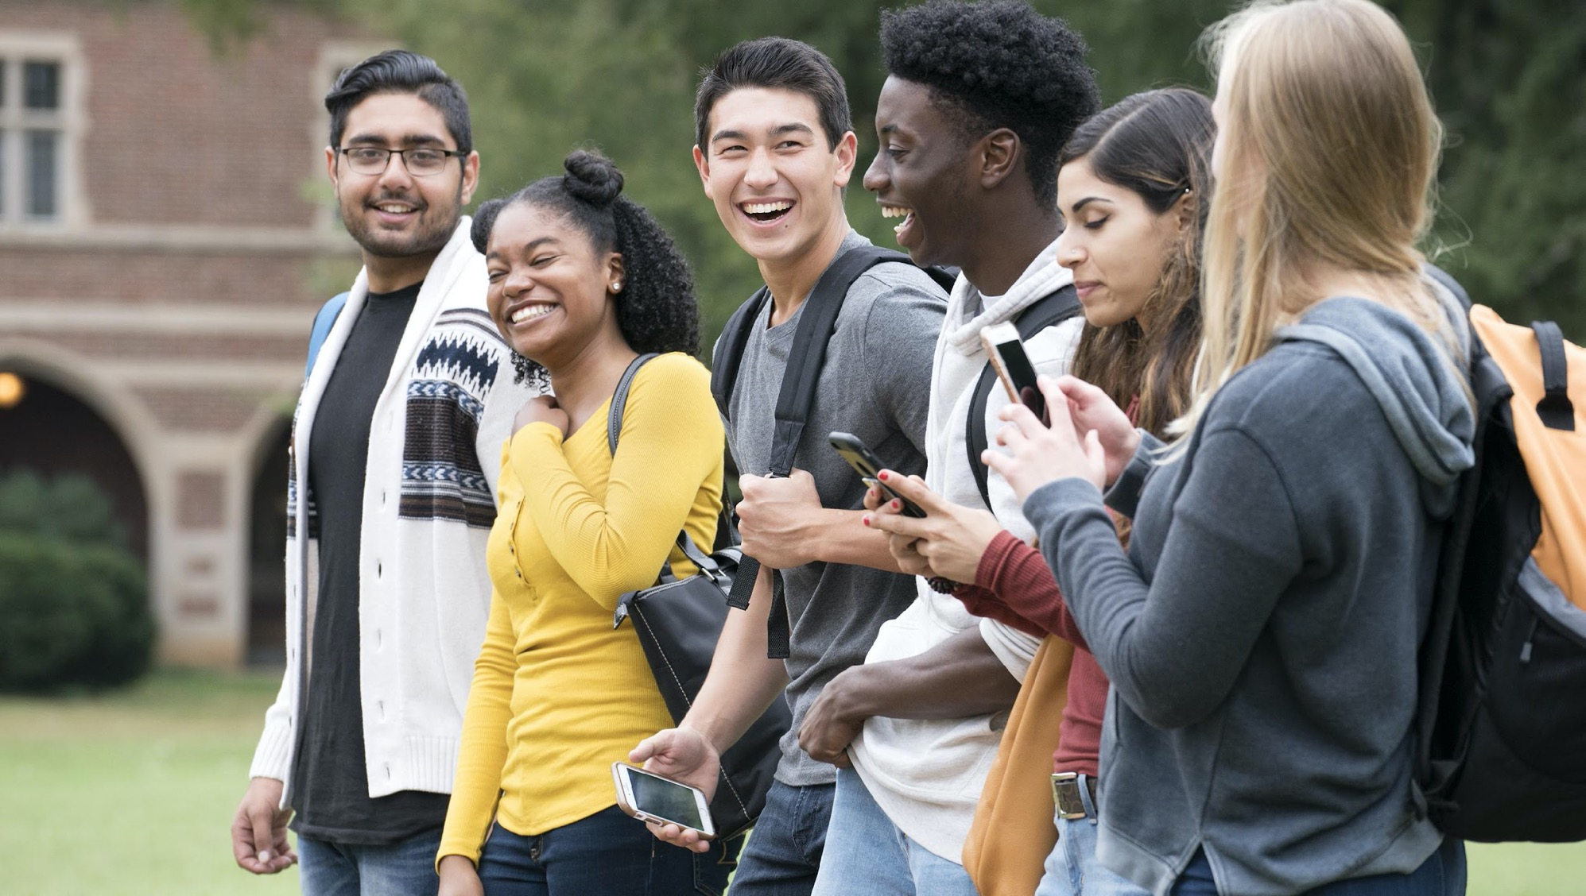
Student-Centered

Slide 18
Definition
From the Glossary of Educational Reform: Definition of Student-Centered Learning
“A wide variety of educational programs, learning experiences, instructional approaches, and academic support strategies that are intended to address the distinct learning needs, interests, aspirations, or cultural backgrounds of individual students or groups of students”

Slide 19
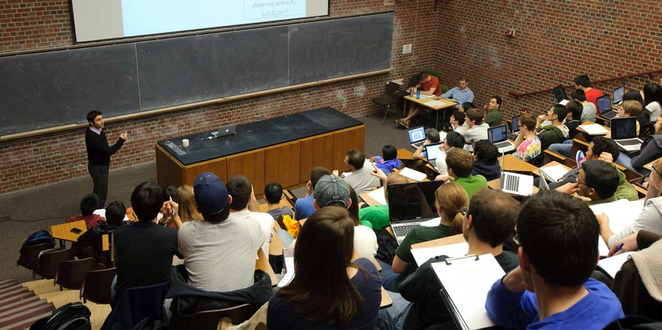
Legacy and Tradition
Do traditional approaches to teaching in higher education fit the definition we just read?
Historically, faculty have focused on conveying their disciplinary expertise to students through lecture.
Our teaching environments commonly reflect this approach.
What do you notice about this photograph?
https://wac.gmu.edu/professor-expectations-of-writing-assignments-a-student-perspective/
https://images.app.goo.gl/BUtgKQqmrDXmqdg16

Slide 20
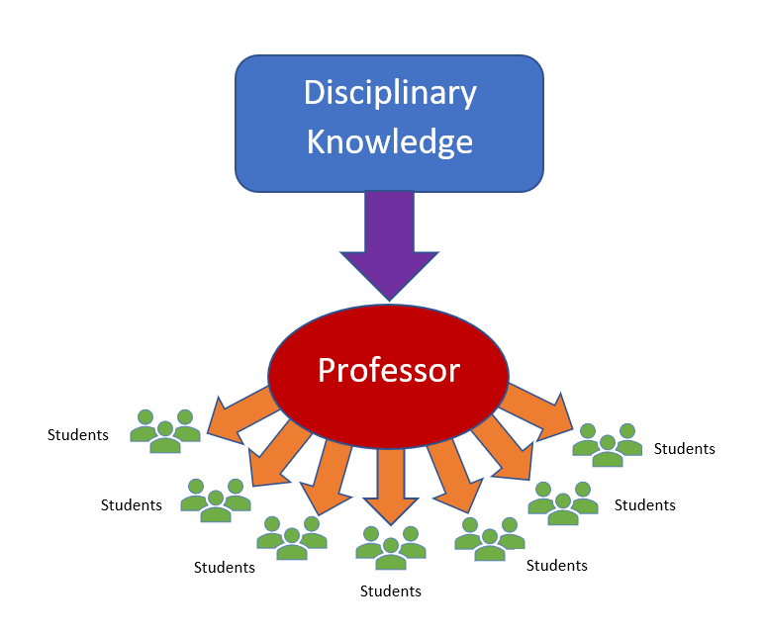
Where is the center?
In the photograph we just saw, the center of attention is on the professor, and to a lesser degree on the material he was presenting.
This exemplifies faculty-centered teaching, which has been the historical model for higher education for millennia.
Becoming student-centered means shifting the focus from teaching to learning.

Slide 21
Instructivism
Traditional approaches to education might be termed “instructivism,” rooted in John Locke’s notion that the human mind is a blank slate at birth.
Therefore, education has been conducted in the belief that students’ minds are empty until filled by the instructor, who is responsible for delivering a carefully planned program of study.
Learners are presumed to be literate and to possess a enough self-discipline to pay attention to information presented by the professor and remember concepts even if they don’t fully understand them.
In this model, instruction is mainly conducted through lecture, and students become passive recipients of transmitted information.

Slide 22
Constructivism
Student-centered learning relies on constructivism, as proposed by Jerome Bruner, who identified learning as an active process through which students build new knowledge upon prior learning – a belief consistent with recent research into cognitive neuroscience.
Student-centered pedagogies employ active participation in the learning process: students might design their own projects, work collaboratively with one another, or pursue avenues of research aligned with their interests and career goals.

Slide 23
Characteristics of Student-Centered Learning
Instruction accommodates learners’ goals, needs, interests, aspirations, and cultural backgrounds.
Assessments measure students’ acquisition of the knowledge, skills, and competencies specified in the course’s objectives and outcomes.
Learning activities reflect student voice and choice: subject to parameters determined by the professor and the institution, students determine how, what, where, and when they will learn.

Slide 24
Clarifications
Student-centered learning does not imply that students control every aspect of the learning environment. The professor remains the subject-area expert, establishes expectations for learning within the classroom, and evaluates students’ work.
However, students are more than passive recipients of transmitted knowledge in a student-centered classroom.
The professor sets the purpose for learning and provides background information sufficient to empower students on a journey of discovery.
Students engage in tasks designed by the professor but driven by student interest, active learning, and the construction of disciplinary knowledge and skill.

Slide 25
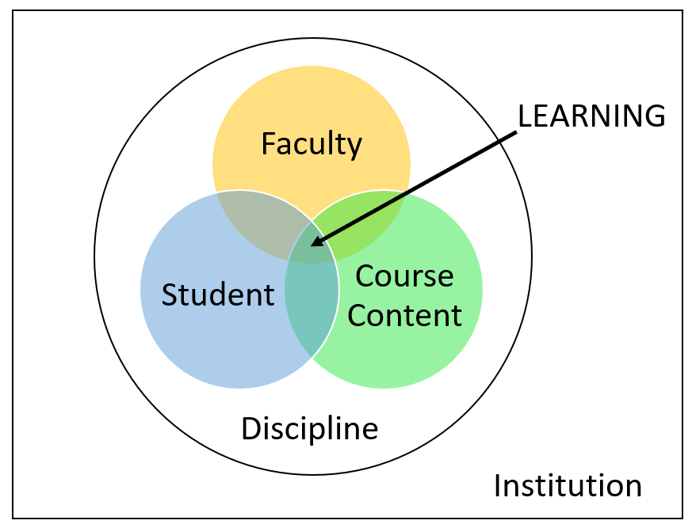
Learning-Centered Teaching
The point of contact between the student, the faculty member, and the course content, occurring within the dual contexts of the discipline and the institution is where learning happens.
To be student-centered is to recognize and value the five components of this equation and recognize that each exerts an influence over the most important activity at our university: student learning.

Slide 26
Think-Pair-Share: Comparison of Faculty-Centered and Student-Centered Models
Please read the document Topic 2: Comparison of Faculty-Centered and Student-Centered Models. Highlight or circle anything that catches your attention: points of disagreement, agreement, or questions you may want to raise. (5 min.)
Turn to someone near you and discuss your circled or underlined items. (5 min.)
Join another pair of participants and compare your responses. (5 min.)
Choose a spokesperson for your group to share the most significant aspects of your conversation with the whole group. (5 min.)

Slide 27
Characteristics of Student-Centered Institutions
Express a sincere belief in all students’ ability to learn.
Embrace a culture of full inclusion and demonstrate appreciation for all stakeholders’ diverse perspectives, whether students, staff, faculty, or administrators.
Prioritize excellence in teaching, learning, student development, institutional functions, and engagement with local and global communities.
Engage in ongoing conversations across the institution about how to support student success.

Slide 28
Why Do We Want to Become Student-Centered?
A focus on student success increases student retention, promotion, and completion, which is good for our students but also good for our institution.
Successful graduates produce robust alumni outcome data, bolstering our institution’s reputation.
Graduates who are satisfied with their educational experiences are our institution’s best brand ambassadors. They form strong alumni networks, increase our base of prospective donors, and encourage their children to enroll.

Slide 29
Orientation Toward Service
Teaching is a service-oriented profession, on par with medicine and law. Doctors serve their patients. Lawyers serve their clients.
We serve our students by providing them with an education.
We serve our institution by meeting our contractual obligations for service such as committee participation.
We serve our professional discipline through research or creative practice and training the next generation of disciplinary professionals.

Slide 30
Does and Does Not
A service mindset does not mean catering to the whims of those we serve, but it does mean caring about students as people and being concerned for their wellbeing.
A service mindset does not dilute academic rigor or demand we say “yes” to every student request, but it does mean being willing to prioritize students’ success over rigid enforcement of classroom policies or convenience.
Most of all, a service-oriented student-centered mindset is about letting go of expectations for who our students “should” be, choosing instead to meet their needs where they are to help every student succeed.

Slide 31
Student Success is Everyone’s Responsibility
Less than 1/5 (19%) of our students earn a 4-year degree in four years.
Just 4/10 (39.5%) of our students earn a 4-year degree in six years.
Enrollment has been declining for the past decade. Retaining more students until graduation would go a long way to addressing this problem.
However, research shows that faculty play an outsized role, not only in students’ academic achievement, but in their lifelong success.

Slide 32
Gallup-Purdue Index
Our actions as faculty can have an outsized impact on our students’ lifelong success.
The 2014 Gallup-Purdue Index identified six factors that are “so strongly related to graduates’ lives and careers [it] is almost hard to fathom . . . yet few college graduates achieve the winning combination.”
The more of these factors survey respondents reported receiving in college, the greater their degree of wellbeing and career engagement later in life.

Slide 33
The Big Six – Gallup-Purdue Survey
Professors who made students feel excited about learning
Professors who cared about students as people
A mentor who encouraged students to pursue their goals and dreams
The opportunity to work on a long-term project
Taking part in an internship or job where students could apply what they were learning in the classroom
Being extremely active in extracurricular activities and organizations during college

Slide 34
Professors who make students feel excited about learning
Our passion for our disciplines is contagious – the more excited we are about what we teach, the greater the positive effect on our students.
Sharing our ongoing research or creative practices
Bringing interesting examples to class
Demonstrating enthusiasm for our course content
Using teaching techniques that foster student engagement such as discussion, projects, fieldwork, and workplace connections.

Slide 35
Professors who care about students as people
Every interaction between students and faculty has the power to make or break the student’s learning experience.
Demonstrating empathy and compassion has a more lasting positive impact than insisting on rigid adherence to classroom policies.

Slide 36
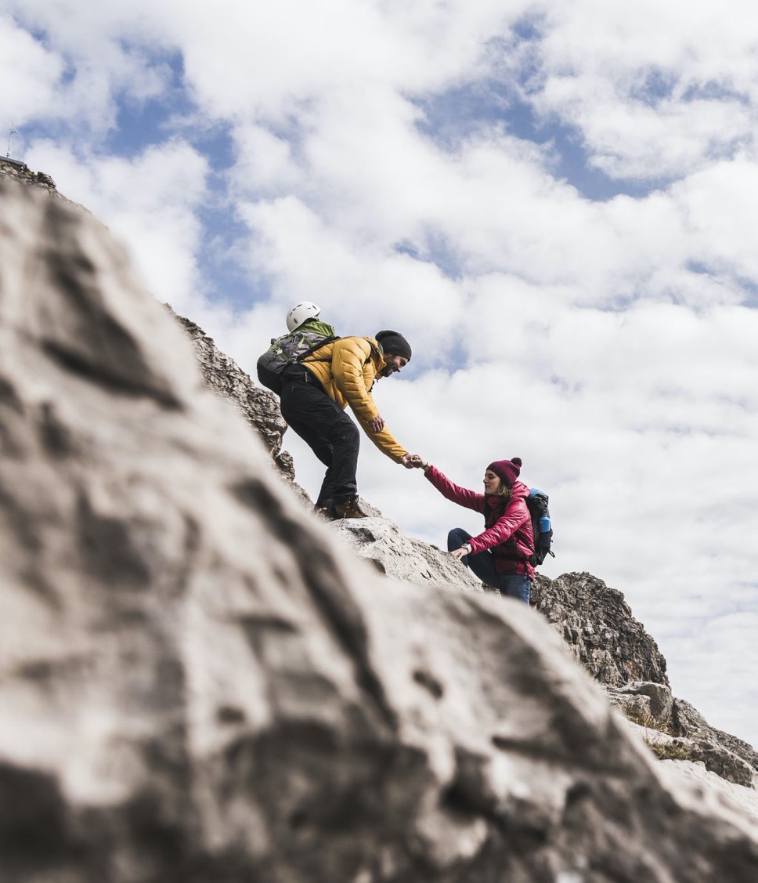
A mentor who encourages students to pursue their goals and dreams
Mentoring can occur formally or informally.
Mentors take a personal interest in the student and verbalize their belief in the student’s potential to succeed
Students need to know there’s someone on campus who “has their back” – a person who understands their needs and aspirations and can be counted-on for support and encouragement.
Notes:
They ask what the student plans to do after graduation. They work with the student to explore graduate programs and offer advice about completing grant applications or writing resumes. They write letters of recommendation, celebrate students’ successes, and help them through hardships.

Slide 37
The opportunity to work on a long-term project
Projects lasting for a semester or more allow students to engage deeply with the topic of investigation.
This aspect of the Big Six overlaps with the High-Impact Practice of involving undergraduate students in faculty research.
Participation in long-term projects fosters development of the “Four Cs” – skills and competencies in high demand in the workplace:
Collaboration and the ability to work well with others
Communication across contexts and audiences
Critical thinking and the ability to solve complex problems
Creativity and innovation

Slide 38
Taking part in a job or internship where students can apply what they learn in the classroom
Learning is most effective when it is meaningful and relevant to students’ lives or aspirations.
Building classroom connections to the workplace provides opportunities to apply learning to real-world contexts, building their understanding of its value and importance.
Workplace connections also help students build a professional network, broaden their understanding of career options, and introduce them to workplace norms and behaviors, all of which are essential to professional success.
Notes:
Business, nursing (or other health professions), and teaching majors already require internships and workplace experience. Other majors could build on these models to provide similarly transformative experiences for their students.

Slide 39
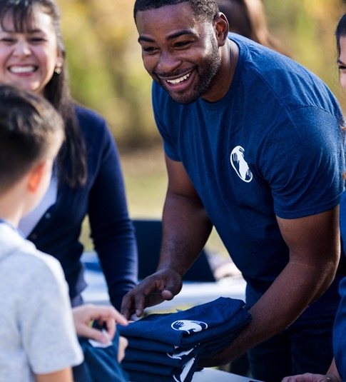
Being extremely active in extracurricular activities and organizations during college
Participation in purposeful co-curricular activities fosters positive results in retention, persistence, and academic achievement.
Students experience an enhanced sense of belonging, capacity for humanitarianism, and growth in interpersonal and intrapersonal competence.

Slide 40
Small Group Discussion
Read the handout Topic 2: Classroom Application of the Big Six. (5 min.)
Break into groups of four and discuss your reactions. (5 min.)
Select a spokesperson for the group to share the group’s ideas, concerns, or questions. (10 min.)
Return to the handout and jot your ideas in the table on the second page (5 min.)

Slide 41
Characteristics of Student-Centered Teaching
Faculty communicate subject-area knowledge through learning activities that foster higher-order thinking.
Learning activities accommodate students’ differences as learners, allowing for student choice, which increases motivation, engagement, and participation in the learning process.
Faculty establish the classroom environment as a community of learners that supports all members and fosters collaboration, respect for others’ perspectives, exploration, and reflection.

Slide 42
Characteristics of Student-Centered Teaching 2
Faculty provide ongoing formative assessment and constructive feedback on students’ work. Criteria for assessments are clear and align with the course’s objectives and outcomes.
Faculty adapt instruction to meet students’ needs, both for the whole group and for individual students. Faculty remain flexible in their approaches to instruction and engage in continuous reflection and improvement of their curricula and pedagogies.

Slide 43
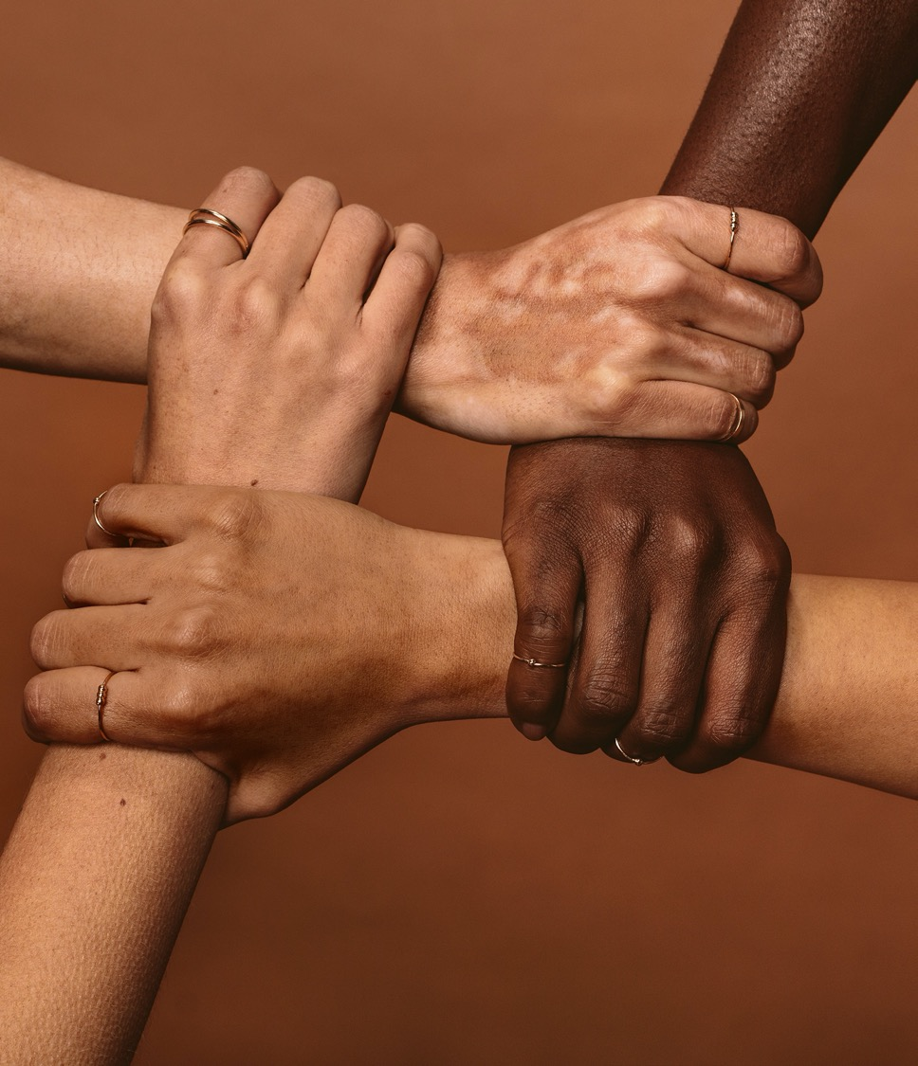
Embrace Inclusion
An inclusive educator accommodates learners’ differences and addresses systemic inequalities by creating a classroom where every student is valued, supported, inspired, and encouraged.
Inclusive educators
Know their students by name and need.
Adjust their teaching in response to formative assessment.
Monitor students’ progress and engagement, following-up with students as soon as they begin to fall behind or develop a pattern of absenteeism or non-participation.

Slide 44
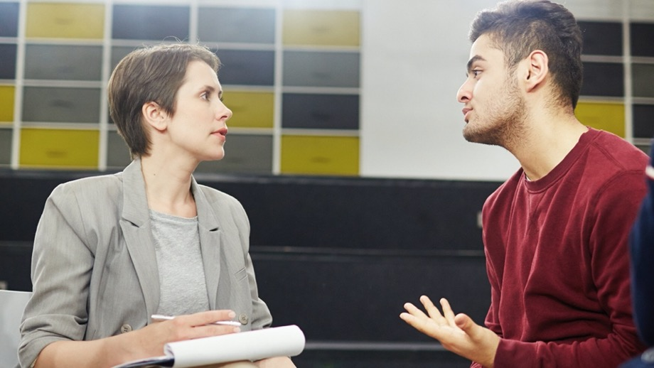
Commit to Seeing Students as Individuals
This Photo by Unknown Author is licensed under CC BY
Not every faculty member can mentor every student in every class. But we CAN choose to be kind, empathetic, and supportive in our interactions with every student.
Student-centered educators reject the time-worn attitude that their responsibility ends with “setting the table” for students – they accept responsibility and ownership for students’ achievement in their courses.
They do not allow students to fall through the cracks of the system. They are proactive and reach out to students whose grades or attendance are falling.
Notes:
We cannot overstate the importance of a caring adult on students’ success.

Slide 45
Reject a Deficit Mindset
Student-centered educators reject deficit-minded perspectives that see problems as residing in the student, recognizing that this attitude is a mask for implicit biases such as believing that certain groups or people lack the intellectual capacity for college-level study or assuming that people who live in poverty are lazy or financially irresponsible.
A deficit mindset faults students for being unprepared rather than blaming the social systems that create and perpetuate inequalities. Student-centered educators strive to address these inequalities instead of accepting them as inevitable or irremediable.

Slide 46
Employ Authentic Assessment
Student-centered educators measure students’ success in achieving the course objectives and outcomes, not just their scores on exams.
They define success by whether the student learned what the course was designed to teach.
Authentic assessment uses methods such as projects, performance tasks, observations, and reflective essays in combination with traditional assessments such as exams.
Transparent assessment criteria explain how students can demonstrate their achievement of course objectives and outcomes, providing a rationale and making explicit connections beyond the course.
Notes:
not the score they earned on an exam or grade calculations that may be skewed by factors unrelated to learning such as attendance or participation

Slide 47
High Impact Practices
First-Year Seminars and Experiences
Common Intellectual Experiences
Learning Communities
Writing-Intensive Courses
Creativity-Infused Learning: the Missing HIP
Collaborative Assignments and Projects
Undergraduate Research
Diversity/Global Learning
ePortfolios
George Kuh, High Impact Educational Practices: What They Are, Who Has Access to Them, and Why They Matter (2008, AAC&U)
Service-learning, Community-Based Learning
Internships
Capstone Courses and Projects

Slide 48
Eight Key Elements of HIPs
45
Performance expectations set at appropriately high levels
A significant investment of time and effort by students over an extended period
Interactions with faculty and peers about significant matters
Experiences with diversity
As we look at the HIPs more closely, we’ll see how these Key Elements factor into student-centered practices.
Frequent, timely, and constructive feedback
Periodic, structured opportunities to reflect and integrate learning
Opportunities to discover the relevance of learning through real-world applications
Public demonstration of competence

Slide 49
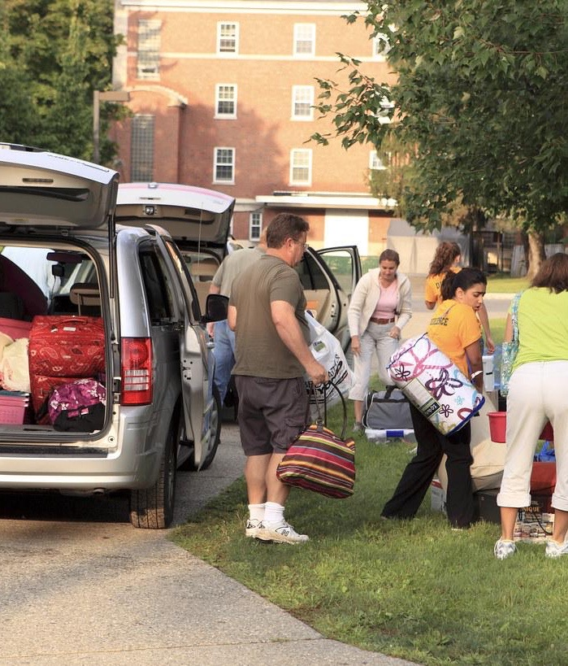
First-Year Seminars and Experiences
First-Year seminars or experiences share the goal of increasing retention by strengthening student engagement and fostering academic success by helping students:
(1) develop a connection with the institution
(2) become familiar with the campus’s resources and services
(3) develop academic skills.
This Photo by Unknown Author is licensed under CC BY

Slide 50
Application
Every course can incorporate elements of First-Year Seminars or Experiences.
Explain the connection between the course and students’ subsequent studies or adult lives.
Provide information about relevant campus services and resources (Writing Center, Tutoring Center).
Incorporate direct instruction in crucial academic skills.
Address personal competencies such as time management and attendance.
Establish a personal connection with each student through frequent targeted communication.

Slide 51
Common Intellectual Experiences
Common Intellectual Experiences are activities that carry through two or more courses to provide a shared experience.
Common Intellectual Experiences usually share these elements:
an interdisciplinary theme
shared content between courses
faculty collaboration
co-curricular connections
strategies for active learning.
A “common read” in which the entire campus community reads the same book is a well-established practice in this HIP.

Slide 52
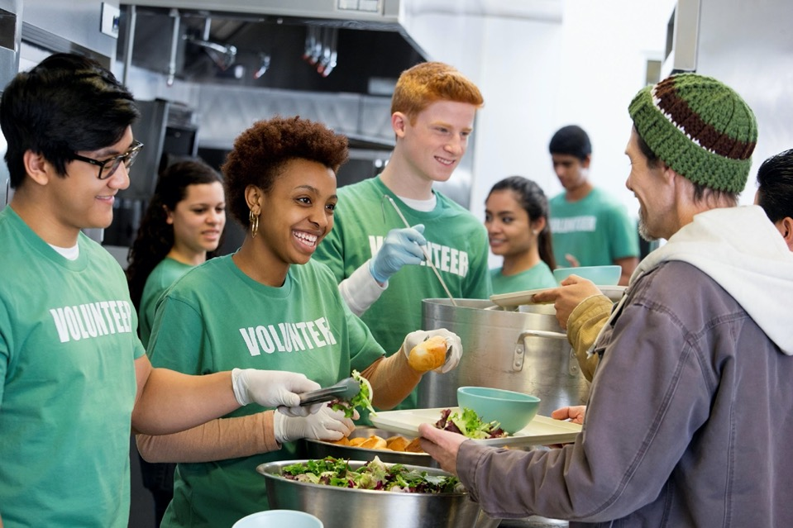
Application
Each course could include some elements of Common Intellectual Experiences.
Include an activity that builds meaningful interaction between students and faculty such as reading an impactful book.
Explore themes and ideas that carry throughout the course.
Incorporate opportunities to reflect on learning.
Include activities that connect the course content to the world outside the university.

Slide 53
Learning Communities
Linked courses, freshman interest groups, meta-majors (clustered courses within a field of interest providing opportunities for exploration of various majors in the field) and living-learning communities are common iterations of Learning Communities.
The primary purpose of a learning community is foster connections between and among students, faculty, and staff using three strategies.
Shared Knowledge: students register for a pair or group of courses organized around a central theme, designed to promote higher levels of cognitive complexity than taking unrelated courses.
Shared Knowing: students build relationships as they construct knowledge together, promoting social and intellectual engagement, cognitive development, and appreciation for others’ perspectives.
Shared Responsibility: coursework offers frequent opportunities to participate in collaborative groups through which students develop essential skills in teamwork, cooperation, problem-solving, negotiation, communication, and accountability.

Slide 54
Application
Shared Knowledge: structure the course around a central theme or topic to create a cohesive, comprehensible, and engaging body of knowledge.
Shared Knowing: build opportunities for peer-to-peer interaction through small group discussions or collaborative projects.
Shared Responsibility: utilize strategies for active learning such as discussion groups, partner activities, or collaborative projects.

Slide 55
Writing-Intensive Courses
Writing-intensive courses integrate specific instruction in expectations for written communication across curricular areas. Characteristics include:
Timely feedback on student writing, both written and spoken, during one or more conferences between the student and instructor.
Opportunities for revision of written work, including a sequence of draft, feedback, rethinking, rewriting, peer feedback and evaluation.
Multiple or sequential writing assignments throughout the semester, or a longer paper completed in installments.
Small class sizes or the capacity for small sections within larger classes, ensuring students receive individual attention.
A significant portion of the student’s grade depends on the quality of thought expressed in good writing.

Slide 56
Application
Writing is among the most ubiquitous academic activities.
Incorporating the characteristics of a writing-intensive course into existing teaching practices can improve the quality of your students’ written communication.
Our task is to teach students the norms and practices of professional communication within our disciplines by including specific lessons about disciplinary writing as appropriate to the course.

Slide 57
Creativity-Infused Learning: The Missing HIP
The environment of high-stakes standardized testing in which our students were raised has instilled beliefs that are antithetical to creativity
They believe there is one right answer to a question, and when they find it, they move on.
They believe that mistakes are bad and should be avoided at all costs.
They study only what will be on the exam.
They are convinced that optimal workflow should proceed in a measured and orderly fashion.
Infusing creativity training into our courses can help students move beyond these limiting assumptions and rediscover their innate capacity for creativity, which is among employers’ most sought-after qualities.

Slide 58
Application
Include opportunities to identify problems or discover multiple solutions to open-ended problems. Problem-finding asks students to identify missing information or apply intellectual or imaginative vision, leading students to think deeply and ask critical questions.
Ask open-ended questions as students are working. Avoid answering students’ questions directly. Saying, “I don’t know, what do you think?” sparks further thinking, while saying, “Here’s a website with a tutorial that shows you how to make a ____” shuts it down.
Incorporate both individual projects and collaborative work to meet the needs of students with different learning styles.
Allow students to respond to discussions or assignments creatively, not only in writing but through poetry, imagery, music, movement, or role-playing.
Debrief each project, encouraging students to reflect on what they learned through both success and failure.

Slide 59
Collaborative Assignments and Projects
Collaborative learning methods build on the idea that learning is an active, integrated, and constructive process influenced by social and contextual factors, recognizing that emotions occurring during social behavior directly influence the brain’s processes of learning and memory.

Slide 60
Application
Strategies for successful collaborative assignments or projects:
Provide overt instruction in collaboration, teamwork, and problem-solving.
Establish clear expectations for group and individual performance. participation, and achievement.
Ensure equity of access and integrate experiences with diversity (to the extent possible for your course).
Discuss connections between the course’s topic, the academic discipline, and real-world issues.

Slide 61
Question
We’re halfway through the list of HIPs.
Do you have any questions so far?

Slide 62
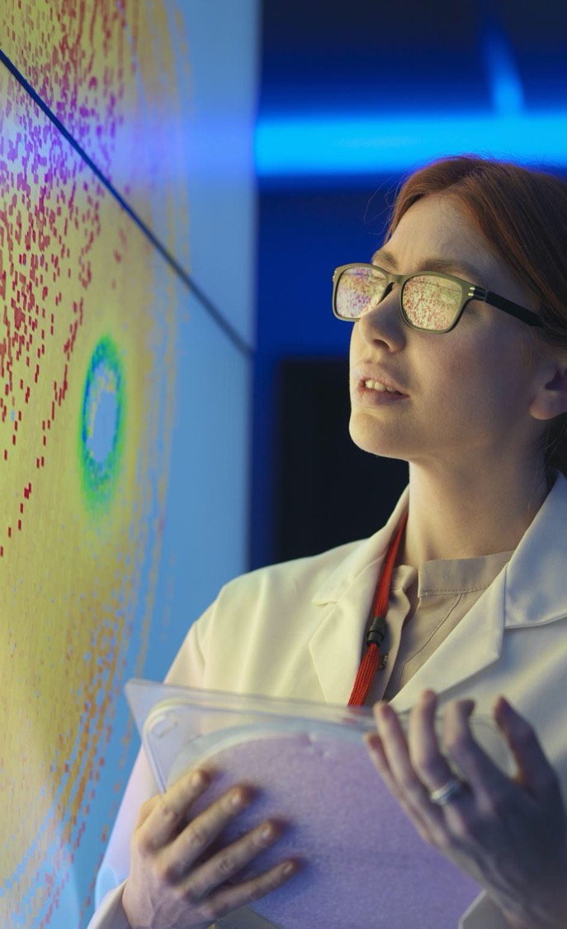
Undergraduate Research
Undergraduate research experiences tend to occur in two main contexts.
Course-based research embeds student research participation in the curriculum, including an emphasis on teaching students the norms and practices of research through a combination of instruction and direct experience.
Experiential learning settings such as summer seminars allow students and faculty work together on long-term, meaningful projects.
In both contexts, students actively engage in the research process, working alongside a mentor who guides the student through the experience, often in an apprenticeship model.
The mentor is usually a faculty member but could also be a graduate student, post-doctoral researcher, or upper-class peer.
Notes:
Note the connection to big six ability to work on a long-term project!

Slide 63
Application
Because most faculty are active researchers or creative practitioners, we can incorporate research into our undergraduate courses by:
Identifying aspects of our research or creative practice that intersect with the content or topic of the course.
Sharing our research or creative practice with students, explaining these areas of intersection.
Including students in our research or creative practice, even if on a small scale.

Slide 64
Diversity/Global Learning
We build classroom diversity when we teach students how to learn in collaboration with others rather than learning about others.
Diversity tends to focus on the composition of our immediate culture, while global learning focuses on our interactions in a globally connected world.
Teaching in these areas emphasizes leading students to shift their perspective.
Problem framing: a purposeful examination of how different people define and experience local, intercultural, international, and global challenges to human and environmental well-being and problem-solving.
Perspective consciousness: insight into one’s own beliefs, values, and assumptions and how these are like or unlike those held by others at home and abroad.
Global perspective: the ability to analyze a complex trans-border problem and consider multiple interpretations of its causes, consequences, and proposed solutions.

Slide 65
Application
Reflectively and honestly examine your own attitudes towards diversity.
Teach students to think critically and reflectively, not just examining others’ ideas but developing awareness of one’s own biases and preconceptions.
Incorporate opportunities for students to work in diverse groups.
Create and promote opportunities to participate in experiential learning that place students in proximity to others who are different from themselves or in unfamiliar cultures and environments.
Consider how to identify and meet the needs of diverse learners in your classroom.
Provide readings and multimedia that expose students to the points of view of persons different from themselves, holding a follow-up discussion.
Notes:
remembering that diversity is not only about race and gender but students with special needs, differing ability levels, and extenuating life circumstances such as being employed full time, being a parent, being much older than their peers, and so on.

Slide 66
ePortfolios
ePortfolios are both a product and a process.
As a product, they are a curated collection of evidence of students’ learning in a digital showcase for their achievements and accomplishments. ePortfolios can include artifacts from coursework and co-curricular activities, work experiences, volunteering, and more.
As a process, ePortfolios provide opportunities for students to reflect on their learning, going beyond the simple acquisition of knowledge and skill to incorporate affective, personal, and self-identity dimensions.

Slide 67
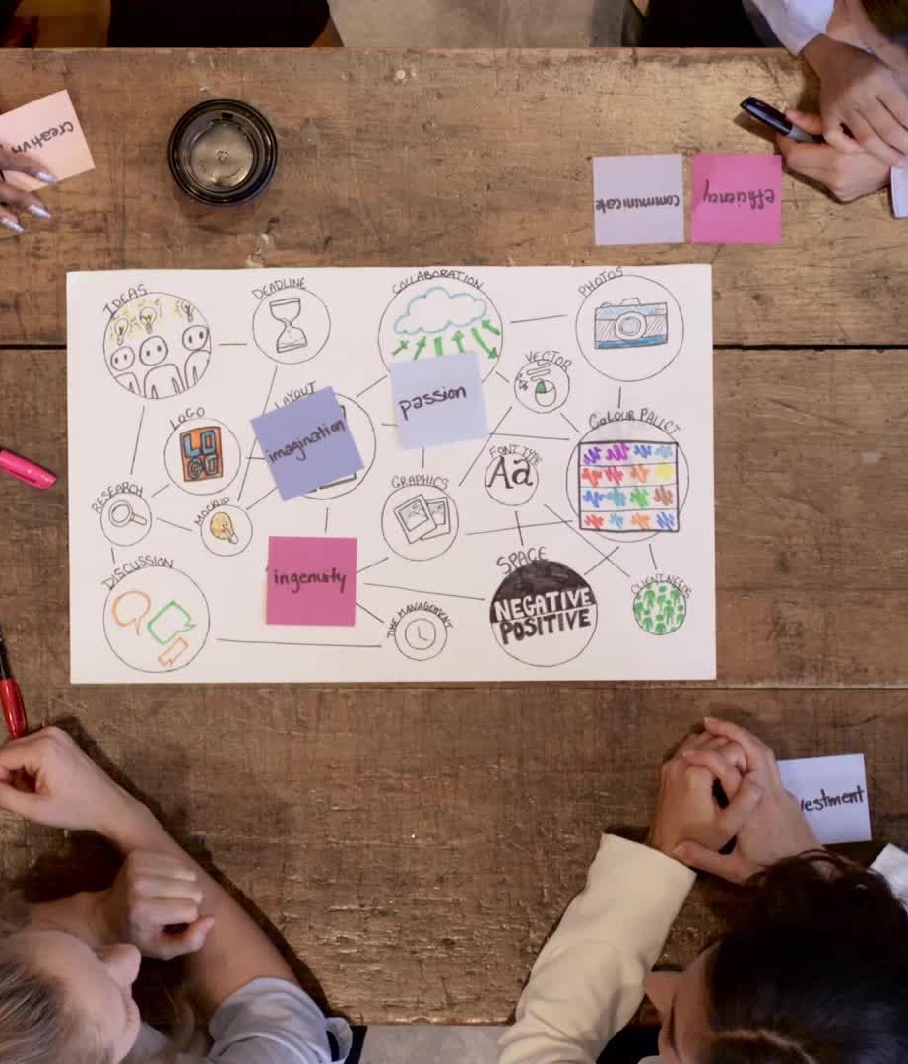
Application
Incorporate the ePortfolio into the course’s outcomes and tie assessments of students’ portfolios to their course grade, using a rubric for grading and providing formative verbal or written feedback during the semester.
Share examples of high-quality ePortfolios created by other students; create and share your own ePortfolio.
Include viewing and commenting on fellow students’ ePortfolios in assignment requirements.
Encourage students to collect artifacts of their learning throughout your course.

Slide 68
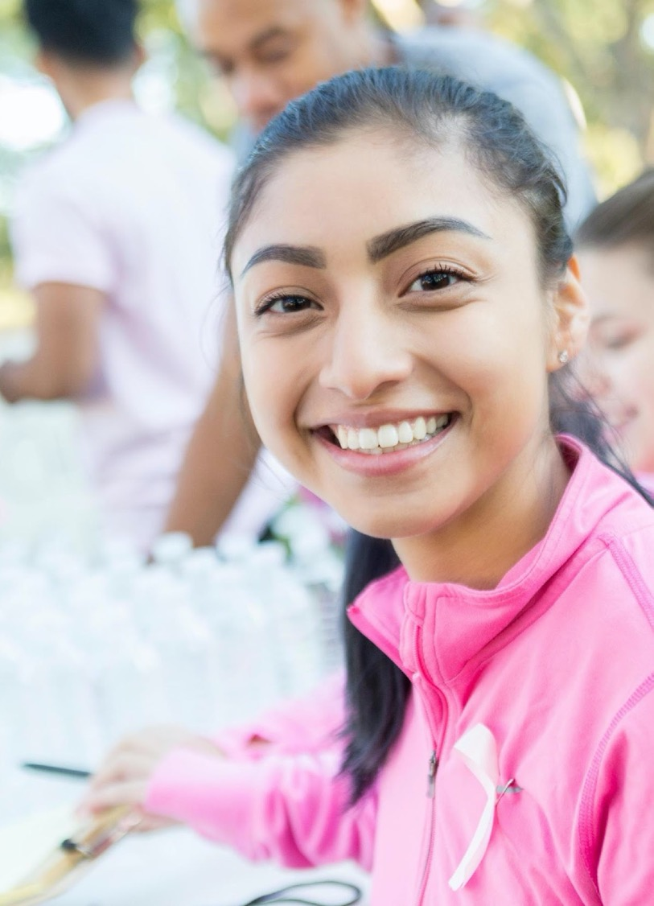
Service-Learning, Community-Based Learning
Most colleges and universities maintain that their mission, at least in part, is to prepare their graduates to become contributing citizens who lead lives of service to their communities.
Service-learning and community-based learning place students in off-campus situations where they experience the social issues they are studying in the classroom as they interact with community members through activities where they can make a difference.

Slide 69
Application
Many courses can establish connections with local partners where students can participate in service or community-based activities related to the course.
Prior planning and preparation are the key to success, as are establishing clear criteria and expectations.
Establish connections with community organizations or agencies.
Clarify expectations for participation.
Manage logistics (materials, transportation, costs).
Compile and share information with all participants.
Provide instruction in problem-solving, critical thinking, and other skills relevant to the experience.
Communicate regularly with the partnering organization.
Incorporate debriefing and reflection when the project is complete.

Slide 70
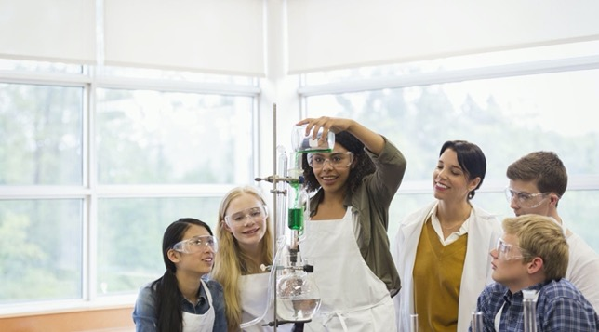
Internships
Many fields require practical experience as a standard part of student learning.
Internships and practicum experiences usually involve a short-term, part-time position in a company or organization related to the student’s major.
Externships are shorter in duration than internships, and usually involve job-shadowing or observations rather than an authentic work experience.
Co-op (cooperative education) is a specialized internship, often with pay, in which students work alongside professionals in their major field. Co-op often requires students to place their other studies on hold, especially if it is a full-time position.

Slide 71
Application
Most internships or practicum experiences involve specific coursework or degree requirements.
However, individual faculty can incorporate externships, job shadowing, volunteering, or other workplace-based experiences for their students, following the same processes as for service-learning or community-based learning.

Slide 72
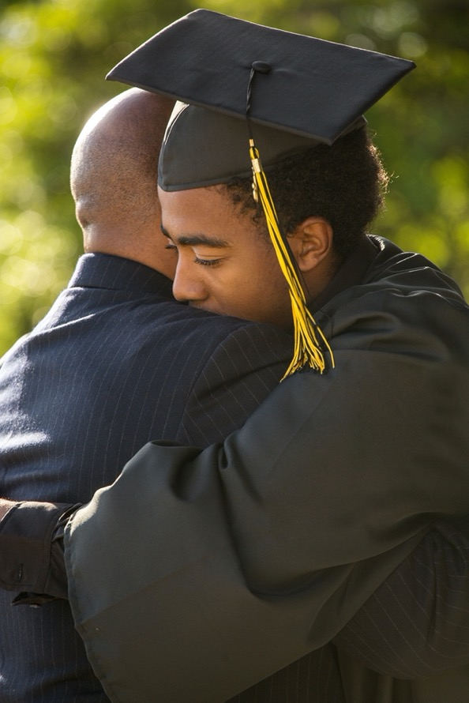
Capstone Courses and Projects
For centuries, doctoral students have written dissertations as evidence of their ability to produce new knowledge in a field of study, and students earning master’s degrees have written a thesis, completed a research project, or presented an exhibition or performance demonstrating their disciplinary proficiency.
Capstone experiences can include a culminating course, comprehensive exam (such as those for certification or licensure), arts performance or exhibition, significant project or portfolio, or experiential learning (internship, practicum experience).

Slide 73
Application
We can scale capstone experiences to our courses by incorporating a culminating activity that allows students to understand what they have learned, how it can apply beyond the classroom, and how it relates to their lives after graduation.
This could be as simple as a final discussion board, a question on the final exam, or a reflective essay. Faculty might also incorporate reflective questions into an existing culminating activity. The point is to prompt students to think about what they have learned and what it means for their futures.

Slide 74
Reflection Point (instructions)
At their core, HIPs are about building connections, which is why they’re such powerful manifestations of student-centered teaching and learning.
When we strengthen students’ relationships with faculty and peers, embed learning in real-world contexts, and increase student engagement with course topics, we can deliver an educational experience that empowers students’ academic achievement and facilitates their ability to form connections between their learning and their lives after graduation.
Which of the HIPs could you incorporate into your course?
The next slide will repeat the list of HIPs. We’ll pause to take notes, then share our ideas.

Slide 75
High Impact Practices
First-Year Seminars and Experiences
Common Intellectual Experiences
Learning Communities
Writing-Intensive Courses
Creativity-Infused Learning: the Missing HIP
Collaborative Assignments and Projects
Which of these strategies could you incorporate into the courses you teach? Jot down your ideas. (5 min.)
Discuss.
Undergraduate Research
Diversity/Global Learning
ePortfolios
Service-learning, Community-Based Learning
Internships
Capstone Courses and Projects

Slide 76
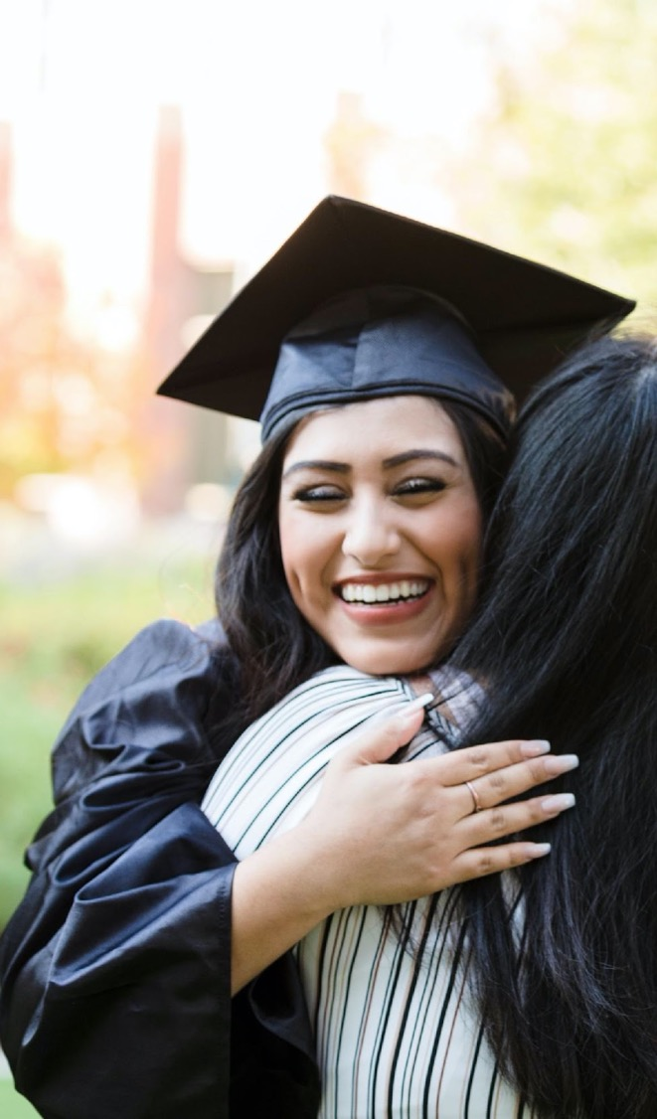
Remember
Student-ready educators:
Are eager to teach all the students in their classes.
Know each student by name and need, then meet those needs to deliver a high-quality education.
Student-centered educators:
Care about their students as individuals and are committed to their success.
Utilize teaching methods that prioritize students’ learning (including the Big Six and High-Impact Practices).

Slide 77
Into the Future
We can no longer cling to “the way it’s always been” if we are to truly serve our students today.
The future of higher education lies in our willingness to become student-ready and student-centered as we incorporate the Bix Six and HIPs into our classrooms, programs, and institutions.

Slide 78
Questions?

Slide 79
References
For a complete list of references, please see the chapter reference lists at the end of chapters 1, 2, and 5 of Mackh, B. (2021). Pivoting Your Instruction. Routledge.

