Slide 1

Topic 15: Creating a Culture of Care in the Classroom
Course Design Institute 2022

Slide 2
Is this who you want to be?
Legally Blonde – Kicked Out of Class
Paper Chase – Here is a Dime

Slide 3
What is the Culture of Care?
Students
Colleagues
Institution
Self

Slide 4


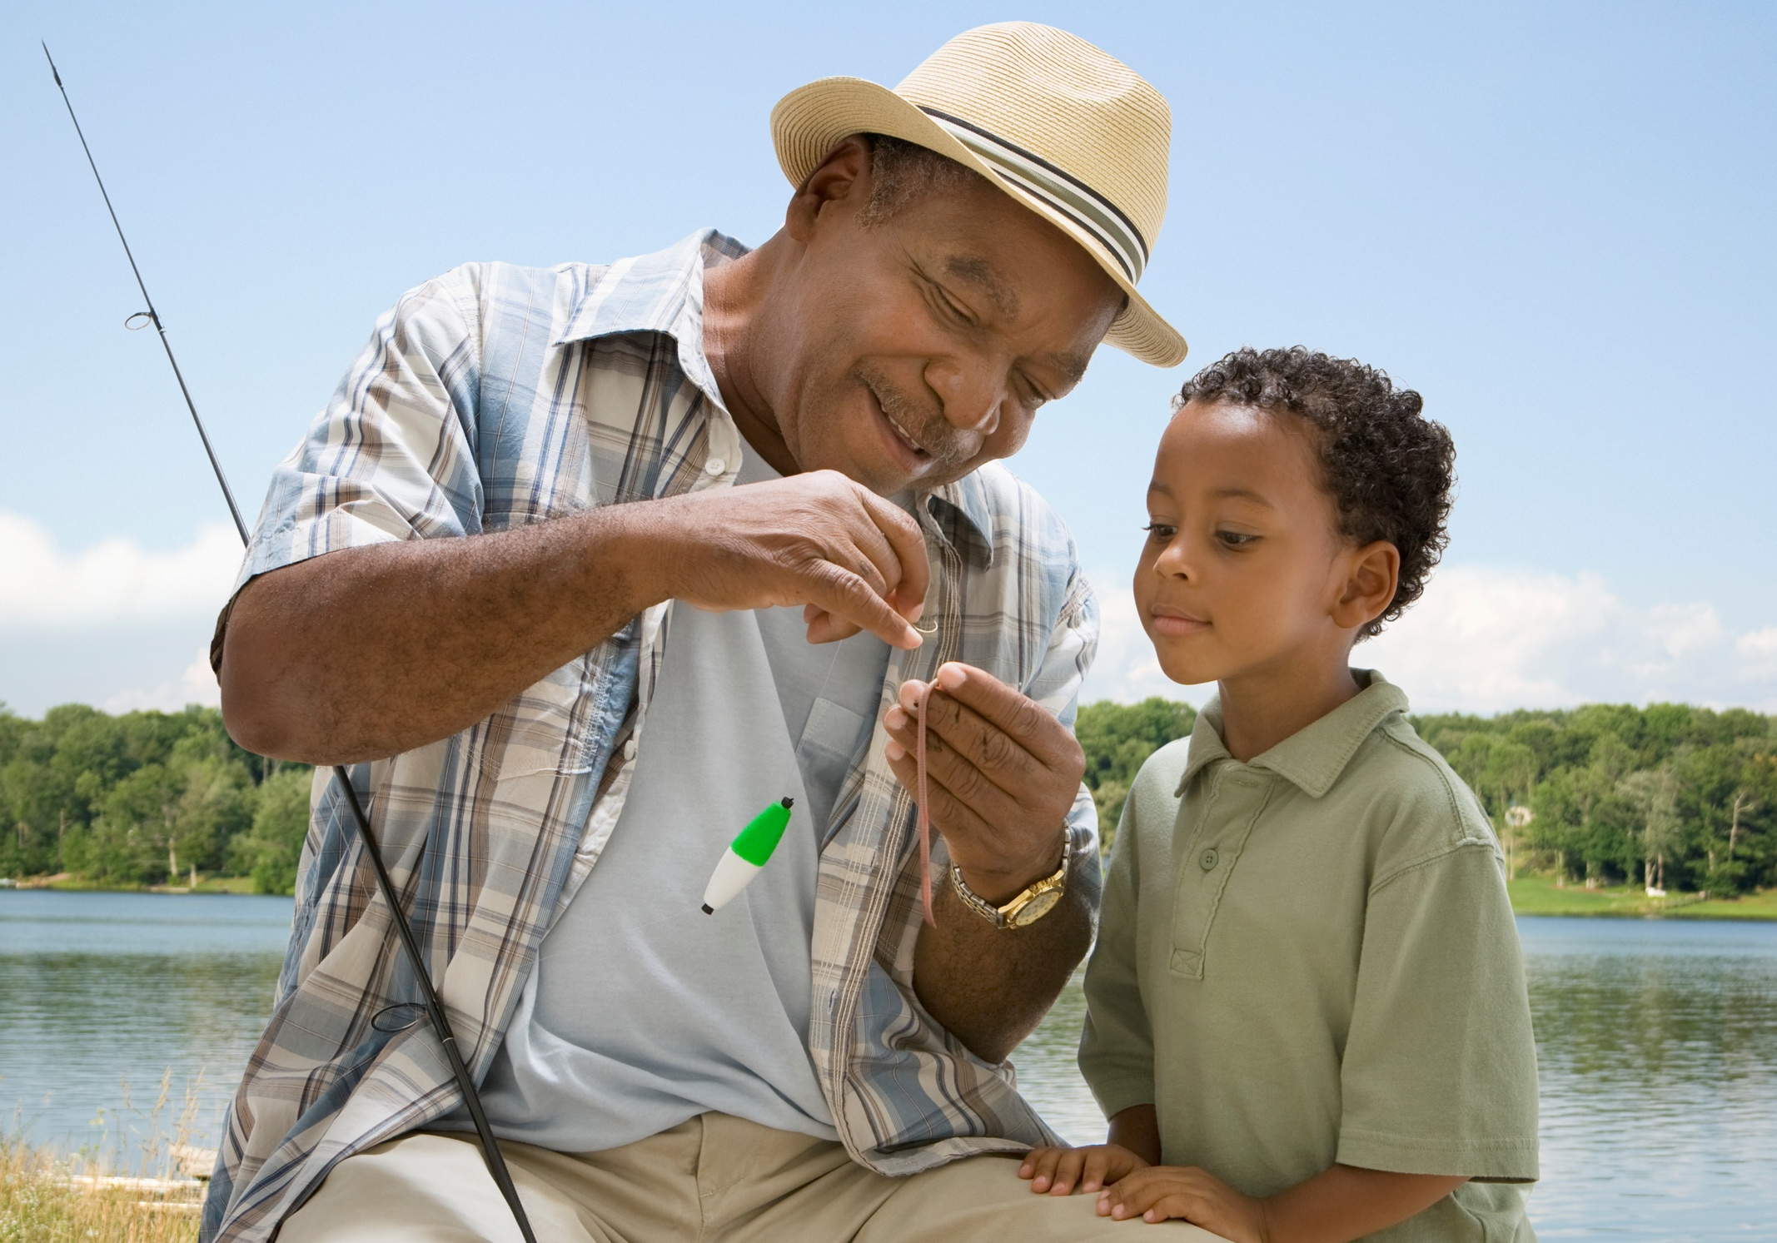
Whom Do
You Love?
Love is, among other things, a feeling of unselfish concern for the welfare of others.
Care is an action and a state of being.
Caring about someone means we want the best for them and act to support their success and happiness.

Slide 5
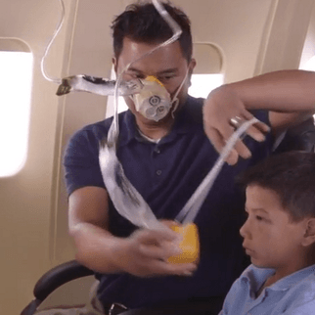
Domain 1: Care for Self
We cannot care for others if we do not first attend to our needs. It’s why flight attendants tell people traveling with a small child to put the oxygen mask on themselves before helping someone else.
Actions:
Positive self-indulgences
Setting boundaries
Maintaining a positive mindset
Activities that boost happiness
Common sense strategies for wellbeing

Slide 6

Domain 2: Care for Colleagues
We care for our colleagues when we bring a commitment to professionalism to our workplace. Demonstrating care for colleagues means respecting their feelings, ideas, and wellbeing.
Actions:
Disagree respectfully
Manage difficult conversations
Stop destructive competition
Choose your battles
Compromise effectively
Restore connections
Celebrate and stand together

Slide 7
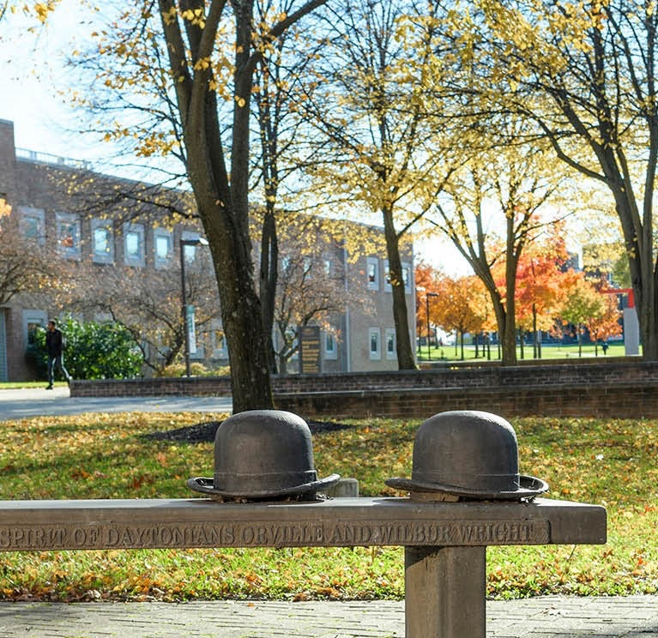
Domain 3: Care for Institution
Caring for our institution means being mindful of the impact our choices and actions have on the University.
Actions:
Daily personal responsibility
Enrollment and retention
Reflected reputation
Speak no evil
Enhanced visibility

Slide 8
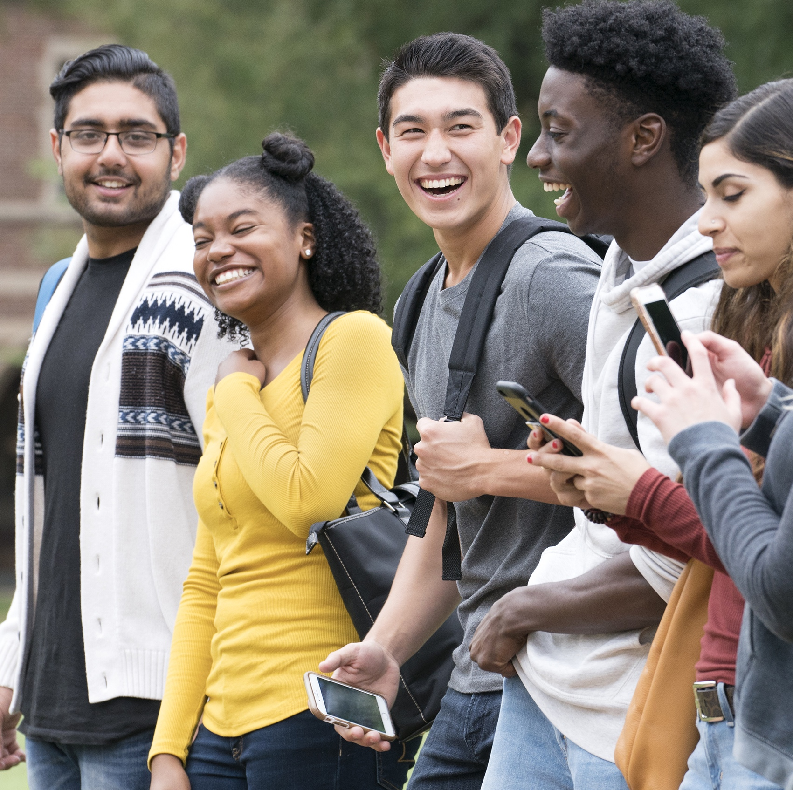
Domain 4: Care for Students
Caring for students is perhaps our most important function as educators.
Our actions can create a culture of care in our classrooms, or produce an uncomfortable environment where students struggle to learn, as we saw in the beginning video clips.

Slide 9

Care is Student Centered
A student-centered mindset is driven by care and empathy.
  We care that our students learn.
  We care that they do well in our courses.
  We know our students by name and need, and then we do our utmost to meet those needs and support their success.

Slide 10
Review: Gallup-Purdue Index
Demonstrating care for our students has an outsized impact on their lifelong success.
The 2014 Gallup-Purdue Index identified six factors that are “so strongly related to graduates’ lives and careers [it] is almost hard to fathom . . . yet few college graduates achieve the winning combination.”
The more of these factors survey respondents reported receiving in college, the greater their degree of wellbeing and career engagement later in life.

Slide 11
Review: The Big Six
Professors who made students feel excited about learning
Professors who cared about students as people
A mentor who encouraged students to pursue their goals and dreams
The opportunity to work on a long-term project
Taking part in an internship or job where students could apply what they were learning in the classroom
Being extremely active in extracurricular activities and organizations during college

Slide 12

Turn and Talk
Round 1: tell someone near you about a professor who demonstrated care for you when you were in college and the impact this had on your learning.
Round 2: tell someone else about a professor who treated you in an uncaring way when you were in college and the impact this had on your learning.
Notes:
.

Slide 13

Building Classroom Community
Every class is a unique group of human beings brought together around a shared purpose.
Fostering a sense of community increases students’ willingness to participate in discussions, ask questions, and engage with course activities.
This principle is especially important in establishing a learning environment that supports access, diversity, equity, and inclusion.
All students should feel welcomed and valued, know that their differences are not only respected but celebrated, and trust that they will be treated respectfully.
Let’s look at five strategies to build an inclusive classroom community.

Slide 14

1. Use Students’ Names
One of the best aspects of teaching through a video conference platform during the pandemic was that students’ names were right there on the screen.
Video conferencing also places “everyone in the front row” – nobody could hide in the back of the room.
Face-to-face teaching requires more effort to learn our students’ names and pronounce them correctly.
We also need to pay attention to students who are not participating and invite them into the class discussion by showing that we notice them and care how they’re doing.

Slide 15

2. Use Culturally Diverse Examples
Our scholarship and teaching should move beyond the traditional “great [white] men of ___ [name of discipline].”
Students need to see that people who share their identities are contributors to our academic fields.
If not, students should understand why they weren’t represented before and how that’s changing for the better today.

Slide 16

3. Provide Opportunities for Collaboration
Incorporate opportunities for students to work with one another, such as in small group activities.
Structure the learning task to ensure that everyone participates, such as assigning roles within those groups.

Slide 17
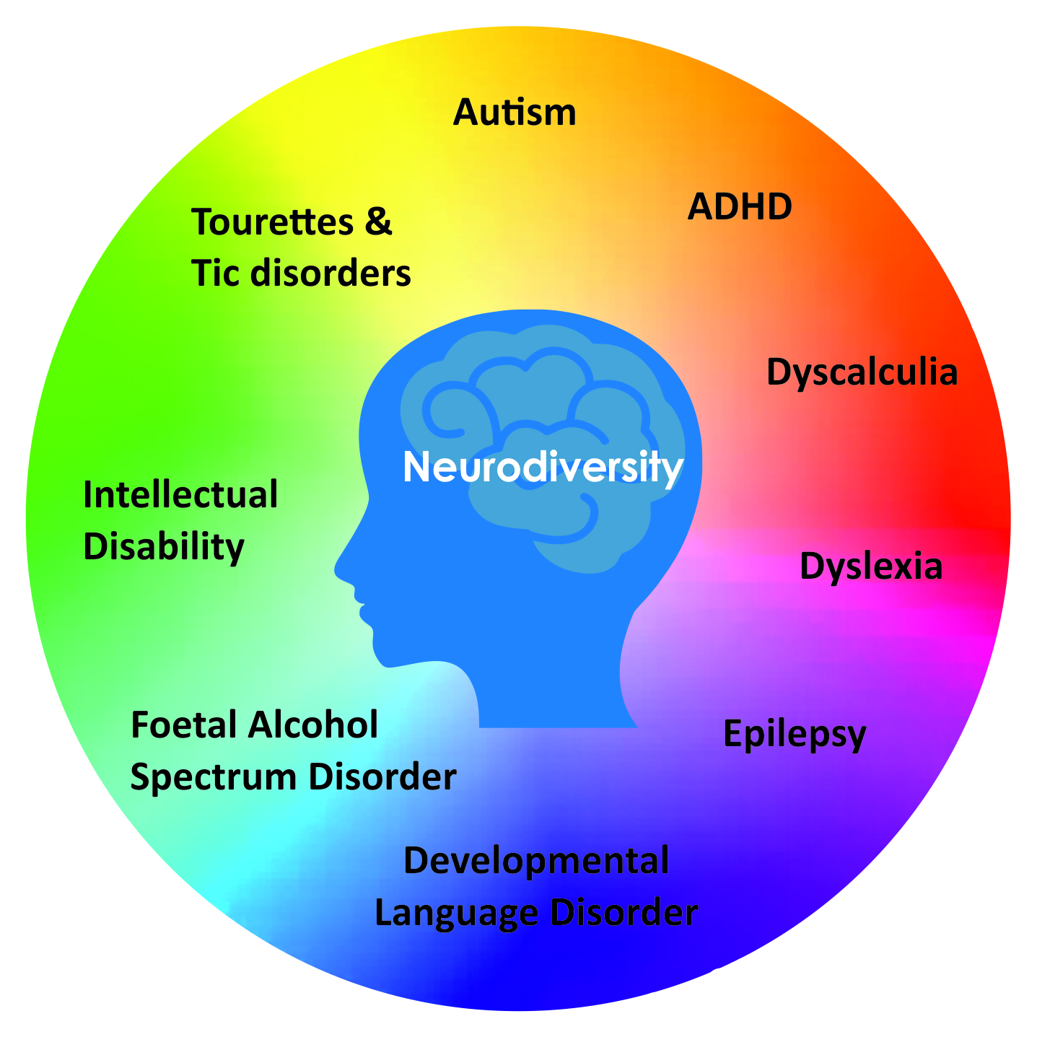
4. Vary Your Teaching Strategies
Neurodivergence is also an aspect of diversity.
Students who are anxious or introverted find social interaction to be difficult.
Offer choices of how to engage and participate.

Slide 18

5. Promote Access and Equity
Make your intention to promote access and equity explicit.
State your views on the first day of class and enforce your classroom norms throughout the semester.
Insist that students treat one another with respect, refrain from monopolizing discussions, and help each other succeed.

Slide 19
Creating a Caring Classroom
Establish a sense of belonging
Implement classroom management techniques that build community
Model the behaviors you want students to emulate.

Slide 20

Benefits of Rapport,
From Higher Education by Design
Most students will be more receptive to learning if they believe that their instructor cares about them and trust that they will be treated fairly. This belief is essential to establishing rapport, both in face-to-face or online learning environments.
Positive rapport increases student enjoyment of the course, improves attendance and attention, promotes additional enrollment in subsequent courses, affects the broader classroom climate, and reduces classroom conflicts.

Slide 21

Suggestions for Establishing Rapport
Talk about something other than course content sometimes. Students need to see you as a genuine human being, not an unapproachable monolith.
Start the first class of the week by asking students if anyone has a celebration to share and be sure to share one of your own.
Take attendance by asking students to respond to a simple (non-academic) question like, “What’s your favorite ___ [color, ice cream flavor, video game, sports team, musical group, etc.]?

Slide 22

Establishing Rapport (2)
Chat with students before class (being sure you’re not talking to the same students each time).
Greet students by name as they enter the classroom.
The stronger the rapport you develop with your students, the more engaged they will be in your class.

Slide 23
Turn and Talk
Round 1: share a strategy or method you use to build community in your classroom.
Round 2: tell someone else which of the new strategies we’ve heard today you’d be willing to try in your classroom this week.

Slide 24

Demonstrating Care for Students
Caring for students rests squarely on empathy – making a conscious decision to treat students the way we would want someone to treat us (or someone we love) under similar circumstances.
We demonstrate care for our students at many levels.
  Smile and say, “Hello,” when encountering them around the campus.
  Extend a deadline or refrain from penalizing late work.
  Hold students accountable for meeting your expectations – kindly – explaining the rationale for your decision and how the student can take the lesson learned and apply it in their future.

Slide 25

“When Life Happens, Send Me an Email”
In each class you teach, send a message at the start of the semester that says, “When life happens to you, just send me an email. Your success in this course is my highest goal. If something is standing in your way, we can work together to find a solution that supports your learning of the course content.”

Slide 26

Make it Work
Making accommodations does not mean giving every student an A without taking an exam or doing any work. That’s not caring because students have not learned anything.
Caring is finding a way to make things work for the student, even if it’s inconvenient for us as their instructors or different from other students’ paths.

Slide 27

“There’s no toilet paper in New Jersey”
During the early phases of the COVID-19 crisis, toilet paper was in notoriously short supply. Warren County Community College in New Jersey purchased toilet paper from industrial suppliers and distributed it to students, faculty, and staff.
The college also purchased gift cards from local restaurants and gave them to students who had suddenly lost their jobs.
Warren students received no less than three phone calls from faculty checking on their wellbeing during the 2020 Spring semester.
Warren’s president Will Austin said, “Our students at Warren are learning the most important thing is not how much my professor knows, it’s how much my professor cares.”

Slide 28
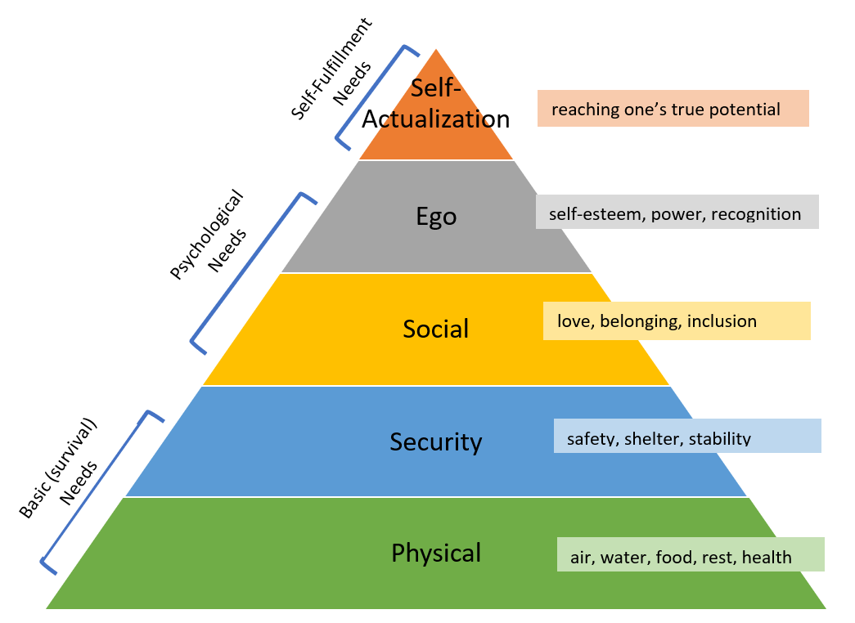
Maslow’s Hierarchy of Needs

Slide 29








Maslow’s Theory
Deficiency Needs
Growth Needs
Deficiency needs must be satisfied in order of importance, beginning with the most basic physiological needs: hunger, thirst, or other bodily discomforts.
Next, the need for safety and security must be met, followed by the need to belong and to be loved. Finally, an individual must meet their need for esteem: to achieve, to be competent, and to find approval and recognition.
After deficiency needs are met, an individual can act upon growth needs. These include cognitive needs to know, understand, and explore, followed by an aesthetic need for symmetry, order, and beauty.
An individual can then move towards self-actualization, or realizing one’s potential, and finally to self-transcendence - connecting to something beyond the self and helping others find self-fulfillment.

Slide 30
Turn and Talk
Round 1: describe a time when an unmet physical need prevented you from doing what you were supposed to do.
Round 2: tell someone else about a time when you met a student’s need so they could learn.

Slide 31

Common Sense
Maslow’s ideas have endured because they echo universal experiences and common sense.
We know that being hungry, thirsty, too hot, too cold, or in pain will prevent us from learning or from doing our jobs well.
We know that students who feel unsafe are too fearful, anxious, and distracted to learn.
Conversely, a strong sense of belonging and involvement in caring relationships help us to be happier and more successful.

Slide 32
Applying Maslow’s Theory in the Classroom
Teaching usually focuses on students’ growth needs but this may cause us to overlook deficiency needs that interfere with their learning, such as homelessness or food insecurity.
Be mindful of not creating deficiencies for others. For example, dishearteningly negative feedback on a student’s work undermines their self-esteem.
Maslow’s framework gives us a template within which we can identify opportunities for care and prioritize our actions according to the urgency of the need.

Slide 33
Caring for Students Is Everybody’s Job
Meeting students’ needs extends beyond our classrooms to the institution’s support services and resources in the surrounding community.
Physical needs: campus wellness programs, exercise facilities, mental health services, food pantries
Safety needs: emergency housing, campus security, referrals to community support services
Social needs: creating a sense of belonging through social events and co-curricular activities; mentoring, intentional inclusion, removing barriers to access, increasing attention to diversity and equity; establishing a supportive and caring campus community
Ego needs: opportunities for success, recognition of achievements and accomplishments
Self-Actualization needs: participation in experiential learning such as study abroad or internships, student leadership, undergraduate research, or working on long-term projects

Slide 34
Leadership in the Culture of Care
Students
Faculty and Staff
Colleagues
Institution
Self
Caring for faculty, staff, and students
Modeling caring behavior
Casting the vision for the culture of care
Remembering that actions speak louder than words

Slide 35

“Still, I am one.”
“I am only one, but still, I am one. I cannot do everything, but still, I can do something; and because I cannot do everything, I will not refuse to do something that I can do.”
~ Edward Everett Hale

Slide 36

What if?
What if we could say our institution is a place where everyone genuinely loves and cares for one another?
What if we could point to the proof of this statement in the fact that 100% of students who enroll at our institution graduate having received each of the Big Six?

Slide 37

Wrap-Up
Turn to someone near you and tell them one thing you’ll take away from today’s session.
Any questions?

