Slide 1

Topic 13: Access, Diversity, Equity, Inclusion, and Belonging
Course Design Institute 2022

Slide 2

Still Striving Toward the Goal
The US has been moving away from oppressive socio-political systems since at least the Civil War.
We have made great strides: Women’s suffrage, the Civil Rights Movement, marriage equality and more.
However, the social upheavals that happened in the summer of 2020 show us that we haven’t reached the goal of a truly just, equitable, diverse society just yet.

Slide 3

Thinking Critically
Theories developed by the Frankfort School in the 1930s led to the end of Enlightenment-era beliefs that knowledge is objective and discoverable.
Instead, we now understand that knowledge is contingent upon socio-historical contexts and influenced by individuals’ values and beliefs. Many views can coexist simultaneously rather than thinking that there is just one “right” way to interpret information.
Textbooks are no longer seen as neutral, objective, or reliable because they contain provable facts. Instead, we know that publishers’ decisions of what to include and how to present it communicate implicit biases under the guise of factual objectivity.

Slide 4

Individual Attitudes – Cognitive System 1
In Thinking Fast and Slow (2011), author Daniel Kahneman explains that our brains operate on two systems.
Cognitive System 1 works automatically, unconsciously, and extremely quickly - 11 million bits of information per second!
We rely on System 1 for the rapid decision-making involved in driving a car, receiving, processing, categorizing, and acting upon information with ease.

Slide 5

Individual Attitudes – Cognitive System 2
Conscious processing occurs in System 2. We depend on System 2 for tasks that require concentration such as active learning.
System 1 might let us drive a car without thinking, but when we need System 2 to find the address of a new place where we’re going.
System 2 helps us with cognitive tasks like solving math problems or following a new recipe.

Slide 6
Here’s the Problem
Our brains constantly gather information about the world that shapes our perceptions. This causes us to form implicit associations occurring below the level of conscious thought that instantly transpire through System 1.
When this causes us to hit the brakes when a stoplight turns red, it’s a good thing. But when these stored perceptions create implicit biases, it’s quite another.
The identities we perceive in other people – ethnicity, gender, race, age, and so on – are deeply embedded in System 1, so we’re unaware of their influence.
Harvard University’s Project Implicit offers a series of free online tests that can reveal hidden bias related to sexuality, disability, gender and career, gender and science, age, weight, skin tone, Arab-Muslim, Native American, and Race (Black/White).
Taking these quizzes can be a little bit upsetting when we find out that our implicit attitudes don’t match what we think we believe.

Slide 7
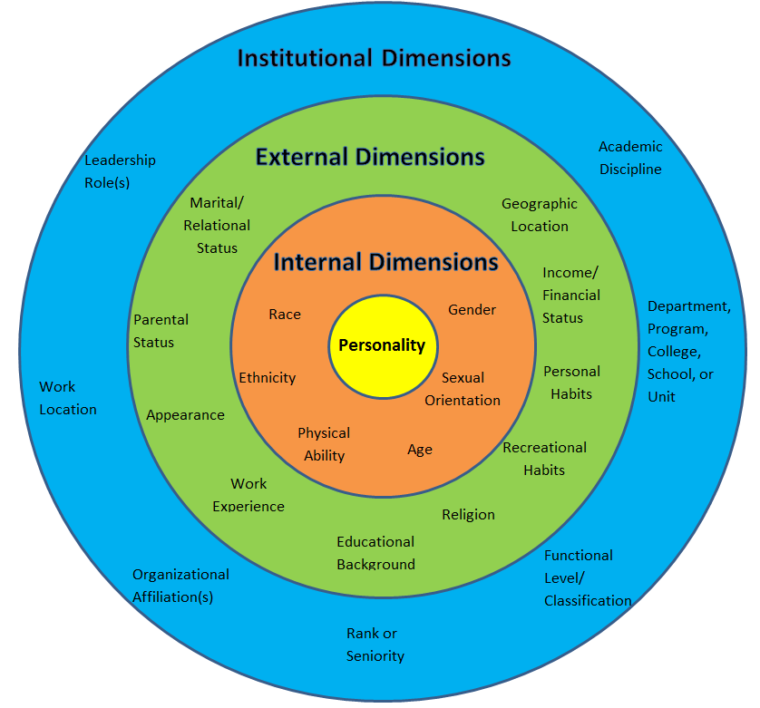
Dimensions of
Diversity
These factors make up our identities – but they also become criteria upon which we judge one another.

Slide 8
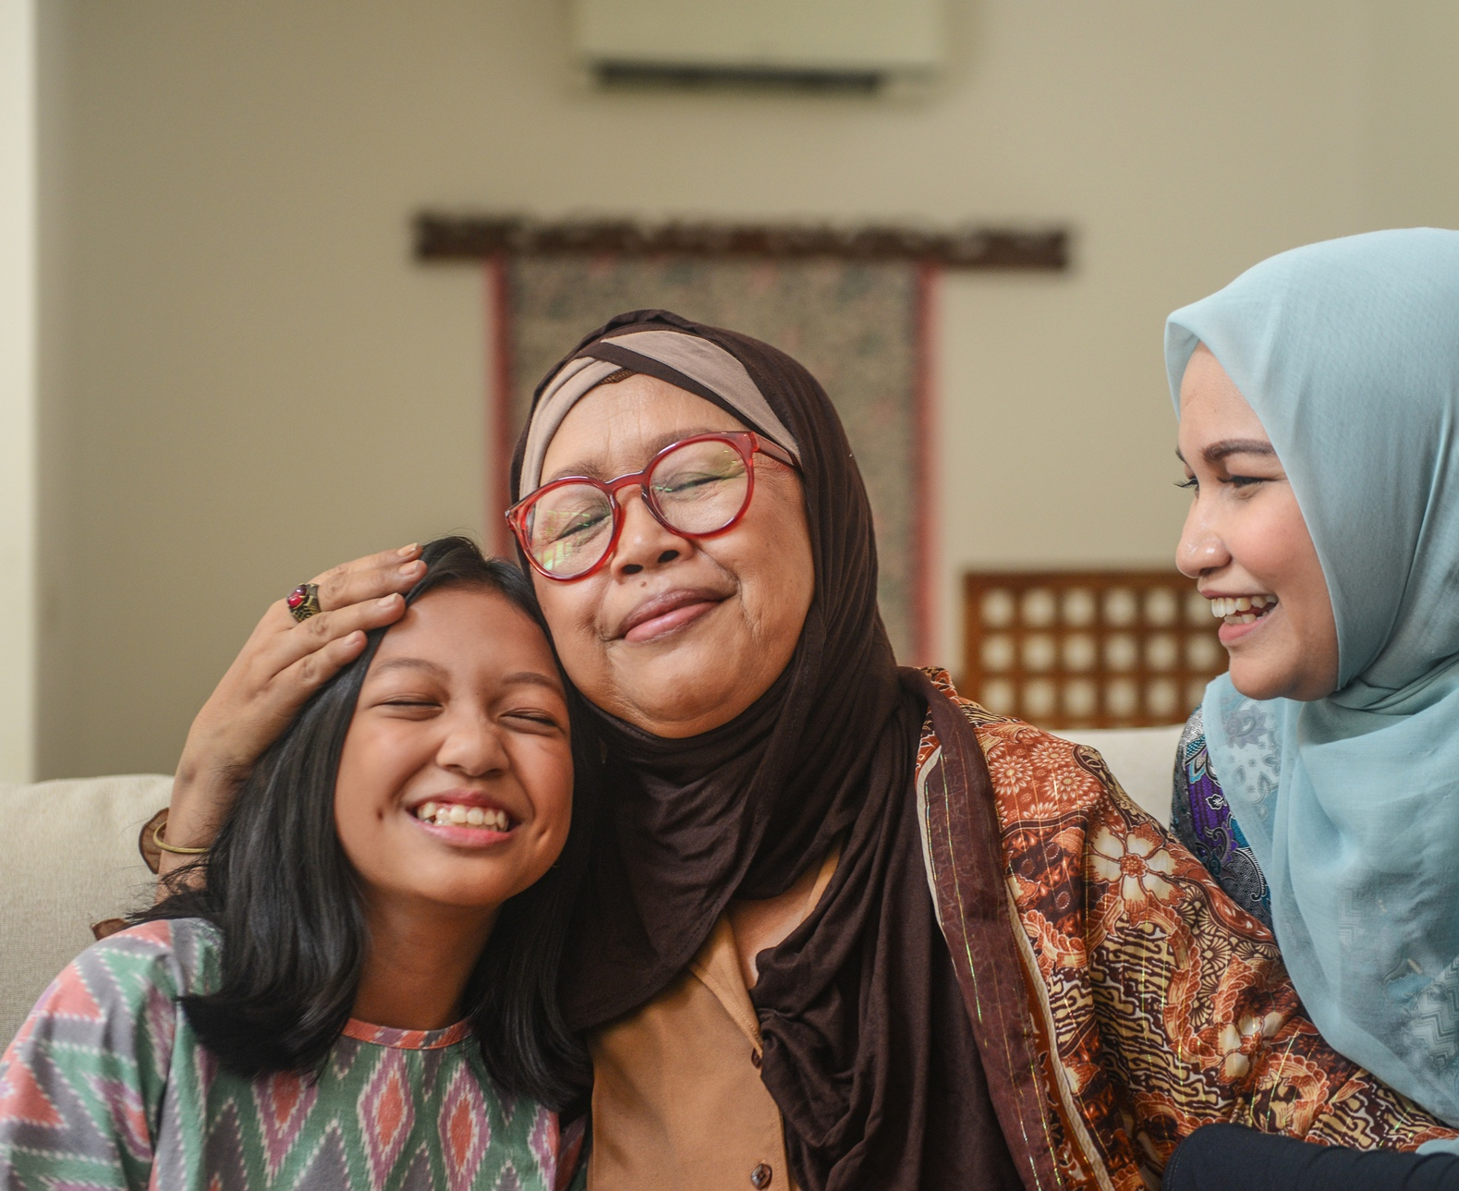
Extending Empathy
We’ve all been on the receiving end of another person’s judgement based on unfair generalizations, stereotypes, prejudice, or preconceptions.
Not all forms of discrimination are equally harmful, and we cannot judge another person’s suffering.
The point is to make a connection, drawing upon our experiences to relate to people different from ourselves.

Slide 9
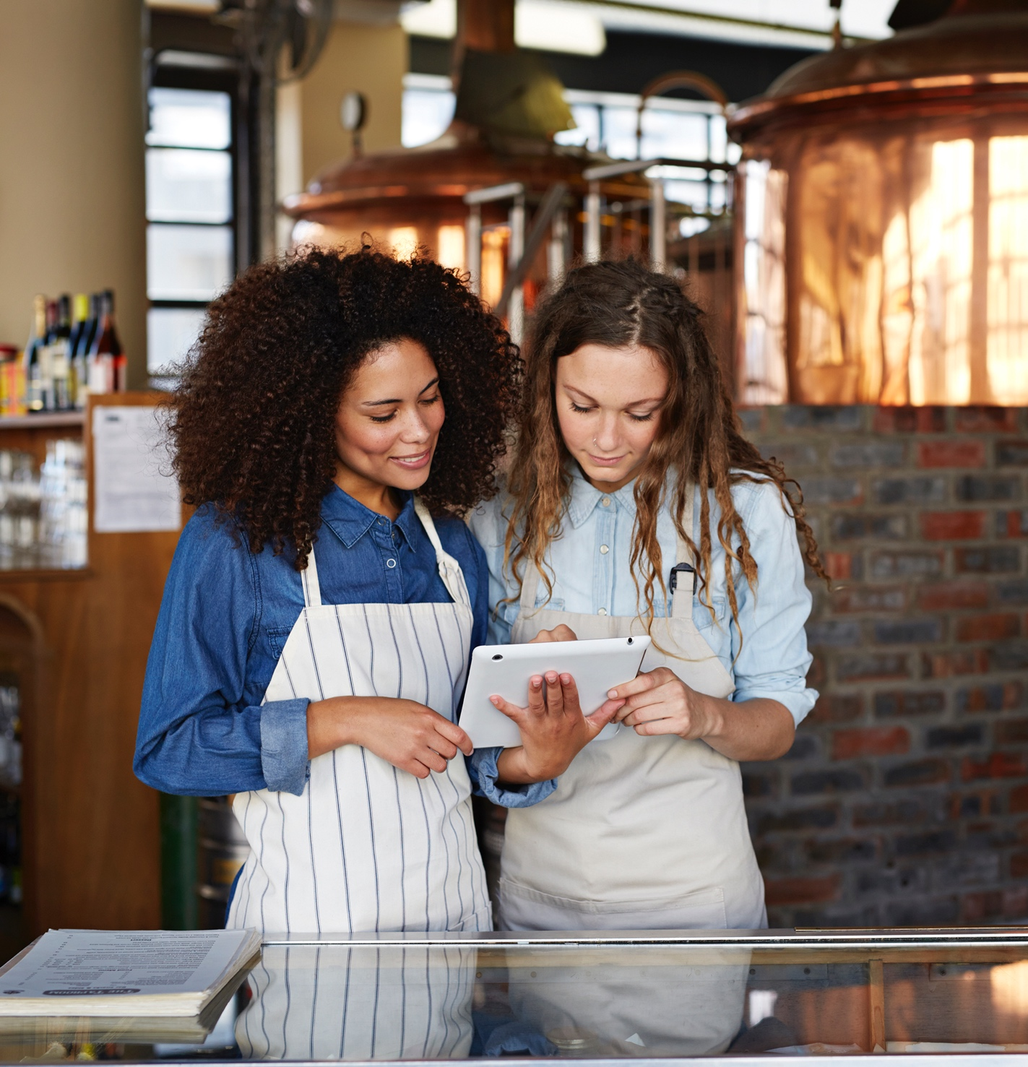
Taking Personal Responsibility
The first step to becoming a more equity-minded, empathetic person is to take responsibility for one’s own thoughts, biases, and actions.
Responsibility begins with accepting that we have participated (knowingly or unknowingly, intentionally or unintentionally) in actions that harmed others based on their identities. It also means acknowledging that we have enjoyed privileges based on our identities that others do not share.
When we courageously uncover our unconscious biases, own them, and strive to eradicate them, we take a step toward becoming better human beings. This includes educating ourselves about equity and becoming more sensitive to our gut-level reactions to others.

Slide 10

A New Look
Part of this responsibility is to look at our curriculum with a set of fresh lenses.
Consider the examples you use in your instruction. Are most of the notable persons you talk about white and male? Have you always taken this fact entirely for granted?
How might you incorporate diverse examples in your teaching to highlight the achievements of people with diverse identities?

Slide 11
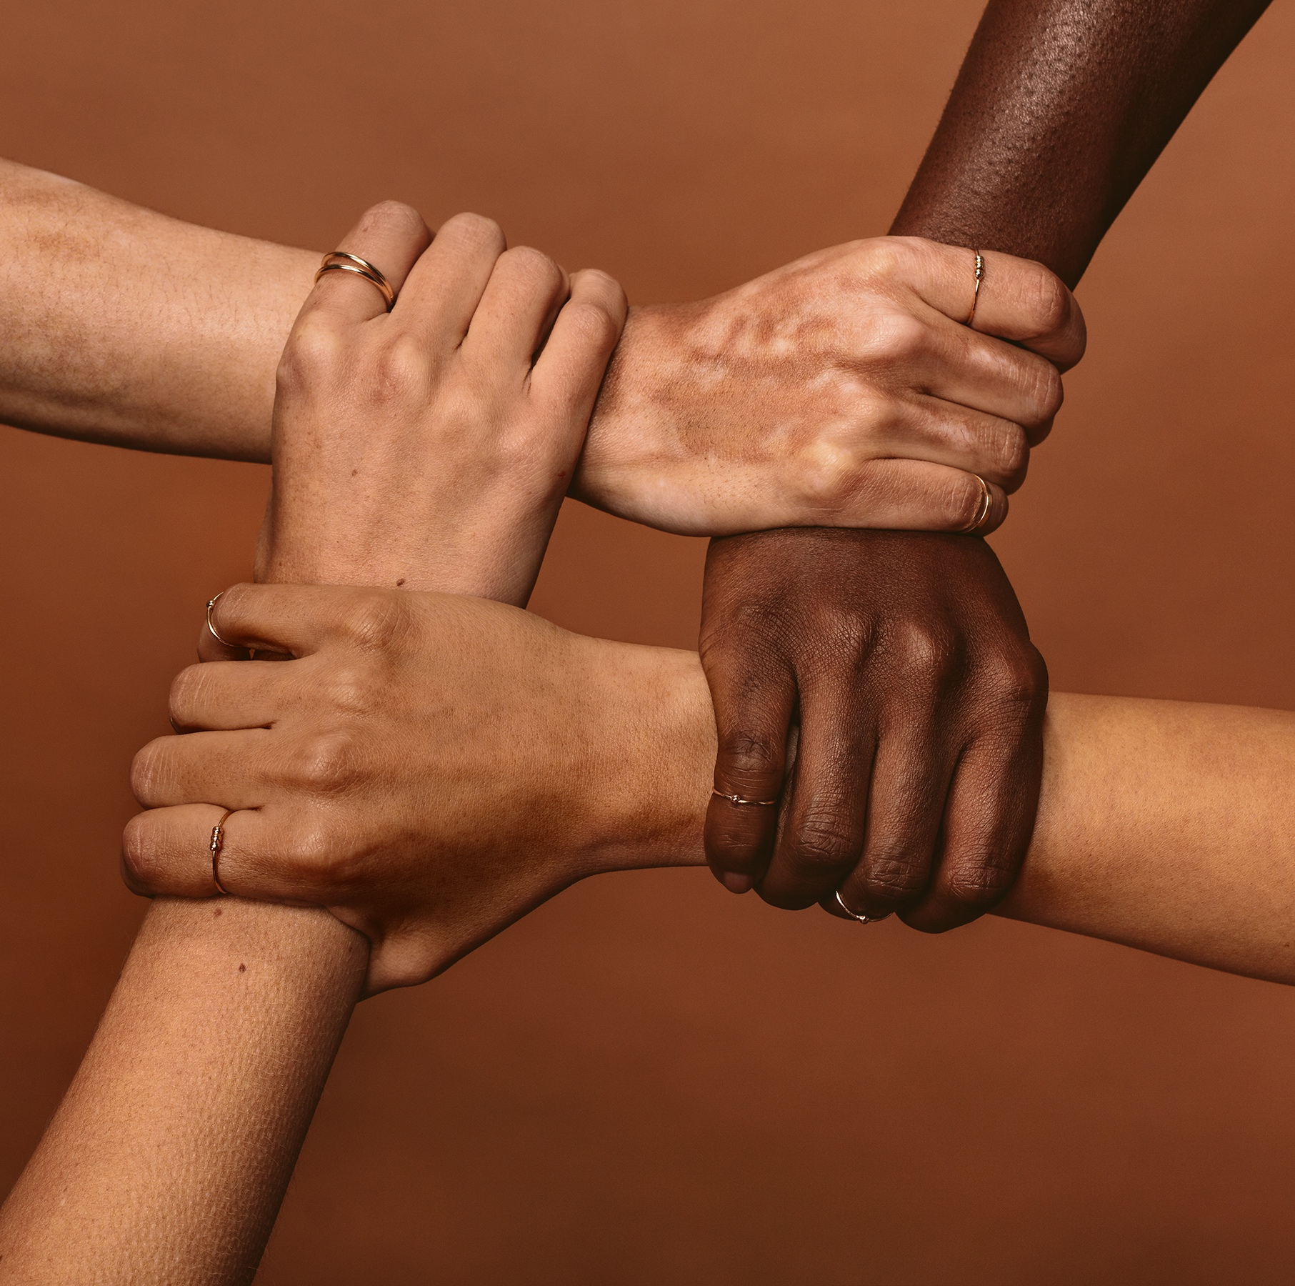
Reaching for Diversity
How might you teach your students about the impact of your discipline (both good and bad) on diverse populations?
How can you implement purposefully designed, aesthetic, creative communication in/through/with/about your academic discipline that motivates students to develop critical consciousness, builds community, and inspires them to work towards a more just society and a better world for future generations?

Slide 12

Partner Discussion
Find a partner who teaches in your department or in a field similar to yours.
Answer these questions together:
  What is the demographic profile of the notable people we teach about?
  How can we incorporate more diverse examples?
  What is the impact of our discipline on diverse populations?
  How could we leverage our discipline to work toward a more just, equitable, and compassionate world?

Slide 13
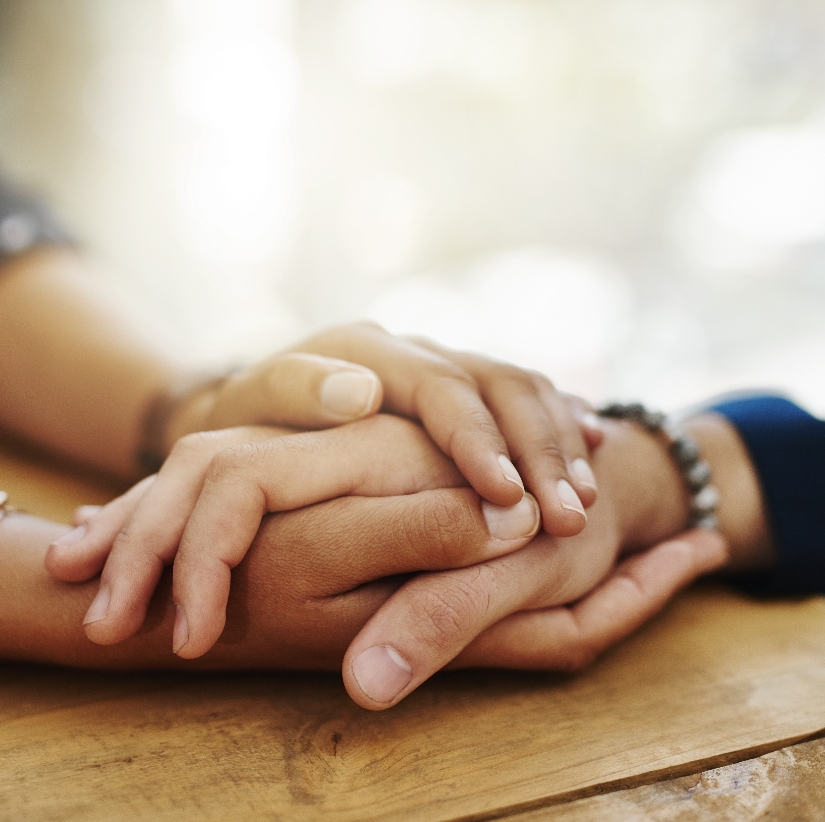
Pity, Sympathy, Empathy, and Compassion
Let’s look at the handout “Topic 13 Resource: From Pity to Compassion” to explore these mindsets.
Read through the table (5 min.)
Turn to a partner and discuss what surprised you or resonated with you (5 min.)
Then we’ll share our ideas with the whole group. (5 min.)

Slide 14

Radical Inclusion
Our classrooms are rich environments in which we can advocate for the values of radical inclusiveness, radical reconciliation, and helping people live their potential.
Radical inclusion means welcoming all persons who are interested in becoming a member of a group.
Gaining access to higher education has a profound impact on “populations at hope” – those students whom others would call “at risk” – providing them with the tools for succeed and ability to make a difference in the world.
How will we support students who need more of our help or attention than others? How should we approach students who do not meet our prior expectations?

Slide 15

Radical Reconciliation
Radical reconciliation takes radical inclusion a step farther, offering special consideration or support to persons from populations that have experienced extreme discrimination.
This idea began as an attempt to address racial discrimination, but it can be extended to the members of many disadvantaged or oppressed groups, sometimes as financial assistance, individualized programs of study, or by providing additional supports such as adaptive curricular materials, tutoring, or exemptions from standard admissions requirements.
Each of us can facilitate opportunities for our students, paying particular attention to those who would not usually be able to achieve academic success within institutional structures that maintain an implicit bias towards students who more closely meet traditional expectations.

Slide 16

Impact of Income Inequality
Income inequality has a wide-reaching impact on students. Students who grow up in lower socioeconomic households:
  Are likely to have received poorer healthcare and nutrition throughout childhood, which can lead to cognitive or physical problems in later life.
  May have experienced lower-quality verbal exchanges with adults and have less language development from an early age.
  Often believe that their ability to succeed is pre-determined (a “fixed mindset” such as “I’m not good at math”) as opposed to believing they have the power to learn, grow, and succeed academically (a “growth mindset”).

Slide 17
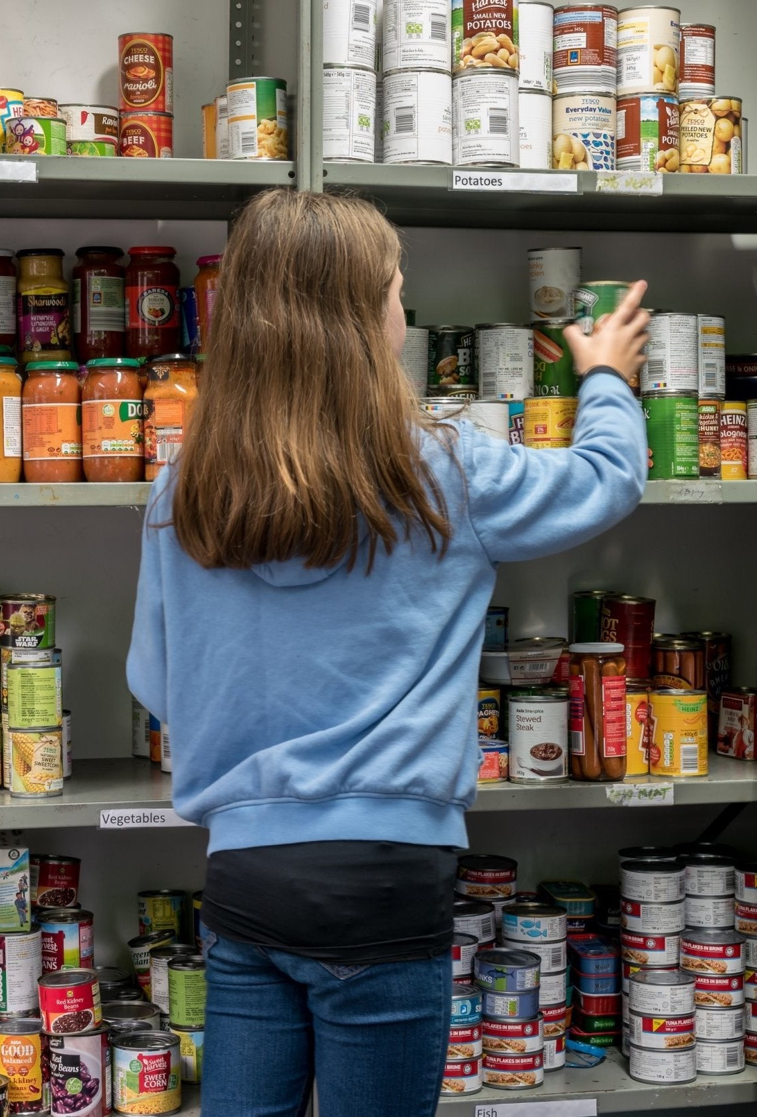
More About Income Inequality
  Students who grow up in low-income households may not have developed the same cognitive skills or been exposed to the same quality of educational experience as their more affluent peers. For example, they may have had fewer opportunities to engage in creative problem solving or to experience the arts.
  They are more likely to have had traumatic early experiences such as the loss or desertion of a parent, unreliable availability of food, being the victim of a crime, or to have experienced trauma caused by poor housing or homelessness, any of which cause them to have difficulty in assimilating into social groups or forming high-quality personal relationships.
  They have fewer financial and social resources, lacking the ability to pay for project supplies, participate in field trips, or even to socialize in the same manner as their more financially stable peers.

Slide 18

Role Models and Mentors
Such students, as well as those from other diverse or non-traditional backgrounds can encounter social isolation, may lack an established support network, or sometimes face a shortage of mentoring or professional opportunities, particularly when the institution employs comparatively few faculty members of color.
Furthermore, many such students are the first generation in their families to enter higher education, so they do not possess prior knowledge of what is socially necessary for success in academic environments.

Slide 19
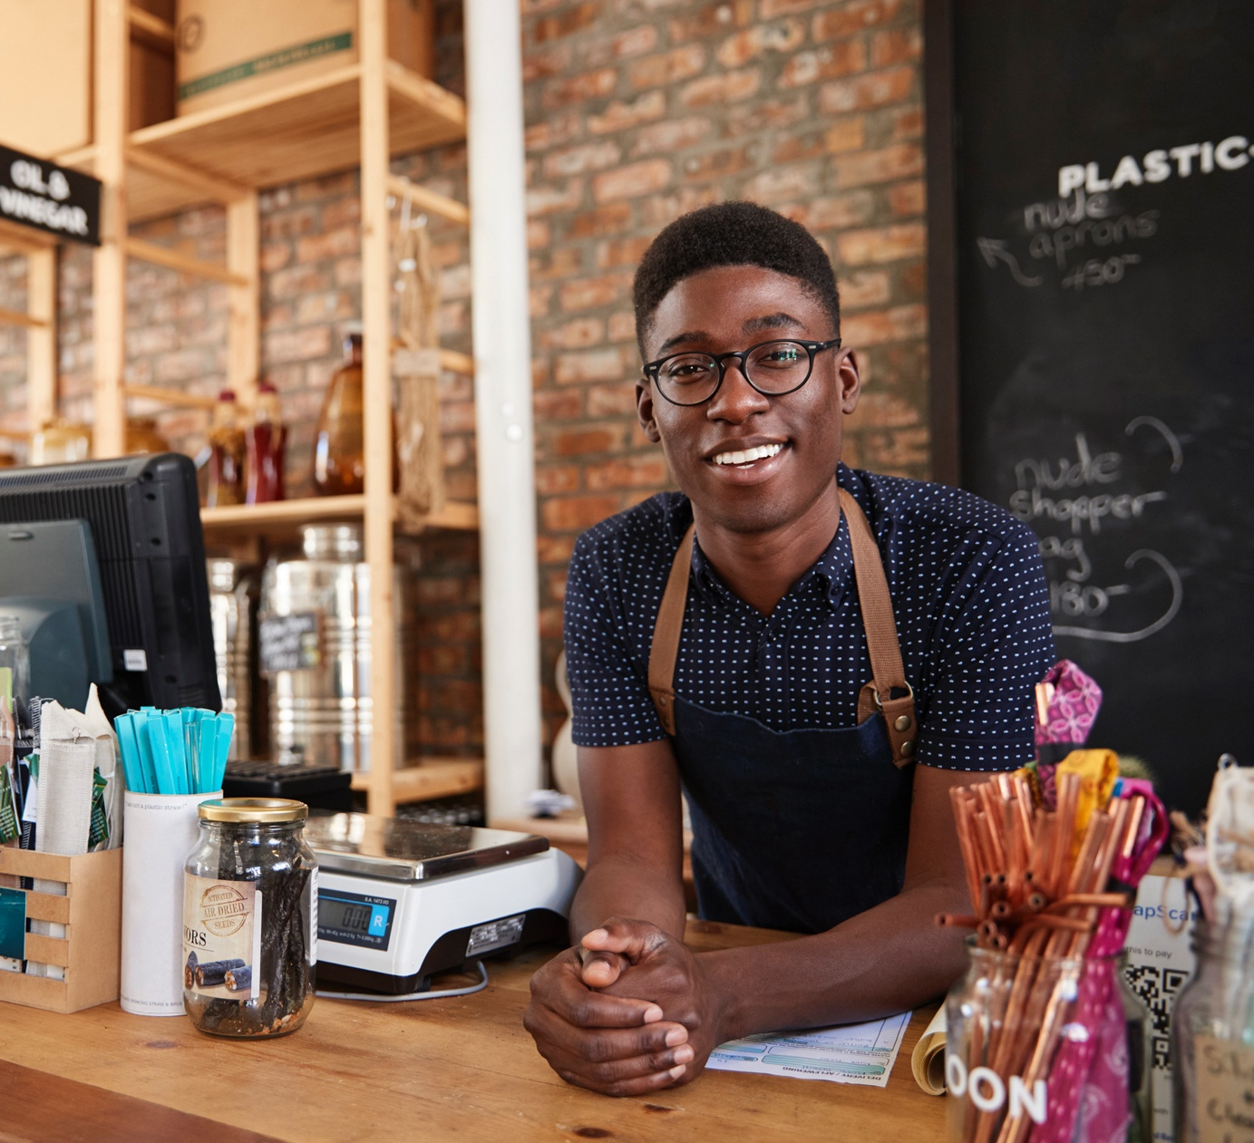

Unintentional Exclusion
When in every class you enter, you are the only one or among only a few of your racial group in that class, it might signal to you that you don’t belong.
Or if in every class, all your professors are white, it might signal to you that smart people of color don’t belong here.
Or when the only people who look like you are cutting the grass, emptying the trash or frying French fries in the food court that might suggest to you that my people are not thought of as professorial or professional.
Not that custodians, groundskeepers and food service employees are not professional; but they are not located at the power epicenter of the campus.
Shaun R. Harper, Executive Director of the USC Race and Equity Center

Slide 20

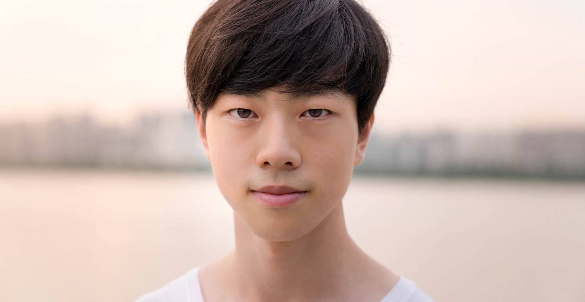
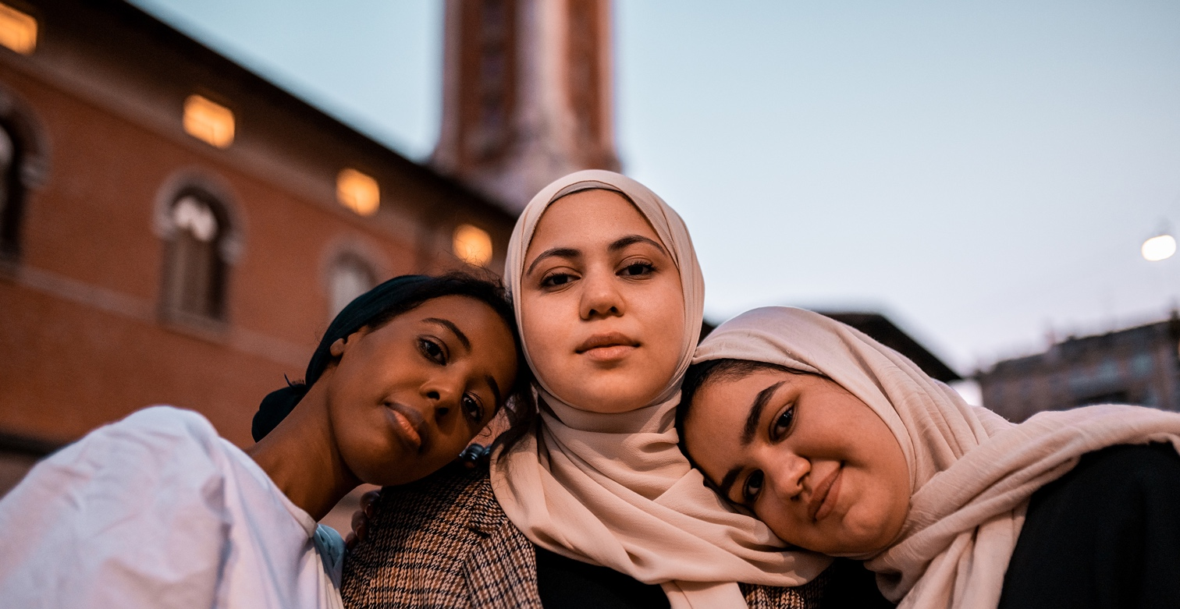
Reflection Point
Let’s pause to imagine the college experience through the eyes of a diverse student.
What if …
  Faculty never mentioned notable figures in the discipline who looked like you or shared your cultural background?
  Everyone seems to have more money than you do?
  Your peers talk about things you’re never experienced, like taking vacations, participating in co-curricular activities, taking advanced or honors courses?
  Nobody shares your holidays and traditions?
  The campus dining facility, nearby restaurants, or local grocers don’t offer any foods from your culture?
  Nobody looks or dresses like you.

Slide 21
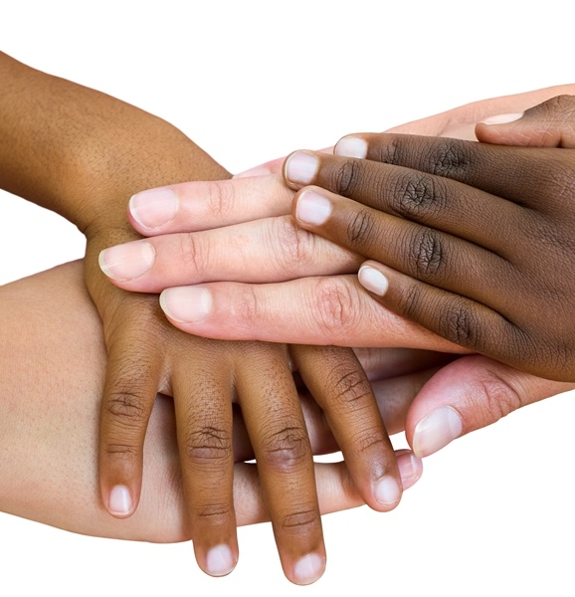
Diversity-Rich Curriculum
  Includes many voices – utilizes writings, speeches, dialogues, films, etc. that originate from people of different social identities, cultural backgrounds, gender, and disabilities
  Communicates interconnectedness - the development of a sense that we are connected to others beyond our immediate experience and geographic area
  Values diversity and equity – embeds information and techniques designed to impart a sense of why diversity and equity are important
  Promotes transformative thinking – challenges traditional views and assumptions; encourages new ways of thinking; and re-conceptualizes the field in light of new knowledge, scholarship, and new ways of knowing

Slide 22

Making Connections
The inclusion of non-traditional students from diverse backgrounds in our classrooms provides us with opportunities to grow and learn alongside our students.
When we practice “two-way teaching” we maintain an open mind towards our students, not just expecting that students will learn what we have to teach, but also remaining open to the possibility that students may have something of value to teach us in return.
In these cases, everyone in the classroom can learn from one another.
This also helps us to avoid perpetuating a view that our own culture is dominant, and others should simply assimilate our values and practices.

Slide 23
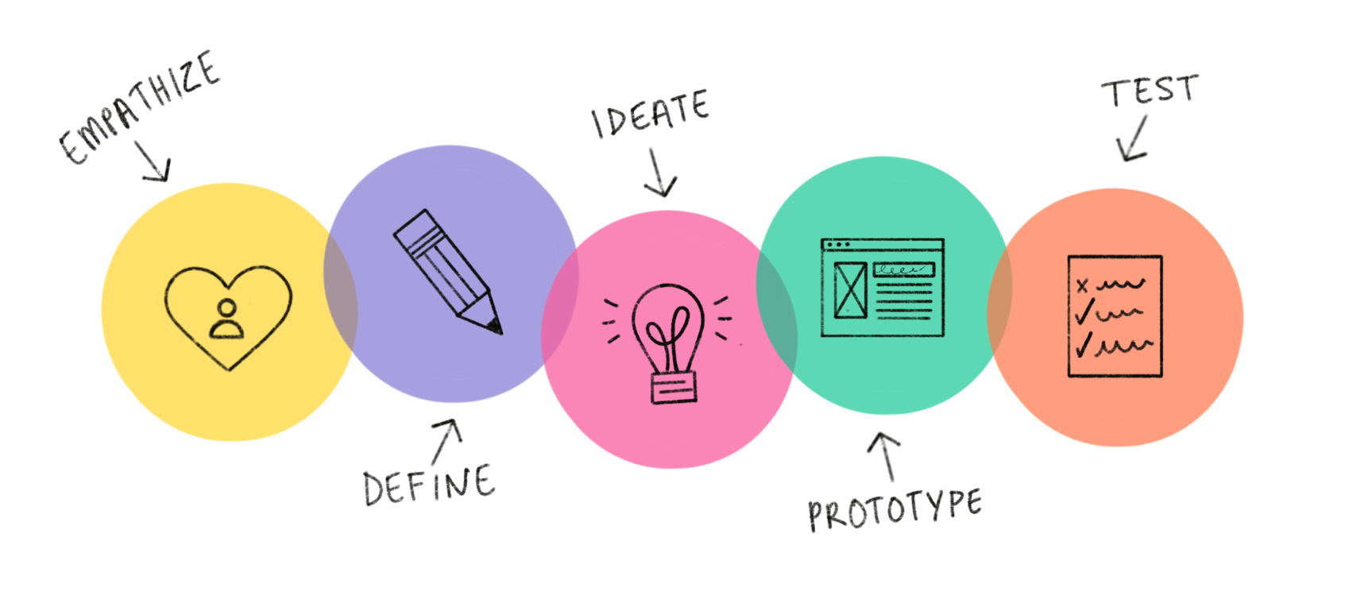
Course Design (Thinking)
Start with empathy
  Talk to the people for whom you’re (re)designing the course.
  Ask questions and really listen to their answers.
  Seek to understand the history of the problem. What has been tried already? What do they want? What do they need?
Set aside your cultural assumptions.
  Beware the “White Savior Complex”
Solicit feedback from students, asking what you can do to meet their needs and improve your course for your diverse learners.

Slide 24
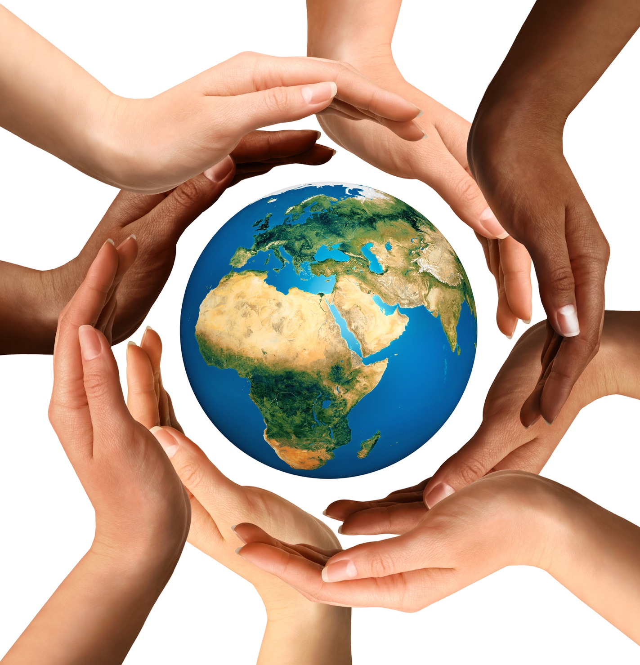
Remember
The first step in overcoming bias is to become aware of it in ourselves, our disciplines, our institutions, and our society. We cannot work to right a wrong that we do not perceive.
Foster an environment of critical inquiry in your classroom that leads students to question social and disciplinary norms.
Practice radical inclusion and radical reconciliation.
The more we build bridges between people who exhibit dimensions of diversity different from ourselves, the more we work towards a more just, equitable, and inclusive world in which all persons are free to live their potential.

Slide 25

Questions?

Slide 26
Gordon, L. (Jan 3, 2018). Racial minorities feel like outsiders at some colleges, USC diversity expert says. College & Careers: EdSource. https://edsource.org/2018/racial-minorities-feel-like-outsiders-at-some-colleges-usc-diversity-expert-says/591725

