Slide 1

Topic 11: Communicating with Students
Course Design Institute 2022

Slide 2

On a scale of 1 to 5, how effective are your communications with students?
It feels like I’m shouting into a void most of the time.
Sometimes students respond, other times not.
Students hear what I say in class but don’t pay attention to email.
I feel like I reach most students most of the time.
I’m a rock star communicator!

Slide 3

Leverage the Syllabus
The first (and perhaps most important) step to establishing effective communication with students is to leverage your syllabus.
Include detailed statements about what students can expect from you and what you expect from students.
Provide grading criteria and instructions for any significant assignments or projects.
Publish a calendar, outline, schedule, or checklist with specific due dates and deadlines.
Explain these items on the first day of class and refer to them whenever necessary or advantageous in class.
NOTE: we’ll talk about creating a student-centered syllabus in Topic 14 tomorrow.

Slide 4

Use TILT
TILT stands for Transparency in Teaching and Learning.
Transparency means disclosing all expectations for student performance, providing:
Written instructions for every assignment
Grading criteria, including tools such as rubrics or checklists
Examples of successful and unsuccessful student work
Detailed criteria for what will be covered on exams and how they will be graded
Explanations of the course’s grading schema
Rationale for any student action that could impact their grade

Slide 5

More About TILT
Transparency also means providing an explanation of how everything that could produce or impact a student’s grade links to the course’s objectives and outcomes.
No expectation is left unspoken – nothing is implied or presumed.
There are no surprises (pop quizzes, unannounced assignments, unarticulated grading penalties)

Slide 6

Tools and Tips
The more tools and resources we can provide for students, the more likely it is that they will meet our expectations and achieve success in the course.
Calendars
Checklists
Schedules
Outlines
Lecture notes
Study guides
Supplementary readings, how-to videos, links

Slide 7

Email Expectations
The syllabus should include a statement that email is your primary means of communicating with students outside of class time.
Specify that students should check their email at least once per day.
Although students tend to use other communication tools more often (text messaging, for instance), faculty should not communicate with students through their personal phone numbers.
Emphasizing that email is the main communication tool sets expectations congruent with workplace norms.

Slide 8

Email Etiquette
We all use email for work, and most of us already follow typical norms for professional written communication (using complete, grammatically correct college-level English, and so on).
Email exchanges with students should also adhere to these norms, with a few additional recommendations.

Slide 9

Email Rule 1 – Be Prompt
Just as we appreciate prompt replies to the email we send, students also deserve a prompt response when they email us.
It’s best to reply the same day, preferably at the earliest reasonable opportunity.

Slide 10

Email Rule 2 – Be Accurate
Spelling and grammatical errors are a fact of life, especially when auto-correct is involved.
However, students expect their professors’ written communications to be letter-perfect. A typo can be embarrassing at best and a serious problem at worst.
Always proofread any email or other written message before hitting “submit” or “send”.

Slide 11

Email Rule 3 – Be Kind
It takes a great deal of courage for some students to reach out with questions or to tell us they’re experiencing a problem.
Our response to every student email should be exceedingly warm, kind, polite, and encouraging.
Even if we would say something in a much more straightforward manner face-to-face, our email can come across as brusque or terse if we write the same words. Therefore, making an extra effort at kindness is warranted.

Slide 12

Example
Let’s imagine you receive this email :
“I was starting to work on the assignment that’s due tomorrow but I can’t find the directions you gave us so I need you to send them to me again.”
Naturally, the student’s irresponsibility in waiting until the last minute to begin the assignment, their demanding tone, and their poor grammar might set our teeth on edge.
Even so, the best option is a kind reply giving the student the necessary information.
“[Student name] thank you for your email. The assignment instructions were on page 10 of our course syllabus, but I’ve also attached them to this email. I’m glad you reached out for this information so that you could submit your work by tomorrow’s deadline. I look forward to receiving your work. See you in class tomorrow – Professor Jackson.”

Slide 13

Turn and Talk
What are your thoughts and feelings about these “email rules”?
Turn and talk to someone near you.
Discussion.

Slide 14

Err on the Side of Compassion
When students tell us they need an extension on a deadline or are having trouble keeping up with their work, it’s only natural to feel somewhat annoyed.
Our course policies exist for a reason, which can make us reluctant to make exceptions.
Try to put yourself in the student’s place for a moment. What if you were taking a professional development course and needed more time to complete an assignment? How would you want the course facilitator to respond to your request? What if your child were asking their professor for leeway? How would you want the professor to respond?
Whether you ultimately decide to grant the request or not, a kind and compassionate reply helps build rapport and engagement. A brusque reply undermines the student’s trust in you and can be harmful to their self-confidence.

Slide 15
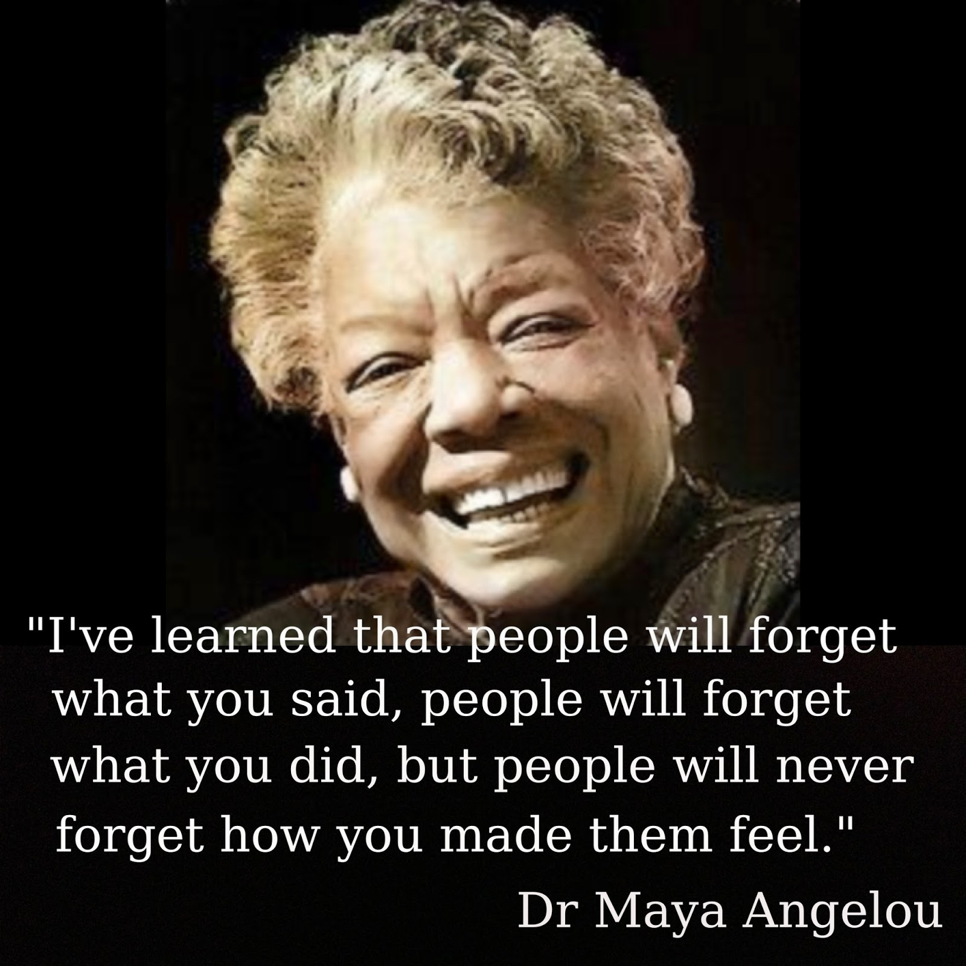
Emotional Impact
The feelings your communications with students inspire speak more loudly than your message.
Before you express your annoyance or irritation, or even if you prefer a minimalistic writing style, pause to consider the tone and emotional impact of your words.

Slide 16

Proactive Outreach
Communicating with students is more than just replying to email.
We can also use email proactively as soon as we notice a student developing a pattern of absences or missing work.
Be especially careful about the wording of your outreach messages. Your goal is to get the student to return to full participation in the course, so the tone should be warm, caring, and inviting.
Telling students that they are in danger of failing the class if they don’t take care of the problem immediately can come across as judgmental and alienating.
Telling students that you care about them, are concerned for their wellbeing, and are eager to help them with whatever challenge they’re facing so that they can pass the course successfully creates motivation to respond positively.

Slide 17

Be Persistent
We can also use communication to our students’ advantage by being very persistent in our messaging.
Don’t give up after sending a student just one email. Email them every day. Email (or call) their academic advisor. Contact the student support team. Keep trying every avenue of communication until the student responds.
Frequent whole-class messaging can help students stay on track.
Consider sending a weekly “Monday Morning Message” email with reminders of upcoming due dates and other information students must know.
This message is also an opportunity to build rapport by keeping the message positive and encouraging, and to reinforce students’ learning by listing the important topics you’ll cover during the week.

Slide 18

Intention and Invitation
We communicate through more than our planned instruction. Everyday mannerisms such as our habitual tone of voice, word choice, and body language send a message to our students, whether we’re aware of it or not.
The same is true of both our deliberate and inadvertent approaches to pedagogical practice.
We constantly invite or disinvite our students to learn, both intentionally and unintentionally. William Purkey (1991, 2015) categorizes these instructor behaviors as seen in the following table.

Slide 19
Intention and Invitation Matrix
Intentionally Disinviting Deliberately discouraging, verbally demeaning Too busy to take the time to assist students Focused on others’ perceived shortcomings Actively seeking to harm, oppress, or discriminate against others | Unintentionally Disinviting Well-meaning but condescending Focused on policies and procedures Oblivious to the feelings of others Unwilling to extend empathy or to make exceptions to stated policies
Unintentionally Inviting Well-liked Reasonably effective Inconsistent and uncertain when making decisions Able to explain what they do as teachers but not why they do it; unaware of the reasons behind success or failure | Intentionally Inviting Optimistic, respectful, trustworthy Affirming while also guiding students Fluency in teaching to the point where it seems natural or effortless Focused on students as whole people rather than merely the aspects we see in our classrooms

Slide 20

Collaborative Activity
Work with a partner to rewrite the professor’s email as an intentionally inviting response.
Student email:
“Professor James, I won’t be able to turn in my research paper on Friday because I’ve had the flu this week. May I please have until Monday to finish it? Sincerely, Elliot.”
Professor’s reply:
“No, Elliot, you absolutely may not have an extension. You have had six weeks to work on this paper and leaving it until the last minute was irresponsible, even if you were sick. As stated in the syllabus, a 5-point deduction will apply to the grade for every day the paper is late.”

Slide 21

Everything Speaks
Communication encompasses more than our spoken and written language.
Every interaction we have with students, in person or online, in writing or face-to-face, communicates volumes.
Facial expressions
Gestures
Posture
Tone of voice
Habits and mannerisms

Slide 22

Physical Immediacy
“Immediacy,” refers to the overt forms of communication that help to establish connections between faculty and students. Physical immediacy includes the following actions:
Gesture while talking to the class
Look at the class while talking
Smile at the whole class while talking
Move around the room while teaching
Maintain a relaxed posture or body position while talking to the class
Smile at individual students while talking to the class
Use a variety of vocal expressions while talking to the class

Slide 23
Verbal Immediacy
Use personal examples or talk about experiences outside of class
Ask questions or encourage students to talk
Engage in discussions based on something a student brings up even when this isn’t part of the planned lecture
Use humor when appropriate
Address students by name
Engage in conversations with individual students before or after class
Use phrases like “our” class or what “we” are doing
Provide feedback on students’ individual work through comments on assignments
Ask students how they feel about an assignment
Invite students to meet outside of class if they have questions or want to discuss something
Praise students’ work, actions, or comments
Discuss topics unrelated to class with individual students or with the class as a whole.
Being friendly, warm, approachable, and inclusive goes a long way toward building appropriate rapport with students

Slide 24

Benefits of Immediacy
Physical and verbal immediacy shows students that you’re a genuine human being, relating to them at a more personal level.
Witt, Wheeless, and Allen (2004) conducted a meta-analysis of 81 studies involving nearly 25,000 students, which revealed a high degree of association between immediacy and students’ positive attitudes toward their instructor and the course. It also increased students’ perception of their own learning and their retention of course material.

Slide 25

Rapport
Most students are more receptive to learning when they believe that their instructor cares about them and can trust that they will be treated fairly. This belief is essential to establishing rapport, both in face-to-face or online learning environments.
Positive rapport increases student enjoyment of the course, improves attendance and attention, promotes additional enrollment in subsequent courses, affects the broader classroom climate, and reduces classroom conflicts.

Slide 26

Teachable Moments
Teaching occurs every time we interact with our students, not just when we’re standing behind the lectern.
When you respond brusquely to inquiries, you teach students that you think poorly of them or that you can’t be bothered to help them.
When you treat students with respect, you teach them that they are worthy of respect.
When you encourage your students, you teach them that they possess the capacity to be successful.

Slide 27

Moving On
We have two more topics to cover today, so we will not use a worksheet to strategize about communication with students.
Next, we’ll consider another aspect of communication: how to deliver effective feedback.

Slide 28
Witt, P. L., L. R. Wheeless, and M. Allen. (2004). “A meta-analytical review of the relationship between teacher immediacy and student learning.” Communication Studies 71:184–207.
Purkey, William. (1991). What is Invitational Education and How Does It Work? Presentation at the International Conference on Self-Esteem, Santa Clara CA. Feb. 1991. ERIC Number: ED334488; see also Purkey and Novak (2015) An Introduction to Invitational Theory, from the International Alliance for Invitational Education, https://www.invitationaleducation.net/
Myers, S. (2009). Do Your Students Care Whether You Care About Them? College Teaching. Vol. 57/No. 4. p. 205-210. Heldref Publications.
In Myers (2009) from Richmond, Gorham, and McCrosky (1987). “The Relationship Between Selected Immediacy Behaviors and Cognitive Learning.” Communication Yearbook. 10:547-90

