Slide 1
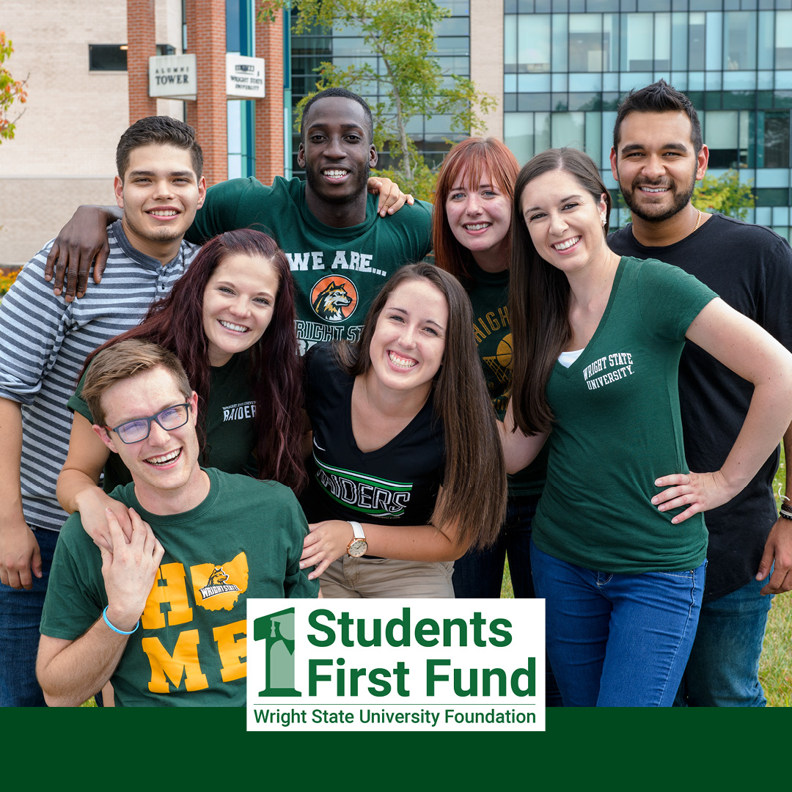

Slide 2
What is the Students First Fund?
Grants program created by the Wright State University Foundation
Provides one-time funding to support the student experience
Helps fund initiatives that will have a direct impact on:
Student Success
Recruitment
Retention
Relationships

Slide 3
Who Can Apply?
All Wright State University students, faculty, and staff with a proposal to promote student success are welcome to apply.
How Much Funding is Available?
$50,000
Distribution will be dependent on the number and quality of the proposals received.

Slide 4
What Types of Projects Will Be Considered for Funding?
Student recruitment and retention initiatives
Student success initiatives
Leadership programs
Educational enhancement activities
Workforce development activities and programs
Community/corporate engagement activities
Mentoring programs
Experiential learning activities
Student life and campus engagement initiatives

Slide 5
Are There Any Restrictions on the Students First Fund Grants?
The Students First Fund does NOT fund:
Scholarships or individual student support
Standard operating expenses or salaries/benefits
Travel expenses (unless they are integral to the program)
Food and beverage requests should be minimal.
This is one-time funding. You must be able to identify other sources of funding moving forward.

Slide 6
What is the Timeline for Funding?
Grants awarded annually in April.
Funding available to use in Fall Semester.
How Do I Apply?
www.wright.edu/StudentsFirstFund

