Slide 1
Reportable Events & Revised Common Rule
WSU IRB Member Training
November 19, 2018

Slide 2
Revised Common Rule
January 21, 2019 Compliance Date
Federally-Funded Only – No Checkbox
Working Group since August 2108
Revised Policies
Exempt Review
Expedited Review
Informed Consent

Slide 3
Exemptions
New/Revised Categories
Expedited → Exempt 2019
Limited IRB Review
One member
Limited to privacy and confidentiality
Chart reviews
Now retrospective and prospective
Can include identifiers, if HIPAA-regulated
Require amendment for personnel/data changes

Slide 4
Expedited Continuing Review
Categories Not Revised ~ 300 studies
FDA-regulated – CR still required
New federally-funded studies must not have “CR”
Administrative Update Every 2 Years – Reviewed by IRB Office
Amendments/Reportable Events still required while study is open

Slide 5
Informed Consent
Key Information Summary
New Consent Elements
Changes to Full Waiver Justification
No waiver for recruitment screening
Consent posted no later than 60 days after last study visit – FF Clinical Trials
Not permitting “Broad Consent”

Slide 6
Next Steps
Complete Policy Revisions
Adjust InfoED Module to Reflect Changes
Train IRB
Read Policies/Guidance Documents
January 28th Meeting
Train Investigators
Training PPTS on Website

Slide 7
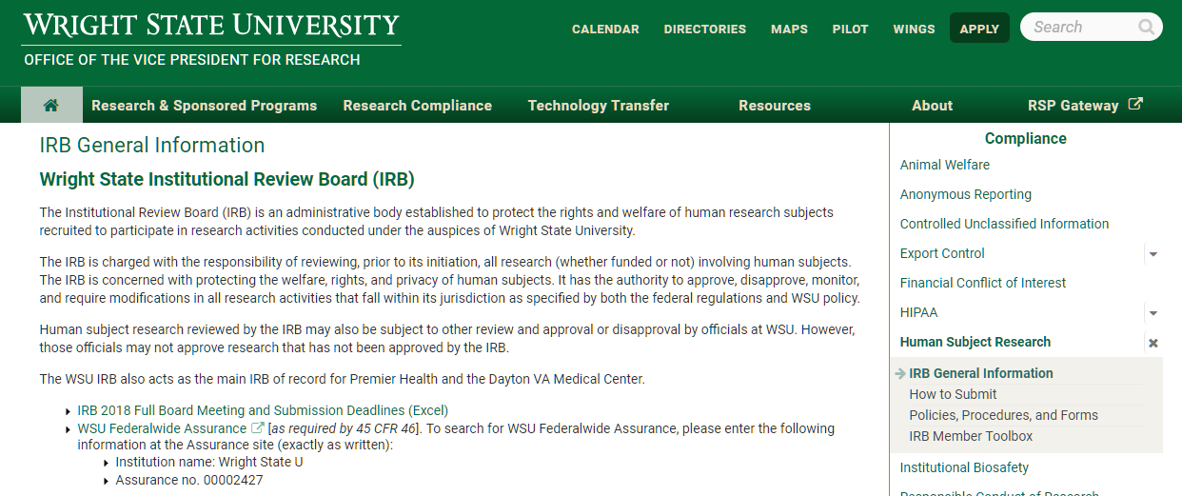
https://www.wright.edu/research/compliance/irb-general-information

Slide 8
The What and Why
In-depth review of WSU’s research policy entitled Reportable Problems or Events
To ensure that you understand how to be compliant with the new policy when reviewing the Reportable Event Form

Slide 9
Scope
Problems/Events Reported to Sponsor/Other
All Problems/Events
Problems/Events Reported to IRB

Slide 10
Reporting Responsibilities
PI – Ultimately responsible for:
Reviewing any and all problems/events associated with study
Ensuring that all reporting is consistent with requirements
Ensuring that all study team members understand reporting process prior to initiation of study
Study Team Members – Responsible for understanding reporting requirements before engaging in any study activities

Slide 11
Reporting Responsibilities
WSU IRB –
Reviewing any potential unanticipated problems
Reviewing other problems/events that may indicate increased risk or potential new risks for subjects
Reviewing all reportable events/problems and determining whether to approve (i.e., continue with no mod), table (i.e., requires mod), suspend or terminate research
Reporting unanticipated problems and suspensions/terminations to IO

Slide 12
Prompt Reporting
Prompt reporting means reporting of problems or events that are defined in this policy should occur as soon as possible after the Principal Investigator (PI) learns of the event, but in all cases within 10 calendar days
Note VA requires UAP be reported to the IRB within 5 days

Slide 13
Submit via InfoED
Reportable Problem/Event Form
Subject Information
Study Enrollment Status
Type of Problem *PI “suggesting category”
Example: Major protocol deviation or privacy breach can also be determined by IRB to be UAP and/or non-compliance

Slide 14
Internal/External Unanticipated Problem
Unanticipated Problem Involving Risks to Participants or Others means:
The problem/event is UNEXPECTED in terms of nature, severity, or frequency, given:
The research procedures described in the protocol, Investigator Brochure, informed consent document and/or other study related documents; and
The characteristics of the subject population being studied; and
The information indicates the research places subjects or others at SERIOUS risk (as defined below) or an INCREASED RISK of physical, psychological, economic, legal, or social harm than was previously known or recognized, and
The problem/event is RELATED or POSSIBLY RELATED to the procedures involved in the research.

Slide 15
Serious
Means a problem/event that:
Results in death;
Is life-threatening (places the subject at immediate risk of death from an event as it occurred);
Results in inpatient hospitalization or prolongation of existing hospitalization;
Results in persistent or significant disability/incapacity;
Results in congenital anomaly/birth defect; or
Based on appropriate medical judgement, may jeopardize the subject’s health and may require medical or surgical intervention to prevent one of the other outcomes listed in this definition.

Slide 16
Change to Risk/Benefit Ratio
Information that indicates a change to the risk to benefit ratio of the research. For example:
An interim analysis indicates that participants have a lower rate of response to treatment than initially expected;
Safety monitoring indicates that a particular side effect is more severe, or more frequent than initially expected; or
A paper is published from another study that shows that an arm of the research study is of no therapeutic value

Slide 17
Change in FDA Labeling
Change(s) in FDA labeling (e.g., black box warning), withdrawal from marketing, manufacturer alert from the sponsor, or recall of an FDA-approved device, or biologic used in the research

Slide 18
Deviation for Immediate Hazard
Change(s) to the research (without prior IRB approval) taken to eliminate an apparent immediate hazard to a research subject
Notes:
Emergency removal of experimental cardiac device

Slide 19
Major Protocol Deviation
Any alteration/modification to the WSU IRB-approved research that has the potential to negatively impact subject safety or integrity of study data (ability to draw conclusions from the study data), or affect the subject’s willingness to participate in the study.

Slide 20
Major Protocol Deviations
Examples include, but are not limited to:
Failure to obtain informed consent (i.e., there is no documentation of informed consent)
Informed consent obtained after initiation of study procedures
Drug/study medication dispensing error
Performing a study procedure not approved by the IRB
Failure to perform a required lab test that, in the opinion of the PI, may affect subject safety or data integrity
Enrollment of a subject who did not meet all inclusion/exclusion criteria
Study visit conducted outside of required timeframe that, that in the opinion of the PI, may affect subject safety
Failure to follow safety monitoring plan

Slide 21
Incarceration of a WSU Subject
"Prisoner" is defined by HHS regulations at 45 CFR part 46.303(c) as "any individual involuntarily confined or detained in a penal institution. The term is intended to encompass individuals sentenced to such an institution under a criminal or civil statute, individuals detained in other facilities by virtue of statutes or commitment procedures which provide alternatives to criminal prosecution or incarceration in a penal institution, and individuals detained pending arraignment, trial, or sentencing."
Notes:
These concerns apply whether the research involves individuals who are prisoners at the time of enrollment in the research or who become prisoners after they become enrolled in the research. In the latter situation, it is unlikely that review of the research and the consent document contemplated the constraints imposed by incarceration.

Slide 22
Unresolved Subject Complaints
Complaint of or related to a WSU IRB research subject when the complaint indicates unexpected risks or the complaint cannot be resolved by the research team

Slide 23
Unanticipated Adverse Device Effect
Unanticipated Adverse Device Effect means any serious adverse effect on health or safety or any life-threatening problem or death caused by, or associated with, a device, if that effect, problem, or death was not previously identified in nature, severity, or degree of incidence in the investigational plan or application. Any other unanticipated serious problem associated with a device that relates to the rights, safety, or welfare of subjects.

Slide 24
Government Audits
Any audit, inspection, inquiry by a governmental agency, or correspondence with a government agency

Slide 25
Federal Reports
Any written report of a federal agency (e.g., FDA Form 483, Establishment Inspection Report (EIR), Warning Letter)

Slide 26
Sponsor Audit Report
Any written audit report by a sponsor regardless of findings
Notes:
Sponsor audits typically happen after study is conducted or if monitoring identifies a compliance issue or if inspection by regulatory agency.
Done to ensure compliance with protocol and regulatory requirements prior to FDA submission or to prepare a site for an FDA audit. Compared to monitoring which usually happens at study start-up, closure and some points in between. Sponsors are investing less and less in monitoring studies.

Slide 27
Internal Subject Deaths
Any internal subject death in a “greater than minimal risk” study, even if “anticipated,” if it occurs within 30 days of a study-related procedure/intervention or the administration of a study drug
Notes:
“Hit by a bus example”

Slide 28
Confidentiality Breach
Does the breach involve Protected Health Information (PHI)?
“The Privacy Rule requires that the covered entity review and address any potential privacy breach within 60 days of any Workforce Member discovering the breach. Therefore, prompt reporting of any Privacy Rule compliance issues is essential to meet this requirement.”
Use and Disclosure of Protected Health Information (PHI) in Human Subject Research
Notes:
Who understands what PHI is? Lost lap top, faxed CRFs to wrong phone number,

Slide 29
Submit via InfoED
Reportable Problem/Event Form
Event Description and Needed Actions
External Notifications
Research Team Review

Slide 30
IRB Review of Reportable Events
IRB Office – Screen whether meets prompt reporting category
Chair or Designee – Initial subject safety assessment
Full Board Meeting –
Discuss substantive issues (Controverted)
Determine Whether Additional Info Needed (Approved or Table)
UAP and Non-Compliance Determinations
Required PI Actions?
IO, OHRP, FDA Reporting?

Slide 31
Sponsor IND/IDE Safety Reports
The WSU IRB does not accept sponsor IND/IDE safety reports describing adverse events that have occurred at sites other than those subject to this policy (WSU, Premier Health, Dayton VA) unless the report is of an incident that is: (1) serious; (2) unexpected or unanticipated; (3) related to the investigational drug/device; and (4) suggests that subjects are at an increased risk of harm and as such warrants changes in the research, consent process, or informing subjects. IND/IDE safety reports that warrant changes must be submitted in InfoED as an Amendment, not a Reportable Problem/Event.

Slide 32
Reporting at Continuing Review
Minor Protocol Deviations via Study Deviation Summary Sheet
Internal Serious Adverse Events (that are not Unanticipated Problems) via Serious Internal Event Reporting Log
Sponsor Monitoring Reports that Require Corrective Actions

Slide 33
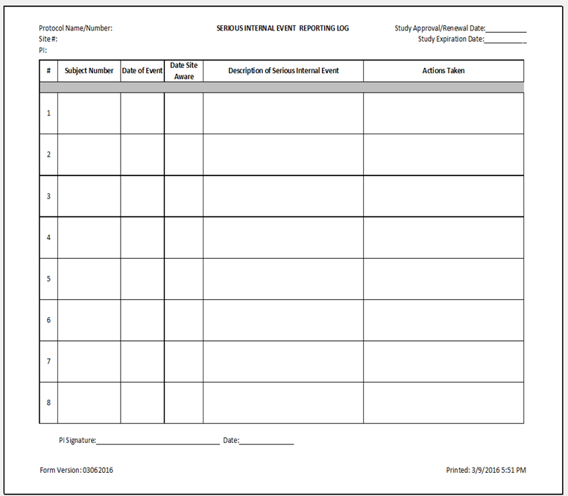
Reporting Forms
Study Deviation Summary Sheet

Slide 34
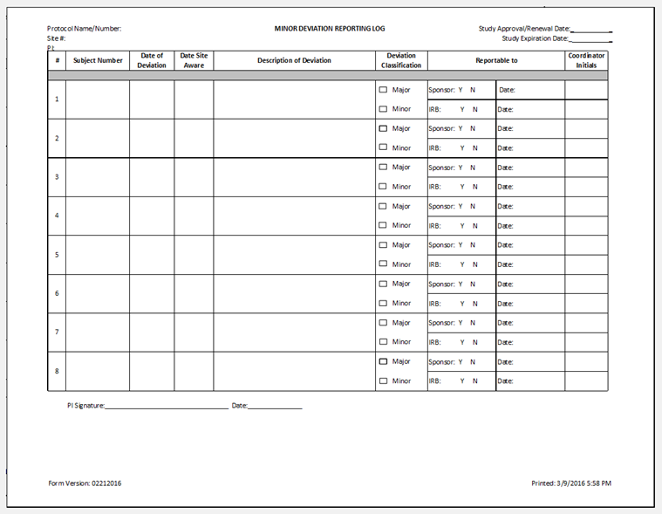

Slide 35
Prompt Report Needed?
Study procedures initiated prior to obtaining written consent per IRB-approved protocol
Subject received experimental radiation treatment 2 days prior to dying at their home
Subject did not show up for study visit and did not receive x-ray within 14-day window – received x-ray on day 17
Study team member’s iPad stolen in ED that contained identifiable study data
Subject hospitalized for expected side effect that was described within the informed consent document

Slide 36
Questions??

