Slide 1
Registration Restrictions and System-Enforced Prerequisites
Office of the Registrar
Spring 2019 Registration

Slide 2
Overview
History of the prerequisite implementation
Prerequisite checking
  Department-Managed (current)
  System-Enforced (new)
Registration Eligibility
Overrides
FAQs

Slide 3
System-Enforced Prerequisites
A plan in the making…
2015 - the Faculty Senate requested the ability to enforce prerequisite requirements at the time of registration. A task force was established to consider the implications.
2016 – mechanisms to support system-enforced and department-managed prerequisites was created. Departments began identifying courses that would have department-managed prerequisites

Slide 4
A plan in the making…
2017 – Data validation and testing – data analysis showed that, in several cases, prerequisite requirements (as they were written at the time) would block registration for an unintended populations of students. Departments worked through curriculum committees to fine-tune prerequisites.
2018 – Continued data analysis, registration validation, and fine-tuning of prerequisite requirements. System-enforced prerequisites to go live for Spring 2019 registration.

Slide 5
What is a department-managed prerequisite?
A prerequisite that is required, but not enforced at the time of registration
Allows students to register for the course, department monitors student eligibility and communicates with students who do not have required prerequisites
Until Spring 2019 registration, all prerequisite enforcement was department managed

Slide 6
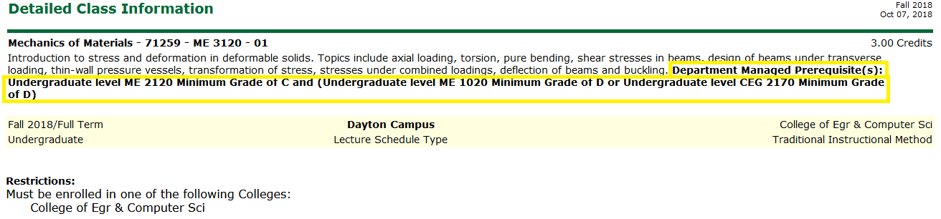
Department-Managed Prerequisite

Slide 7
New: System-Enforced Prerequisites
Prevents a student from adding a class to their schedule if they do not have the required prerequisite
New, beginning spring 2019 registration

Slide 8
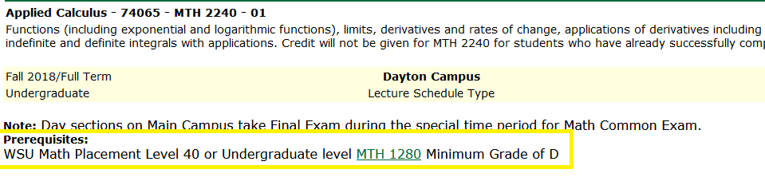
System-Enforced Prerequisites

Slide 9
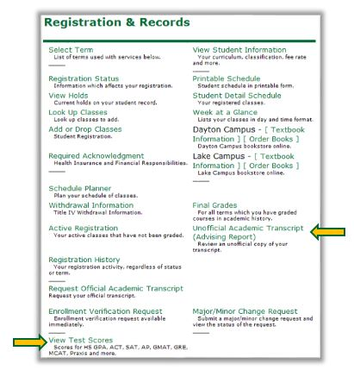
How do I know if I have the required prerequisite?

Slide 10
Other Common Types of Registration Restrictions
Class – (FR, SO, JR, etc.)
Closed Class (Capacity)
Corequisite
Degree/Program/Major (Field of Study)
Department/Instructor Approval Required
Student Attribute (example: Honors)

Slide 11
How do I know?

Slide 12
Registration Overrides
Advisors may provide a prerequisite override if the student has in-progress credit from another institution or appropriate transfer equivalent
Academic departments receive any requests for exceptions to prerequisite requirements

Slide 13
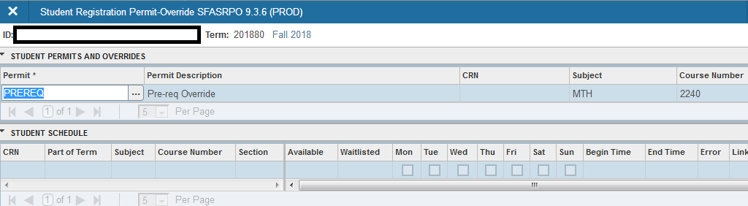
Registration Overrides
SFASRPO (Banner Admin)

Slide 14
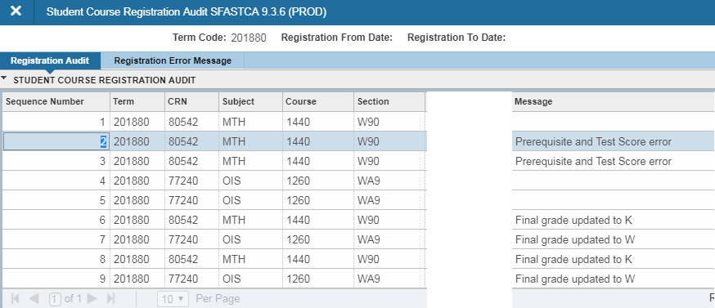
Registration Activity (SFASTCA)

Slide 15
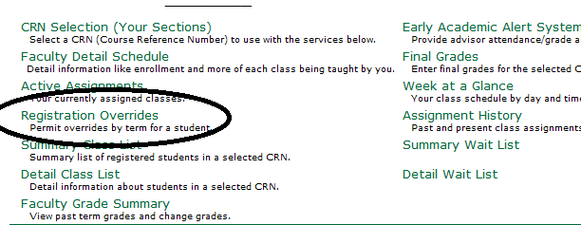
Registration Overrides
WINGS Express (Instructor)

Slide 16
FAQs
Will a student currently enrolled in a course prerequisite be able to register for a class that requires that course?
  Yes, Registration allows students to register for a course next semester that has a pre-requisite if the student is enrolled in that pre-requisite this semester.
  Note: Classes taken in A and B term for the same semester are not considered “in-progress” for prerequisite checking. Prerequisite classes taken in the same semester can be updated to allow for “concurrent” registration in the same semester.
If the prerequisite indicates that a MPL score of 40 is required, will I be prevented from registering if I have a higher score?
  No, the test score is the MINIMUM score that you must have to meet the prerequisite requirement.
If the prerequisite required MTH 1280 and I have completed a higher level math course, will I be prevented from registering for the course?
  Yes, course prerequisites are very literal. You must have completed (or be in the process of completing) one of the listed courses to meet the prerequisite requirements.

Slide 17
FAQs
Does a substitution or exception in the degree audit fulfill prerequisite requirements?
  No, course substitutions do not fulfill prerequisite requirements. The course must exist or be equated in the student’s academic history to fulfill a prerequisite requirement.
Will a student be able to waitlist for a course if they do not meet the prerequisite requirement?
  No. The student must meet the prerequisite requirement or have a prerequisite override, to be eligible to register or waitlist for the course.
If I am taking a course through SOCHE, will I be able to register.
  If the course you are taking through SOCHE is a prerequisite for a course you want to enroll in at Wright State, you will only be able to register with override permission.
Will a student be automatically dropped from a course if they fail the prerequisite?
No. There is not an automatic process to drop a student who does not meet the prerequisite requirement at the end of the term. Departments may review the list of students who do not meet prerequisite requirements (Cognos Report) and submit a request to drop students who are ineligible to take a course.

Slide 18
FAQs
How do I remove a student who has not completed the prerequisite requirement prior to the start of the term?
  Same process used as now to review and drop students who do not meet a prerequisite requirement:
    Review list of students who do not meet the pre-req using Cognos Pre-req report (Cognos.wright.edu>Public Folders>Production>Course Information Reports>Course Detail Lists>Course Prerequisite Report).
    Notify the student of missing pre-requisite requirement and advise the student that they need to drop the class and select an alternate.
    If necessary, send administrative drop request to the Office of the Registrar after notifying the student.
    http://www.wright.edu/registrar/resources/departmental-registration-actions
If I have submitted a proposal to change a course prerequisite but registration is starting and it has not been approved, what do I do?
  Email the Chair of the University Curriculum Committee requesting provisional approval of the change that has been submitted in Curriculog, cc. mary.holland@wright.edu and todd.frantz@wright.edu
    UG Curriculum Committee Chair: Barbara.Dunaway@wright.edu
    GR Curriculum Committee Chair: Mindy.McNutt@wright.edu

Slide 19
FAQs
If I have submitted a proposal to change a course prerequisite but registration is starting and it has not been approved, what do I do?
  Email the Chair of the University Curriculum Committee requesting provisional approval of the change that has been submitted in Curriculog, cc. mary.holland@wright.edu and todd.frantz@wright.edu
    UG Curriculum Committee Chair: Barbara.Dunaway@wright.edu
    GR Curriculum Committee Chair: Mindy.McNutt@wright.edu
  Change only department-managed prerequisites to system-enforced (or vice versa), email mary.holland@wright.edu and todd.frantz@wright.edu

Slide 20
Questions?
Student Resources:
  WINGS Express Registration Guide (on Raider Connect website under “Registration”)
  Academic Advisor
  Raider Connect
  Academic Department
Faculty and Staff Resources
  http://www.wright.edu/registrar/resources (menu on top right of the page)
  wsu-registrar@wright.edu or x5200

