Slide 1


Intro to AFROTC
Click these icons for audio
Detachment 643, Wright State University

Slide 2
Overview
Mission & Program Overview
Careers
Benefits
Requirements
Crosstown Schools
Scholarships

Slide 3
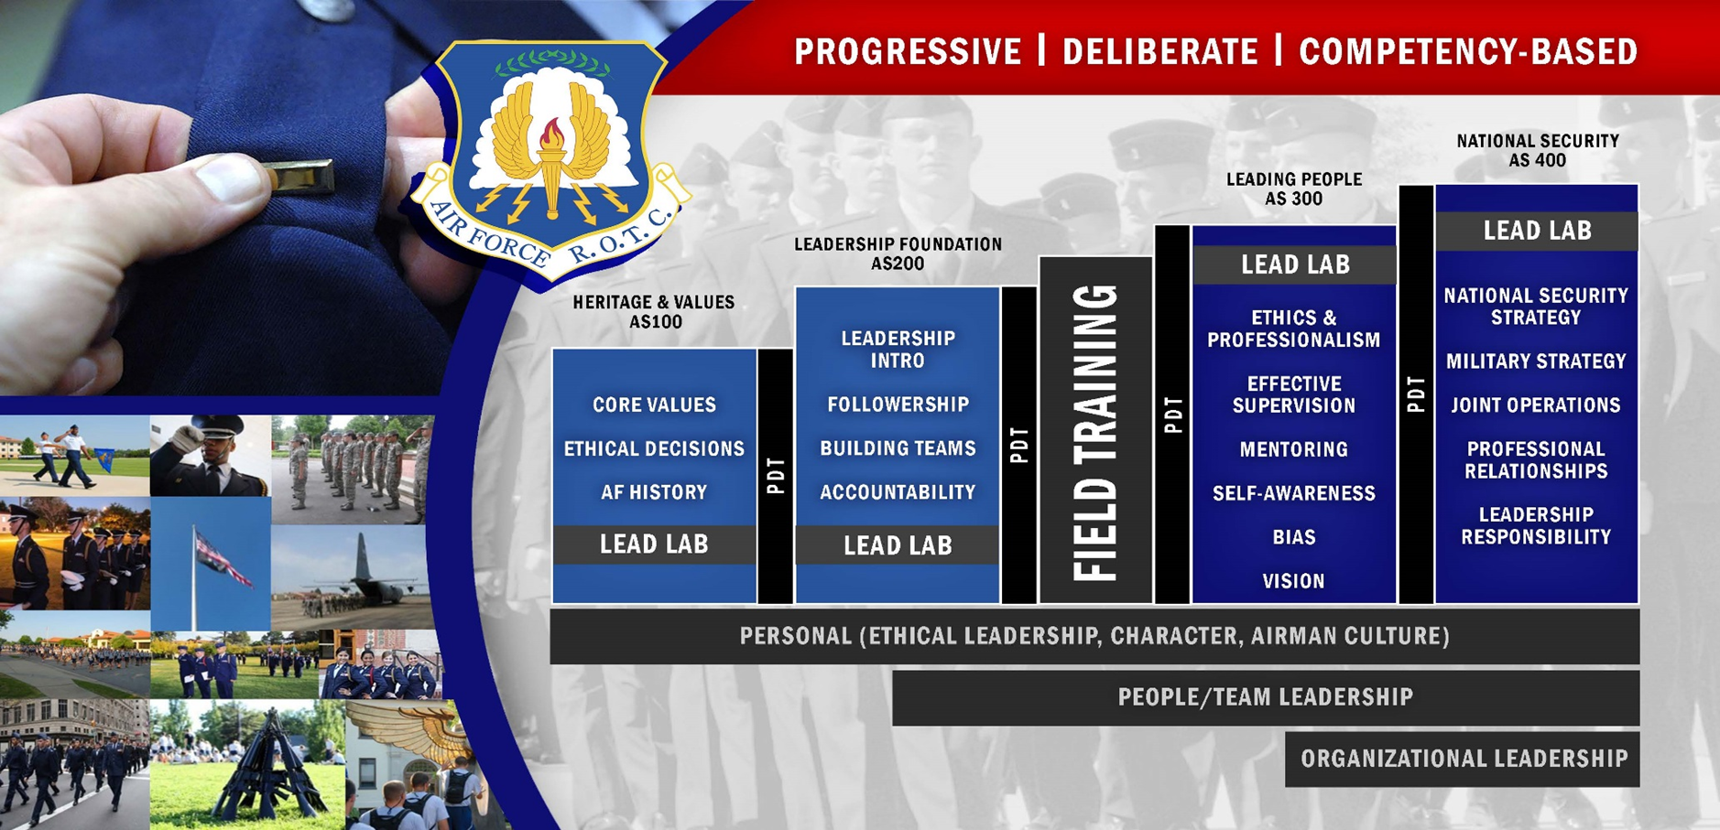
Mission & Program Overview
Develop leaders of character for tomorrow’s Air Force.
https://www.youtube.com/watch?v=1ik5kL_IdDM
https://www.youtube.com/watch?v=1fZPfPi3uxo

Slide 4
Careers
Over 30 career paths are available in 7 primary areas
  Operations – Pilot, Intelligence, Cyber Operations, etc.
  Logistics – Logistics Readiness, Maintenance
  Support – Force Support, Civil Engineer, Communications, etc
  Medical – Physician, Nursing, Dentist, Pharmacist, etc.
  Professional – Lawyer, Chaplain
  Acquisitions – Engineer, Finance, Contracting, etc.
  Special Investigations

Slide 5
Benefits
Base Pay – Start at over $3200 per month as an Officer
Medical – Free to military, low-cost for dependents
Living Expenses – Tax-free food and housing allowances
Vacation - 30 days of paid vacation each year
Education - Tuition assistance and GI Bill
Generous Retirement Package – Pension and 401(K)-type plan
Additional Benefits: https://www.myairforcebenefits.us.af.mil/

Slide 6
Requirements
General Program Requirements
  Be enrolled as a full-time student at an accredited college that hosts or has a crosstown agreement with an Air Force ROTC detachment
  Be a U.S. citizen prior to contracting and commissioning
  Be in good physical condition (cadets must pass the Fitness Assessment)
  Be of good moral character
  Attend both the Aerospace Studies class and Leadership Lab each semester

Slide 7
Crosstown Schools
Antioch College
Antioch Midwest University
Cedarville University
Central Michigan University
Central State University
Clark State Community College
Edison Community College
Embry-Riddle Aeronautical University
Kettering College
Miami-Jacobs Career College
Miami University Regionals
Park University
Sinclair Community College
Southern State Community College
Union Institute & University
University of Dayton
Urbana University
Wilmington College
Wittenberg University

Slide 8
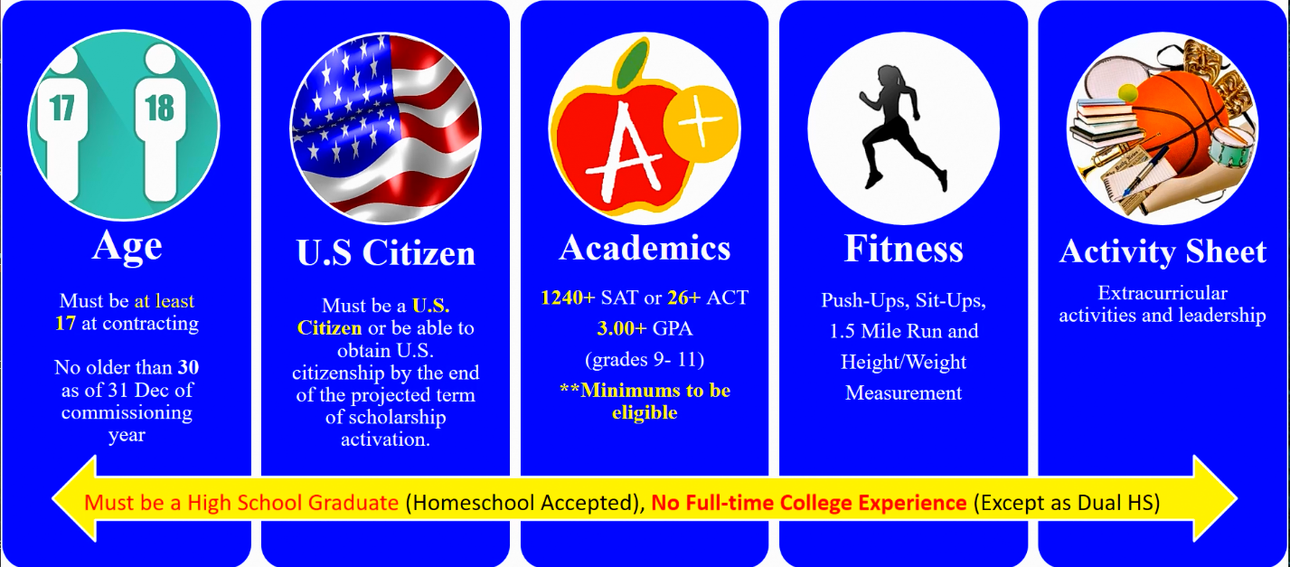
Scholarships
High School Scholarship Program (HSSP)
  Application period normally from 1 May to 1 Dec

Slide 9
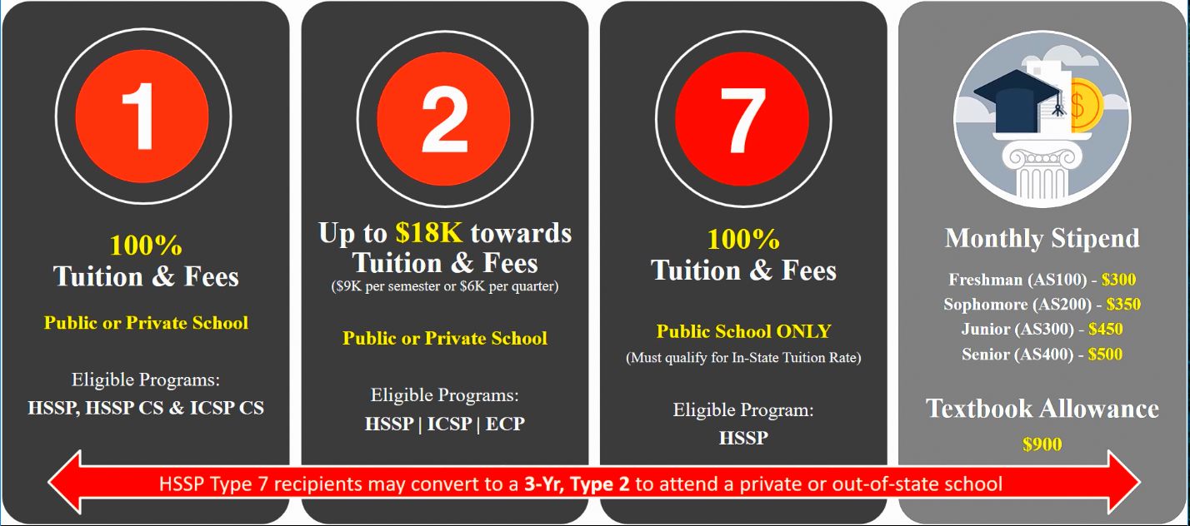
Scholarships
https://www.youtube.com/watch?v=TKQw3kx7wR8
https://www.afrotc.com/scholarships/

Slide 10
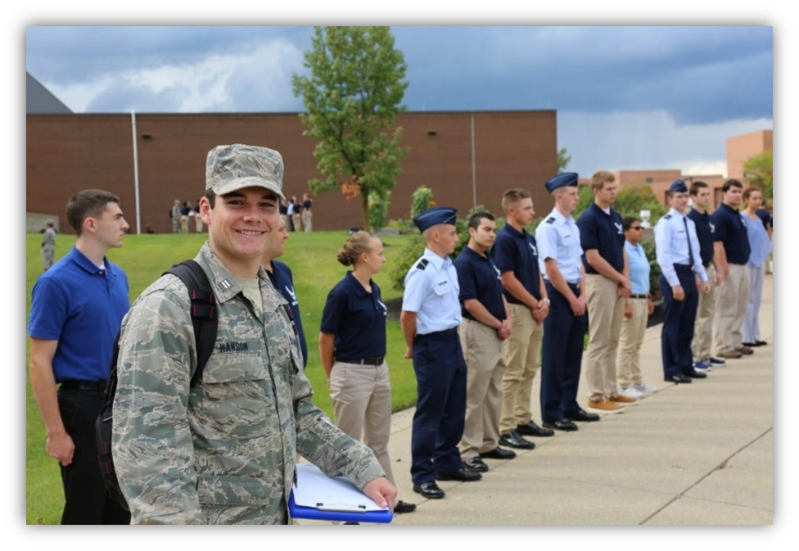
Summary
Mission
Careers
Benefits
Requirements
Crosstown Schools
Scholarships

Slide 11

Questions
Email: afrotc@wright.edu
Phone: 937-775-2730

