Slide 1
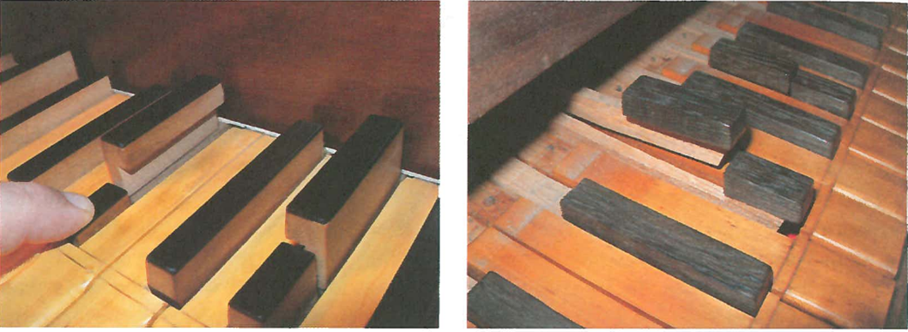
Why Bach sounds funny on the piano
Guy Vandegrift and Michelle Smith
Wright State University Lake Campus
September 26, 2013

Slide 2
Do these “harmonics” make music?
200 cps*
400 cps
600 cps
800 cps
1000 cps
400/200 = 2/1
600/400 = 3/2
4/3
5/3
cps = cycles per second = Hz
(approximate numbers for viola,
rounded for convenience)

Slide 3
Two ways to get from G to E
E
A
D
G
c
Up one Sixth from G up two Fifths and down a Fourth
“up two Twinkles,
down an old Mac D.”
“up a Bonnie”

Slide 4
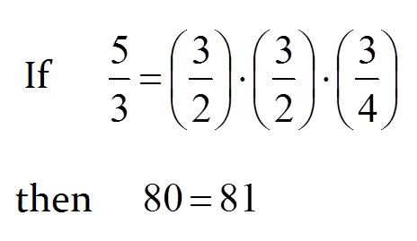
Cross-multiply the fraction
Paradoxes such as this create the need for “tempered” scales that find “compromise” pitches. Three important scales are:
Pythagorean: (uses a circle of 3/2 musical “fifth” ratios)
12-tone equal tempered “scientific”: (logarithms and exponents)
Bach’s “well tempered”: a useful compromise for sophisticated music

Slide 5
Rational Fractions associated close to unity are associated with musical “commas”
$$\log\left(1\right)=0 ⟹\log\left(almost one\right)=almost zero$$
Syntonic Comma: $12 \log_{2}\frac{81}{80}=.2151≈22\% \text{(}\text{of} \text{a} \text{semitone}\text{)}$
Phythaogrean Comma: $12 \log_{2}\frac{3^{12}}{2^{19}}=.2346≈23\% \text{(}\text{of} \text{a} \text{semitone}\text{)}$

Slide 6
Other commas
Small undecimal comma 17.58% 99:98 = 3² * 11 : 2*7²
Diaschisma 19.55% 2048:2025 = 2¹¹ : 3⁴ * 5²
Syntonic comma 21.51% 81:80 = 3⁴ : 2⁴ * 5
Pythagorean comma 23.46% 531441:524288 = 3¹² : 2¹⁹
Septimal comma 27.26% 64:63 = 2⁶ : 3² * 7
34.98% 50:49 = 2 * 5² : 7²
Septimal sixth-tone or jubilisma, Erlich's decatonic comma or tritonic diesis
$$\frac{7}{5}≈\sqrt{2}= \frac{2}{\sqrt{2}}≈\frac{10}{7}$$
THIS HAS A HARSH SOUND
Two eighteenth-century composers (Georg Philipp Telemann and Johann Joseph Fux) wrote that this interval was once associated with the devil, but Wikipedia claims no known citations from the Middle Ages.

Slide 7
Why is the tritone a “diabolus en musica”?
interval | ratio | half-tones | error | How a piano plays it
octave | 2/1 | 12 | zero
fifth | 3/2 | 7.02 = 7 + 0.02 | +2% | 3/2 ≈ 2^{7/12}
fourth | 4/3 | 4.98 = 5 − 0.02 | −2% | 4/3≈ 2^{5/12}
major sixth | 5/3 | 8.84 = 9 − 0.16 | −16% | 5/3 ≈ 2^{9/12}
major third | 5/4 | 3.86 = 4 − 0.14 | −14% | 5/4 ≈ 2^{4/12}
minor third | 6/5 | 3.16 = 3 + 0.16 | +16% | 6/5 ≈ 2^{3/12}
tritone | 7/5 | 5.825 = 6 − .175 | −17.5% | 7/5 ≈ 2^{6/12}
minor sixth | 8/5 | 8.14 = 8 + 0.14 | +14% | 8/5 ≈ 2^{8/12}
Is the “devil” in the SEVEN or in the SQUARE ROOT OF TWO?
$$\sqrt{2}=\frac{2}{\sqrt{2}}$$
, these “devils” always come in pairs!
2^{6/12} = 2^{1/2} . But since,
Perhaps the sound is dissonant because if one is in tune, the other is not. There might be a way to verify this.
$$\frac{7}{5}≈\frac{45}{32}≈\sqrt{2}≈\frac{62}{45}≈\frac{10}{7}$$

Slide 8
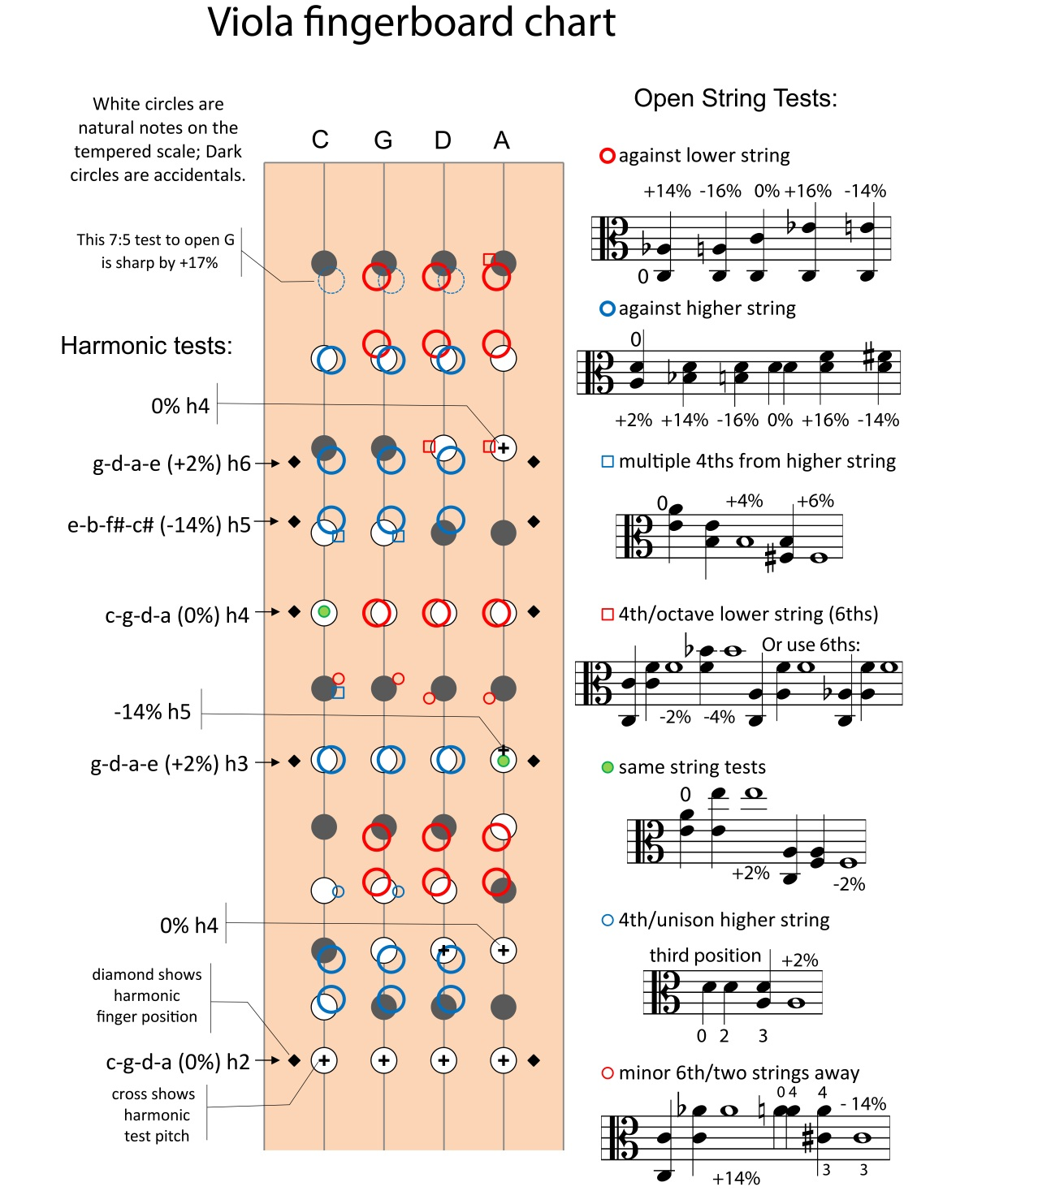
This chart allow almost every note on the to be tested.
Grey and white circles denote the 12-tone equal tempered scale in which all frequency ratios equal
$$2^{n/12}$$
Colored circles and triangles construct the notes using “just” intervals in which the frequency ratios are
$$p/q$$
n, p, and q are integers. Pythagoras is credited with discovering that 2^{1/2} cannot be expressed as an integral fraction.

Slide 9
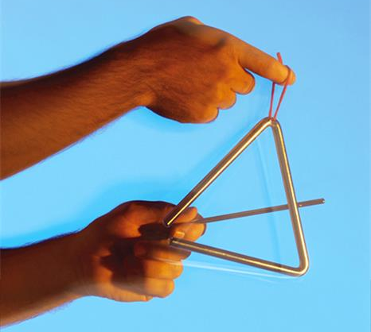
George Plimpton was a journalist who enhanced his stories by actually playing quarterback for the Detroit Lions, boxing against Archie Moore, and blocking 100 MPH hockey pucks for the Boston Bruins. Plimpton did a TV special back in the 1960 and was to play a series of “Pings” on the triangle at a performance by the New York Philharmonic. During rehearsal, Leonard Bernstein stopped the orchestra….
Bernstein: George would you play that note for us again?
Plimpton: Ping!
Bernstein: One more time, please.
Plimpton: Ping!
Bernstein (cupping his hand behind his ear): Once more...
Plimpton: Ping!
Bernstein (impatient and dissatisfied): Now, which of those four pings do you mean? They're all different.
(I got this conversation off the web, my recollection is that Bernstein instructed Plimpton to choose a way to hit the triangle and hit it that way every time.)

