Slide 1
Inventing the Savart Cello
An idea that needs lots of work before it can be useful

Slide 2
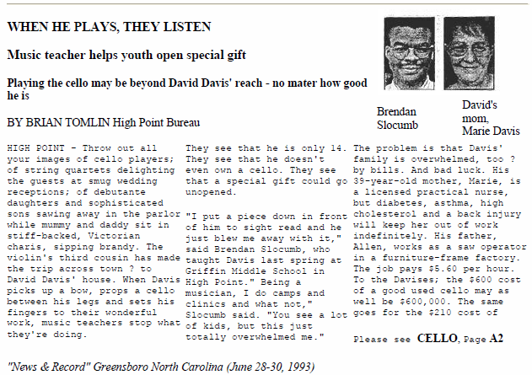
Three reasons to build a low-cost starter cello
1. I saw this story in a North Carolina newspaper in 1993:

Slide 3
Two more reasons ….
Many college music education programs require that students to learn to play all or most of the instruments in their “family”. Why not start early?
3. Some parents might want to “pluck along” with a young child who is starting to learn the violin. A cello is a perfect accompanying instrument and the bass part would be easy to learn.

Slide 4
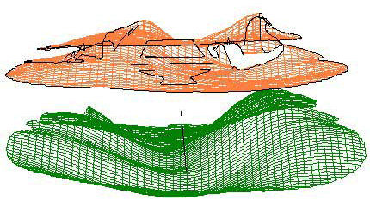
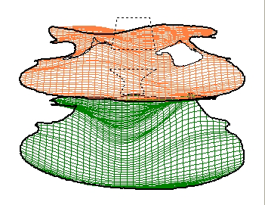
Experimental data on two quality violins at air resonance.
The physics of how violin plates move is very interesting….

Slide 5
I used to call this the “Box Cello” project. Then I discovered this fellow:
Félix Savart
From Wikipedia, the free encyclopedia
Félix Savart (June 30, 1791, Charleville-Mézières, Ardennes – March 16, 1841, Paris) became a professor at Collège de France in 1836 and was the co-originator of the Biot-Savart Law, along with Jean-Baptiste Biot. Together, they worked on the theory of magnetism and electrical currents. Their law was developed about 1820. The Biot-Savart Law relates magnetic fields to the currents which are their sources.
Félix Savart also studied acoustics. He developed the Savart wheel which produces sound at specific graduated frequencies using rotating disks. Félix Savart is the namesake of the unit of measurement for musical intervals, the savart, though it was actually invented by Joseph Sauveur.

Slide 6
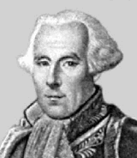
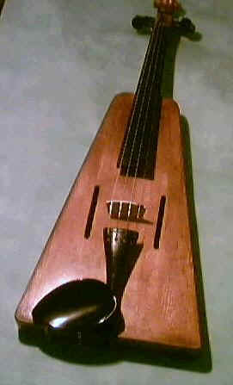
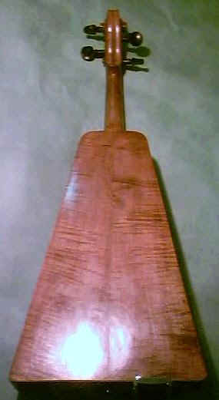
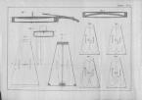

Slide 7
From a website I learned that in 1819 Felix Savart also developed what he called a "rationalised Violin"
It was “met with approval by the academy in Paris”.
Apparently in the Post-revolution climate France, people were open to a re-appraisal of everything including the violin!
However this violin didn't replace the normal violin and it shifted into folk music use.
Michael J King, http://www.michaeljking.com/fiddles.htm
Though it is difficult to imagine an ugly instrument seeming “modern” in 1819, keep in mind that Stradivari's "golden period" of violin making ended in approximately 1720.
The Italians were forgetting how to make great violins!

Slide 8
The goal is not to make a better cello, but one that
has adequate quality for a beginner
is very simple to make
Reasons to make it a box:
Cheap and simple is beautiful cheap and complicated is pretentious.
Historical context (French revolution!)
We will probably need dozens of prototypes before getting an adequate sound out of the homemade cellos. Keep it simple!

Slide 9
The motion of the front and back plates is critical.
If we are lucky, the following “trick” might enable us to get it right:
Two prototype cellos will be constructed.
The “ribs” will be built solid with bolts that will permit quick replacement of “belly” and “back”.
It should be possible to “rebuild” a cello in a day simply by changing the plates.

Slide 11
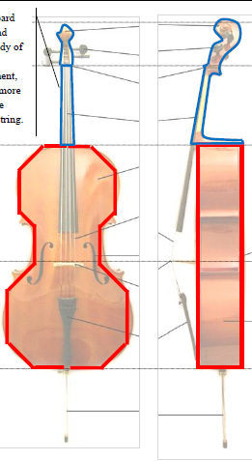
Fingerboard cannot touch moving belly
Top part is the neck and fingerboard. Formed from a single furring strip. Needs not extend over body of cello for starter instrument. Two stringed instrument is OK
Back plate
Sides are called “ribs” and move for violin family instruments. Will be largely stationary for Savart-type cellos.
Need room for bow
F-holes establish “air resonance”
Front plate or “belly”

Slide 12
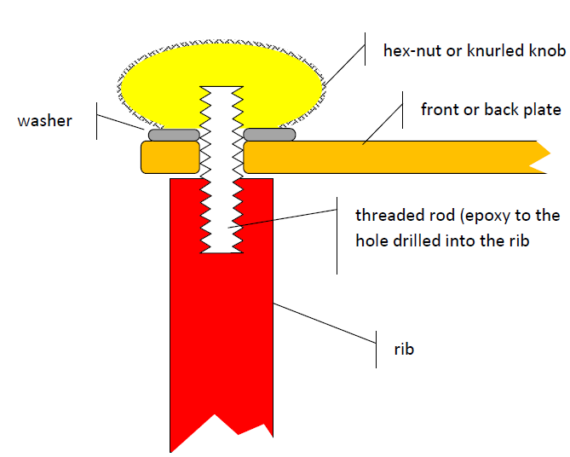
Attach top and bottom plates using machine screws to facilated replacement. These plates are critical to cello performance and will be the subject of much experimental investigation.

Slide 13
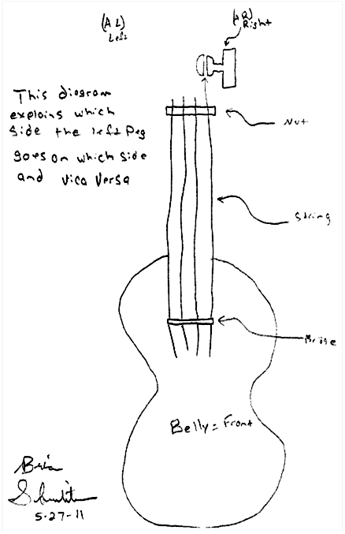
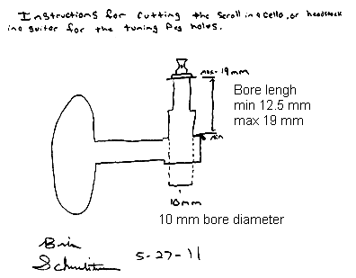
I explained this research to students in General Education Science courses, and devoted several labs to how one goes about designing a new device. Some student efforts are shown:
Purchased 6 guitar worm-gear pegs for approx. $25. Shown below are (1) proper orientation for the “left” and “right” handed pegs and (2) bore hole diameter (10 mm) and pegboard depth (range is 12.5 mm to 19 mm).

Slide 14
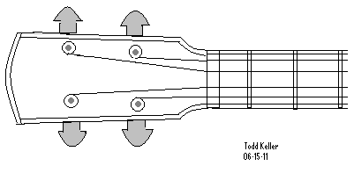
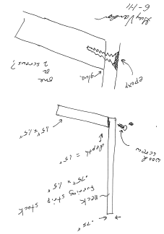
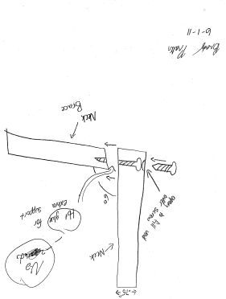
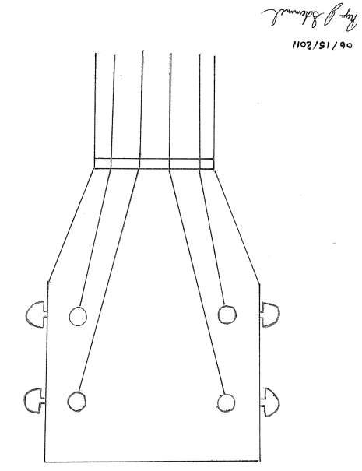
Preliminary ideas on making that pesky neck:

Slide 15
1.5 x .75 in furring strips
Lengths: 20 in; 6 in; 8 in
scale 5:1
K. K. later pointed out that we can easily cut these boards so they can fit.
Ribs are boards 5/8 in thick. Rip boards 3.5 in wide. Board lengths:
17 in; 7.25 in; 9.25 in
(avtually 9 3/8; 7 3/8)
.

Slide 16
Cedar ribs
1.5 x 8.5 cm
1.5x.75 in furring strip
Cedar rib 3/8 in thick
New idea: use washers (red) to keep plates off ribs and enhance buzz.
The air gap will be part of the equation. The extra plate freedom might enhance sound.
Original plan called for 3.5 inch ribs because furring strips went outside.
New plan puts furring strips inside, so we want to use the smaller (scrap) ribs 2.9 in wide.

Slide 17
11 degree fingerboard angle
And finally an instrument was built:

Slide 18
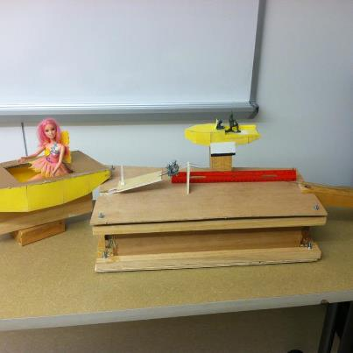
My so-called research:
Find something with physics that is complicated, but not too complicated for students to understand.
Understand it well enough to make radical design changes.
The goal is to make something very easy for an amateur to construct.
Homebuilt sailboats and cellos
Research Philosophy: “Real” research must have unknown outcome and useful purpose. To engage Lake Campus students, the technical issues must be accessible to students without advanced training in math, science, or engineering.

Slide 19
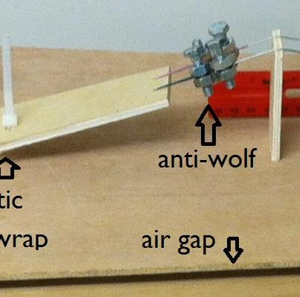
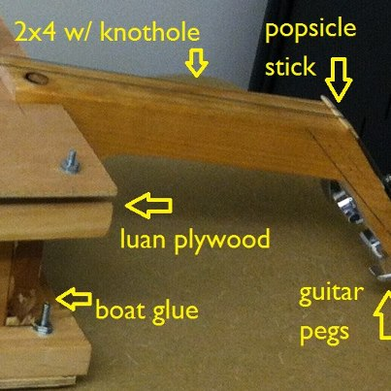

Slide 20
Status Report as of September 12, 2012
Built a pair cellos with luan plywood (4 mm thick). Open strings were G&D.
Learned that back plate must be solid on ribs to avoid “wa-wa” change in pitch as player pressed back of cello.
Sound was pleasant but somewhat muted. Absent are those changes in timbre over the range of the instrument that makes the violin-viola-cello so enchanting. There might be an air resonance somewhere on the top string.
Investigated one inch wide luan plywood strip and were unable to excite standing waves. More precisely: The fundamental mode happens at low enough frequencies, but above about 100 Hz, we only get the first mode, up to perhaps 500 Hz. Cause presumed to be the extreme damping of luan underlay plywood. Will next experiment with 1.5 inch strips ripped from construction grade plywood.
Time to think about how wood vibrates: (see next page)

Slide 21
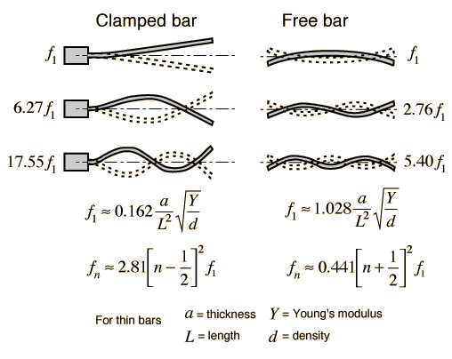
http://hyperphysics.phy-astr.gsu.edu/hbase/music/barres.html#c1
edge.rit.edu/content/P08003/public/materials.xls:
Plywood:
Young’s modulus in range
1.001-1.885*10^6 psi
Average is 9.95*10^9 Pa
We think the modulus of luan underlay plywood is about half that.
Density in range
43.7-49.94 lb/ft^3
Average is 750 kg/m^3

