Slide 1
Q UESTIONS WITH THE PRESIDENT
Dr. Cheryl B. Schrader

Slide 2
Tuition and fees replace state support for Wright State University
65%
54.7%
52.9%
55.8%
55.4%
52.6%
55%
52.1%
48.6%
49.6%
48.8%
48.7%
47.2%
45.9%
46.6%
46.0%
45%
42.9%
41.8%
36.8%
38.9%
39.9%
35.8%
37.8%
33.8%
35.6%
35%
32.0%
31.0%
31.1%
32.4%
28.6%
30.0%
28.4%
28.9%
29.8%
25%
22.0%
22.8%
18.2%
18.2%
18.3%
19.6%
20.2%
19.6%
18.2%
15.9%
15.8%
15.3%
14.4%
15.0%
15%
12.6%
13.5%
5%
FY2002
FY2003
FY2004
FY2005
FY2006
FY2007
FY2008 FY2009
FY2010
FY2011 FY2012
FY2013
FY2014
FY2015
FY2016
FY2017
Net Tuition and Fees
State Appropriations
Other Revenue

Slide 3
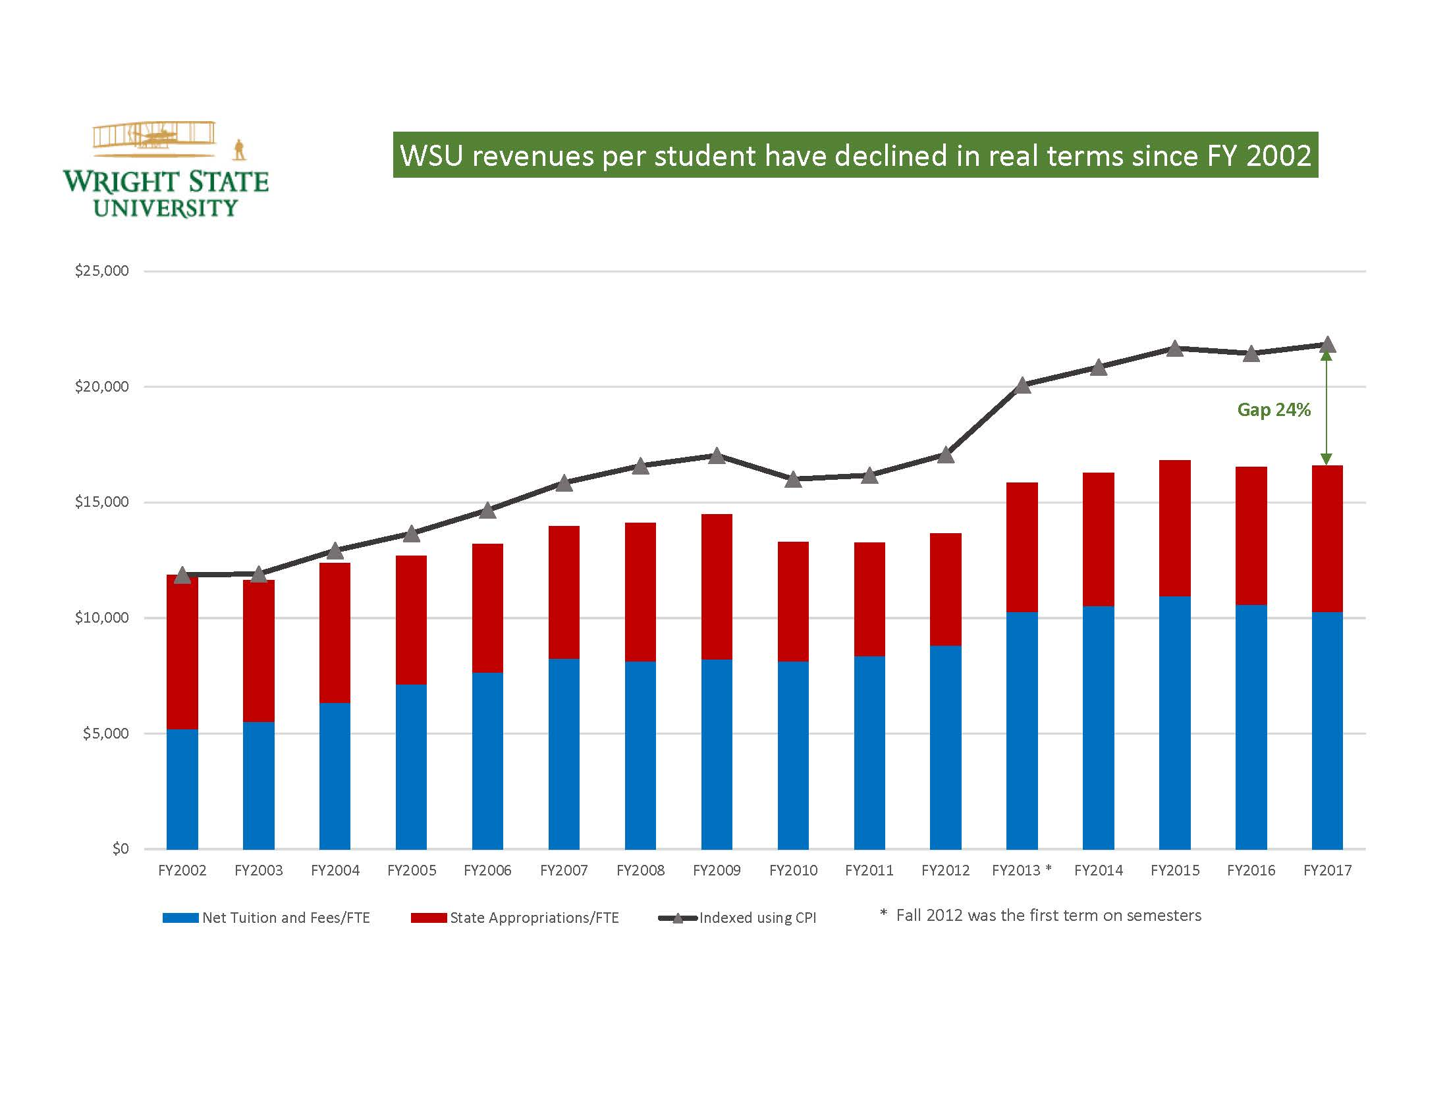

Slide 4
Wright State University
Cumulative Percent Change in Faculty, Staff, Administrative
and Student FTE Based on November 1 Payroll
Adjunct Faculty Staff Administrative Enrollment
Faculty
30%
25%
20%
15%
10%
5%
0%
-5%
-10%
-15%
-20%
PERCENT CHANGE FROM 2008
22.9%
-4.5%
-8.4%
-12.6%
-17.6%
1
2
3
4
5
6
7
8
9
10
YEAR

Slide 5
Will raises be possible in the foreseeable future?
If so, will the fact that staff have had extremely minimal or no raises in the last couple of years be taken into account?

Slide 6
Those who choose to work in higher education often earn a salary lower than our counterparts in private industry because we are offered better benefits (like vacation/leave, health insurance) than those in industry.
Many of these benefits are being taken away and benchmarked with industry while our salaries are not benchmarked with industry. What steps can be taken to bring staff compensation into alignment?

Slide 7
With the elimination of various positions, many of us have been required to take on additional duties and responsibilities which are not included in our current job descriptions.
Is there a plan or timeline for conducting job audits of current staff positions?

Slide 8
What are the factors that would necessitate a staff furlough?
Should we expect furloughs or additional layoffs in the near future?

Slide 9
What is the plan for enrollment management (i.e., increasing recruitment, retention and graduation rates)?
Where are we targeting our recruitment efforts (i.e.: International, Domestic, Raider Country, other)?

Slide 10
Given the university's financial situation, is this the best time for a reorganization of academic programs?

Slide 11
The discussion around our financial situation has largely focused on avoiding fiscal watch.
What is the long-term financial plan and what benchmarks and milestones does it include?

Slide 12
What is the status of the total compensation study?
Why hasn't information been shared?
What is the timeline for implementation?

Slide 13
How is the strategic hiring committee selected?
Can you please give us an update about the strategic planning process?

Slide 14
Has the Administration considered giving classified staff extra vacation days, since bumping rights were taken away?
Has there been additional discussion among administrators about moving toward a unified staff model?

