Slide 1
Faculty Senate Meeting
April 16, 2018
President
Cheryl B. Schrader

Slide 2
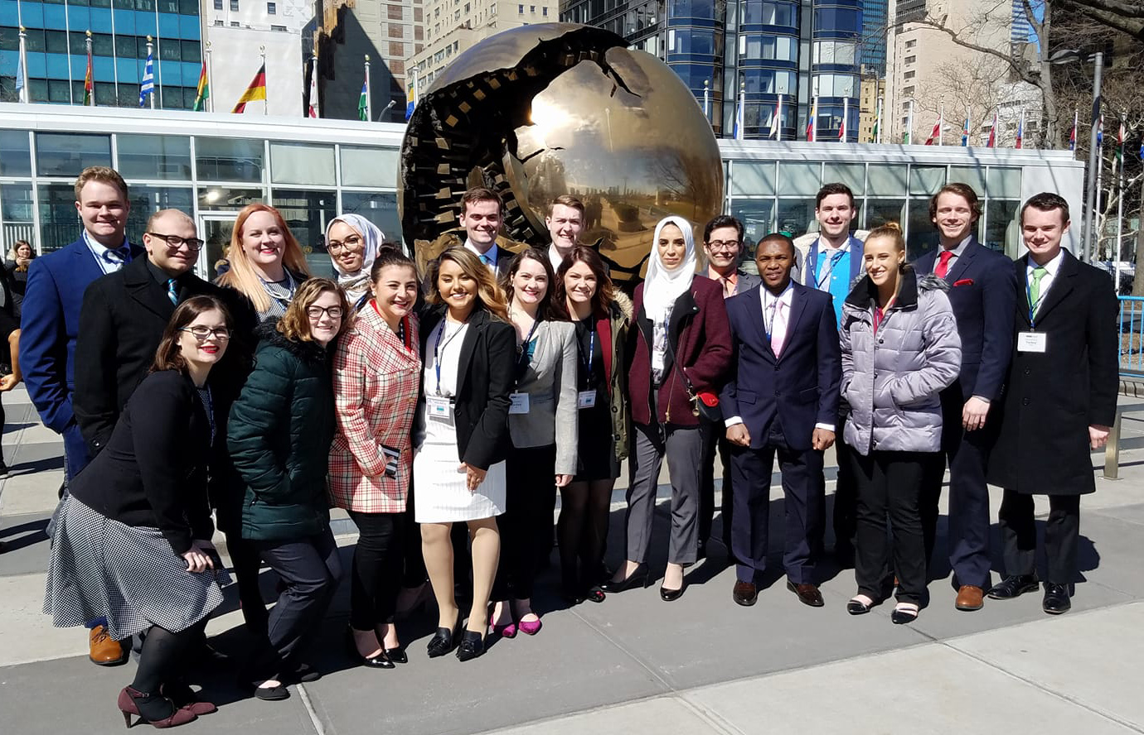
Faculty Achievements
39 Years of Model UN Excellence

Slide 3
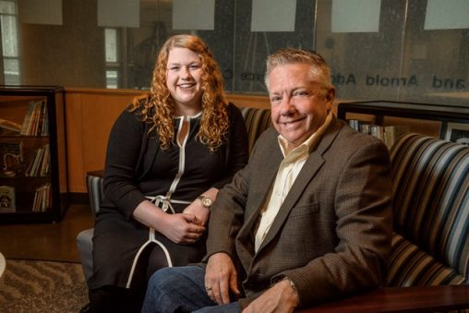
Faculty Achievements
New Mentoring Program

Slide 4
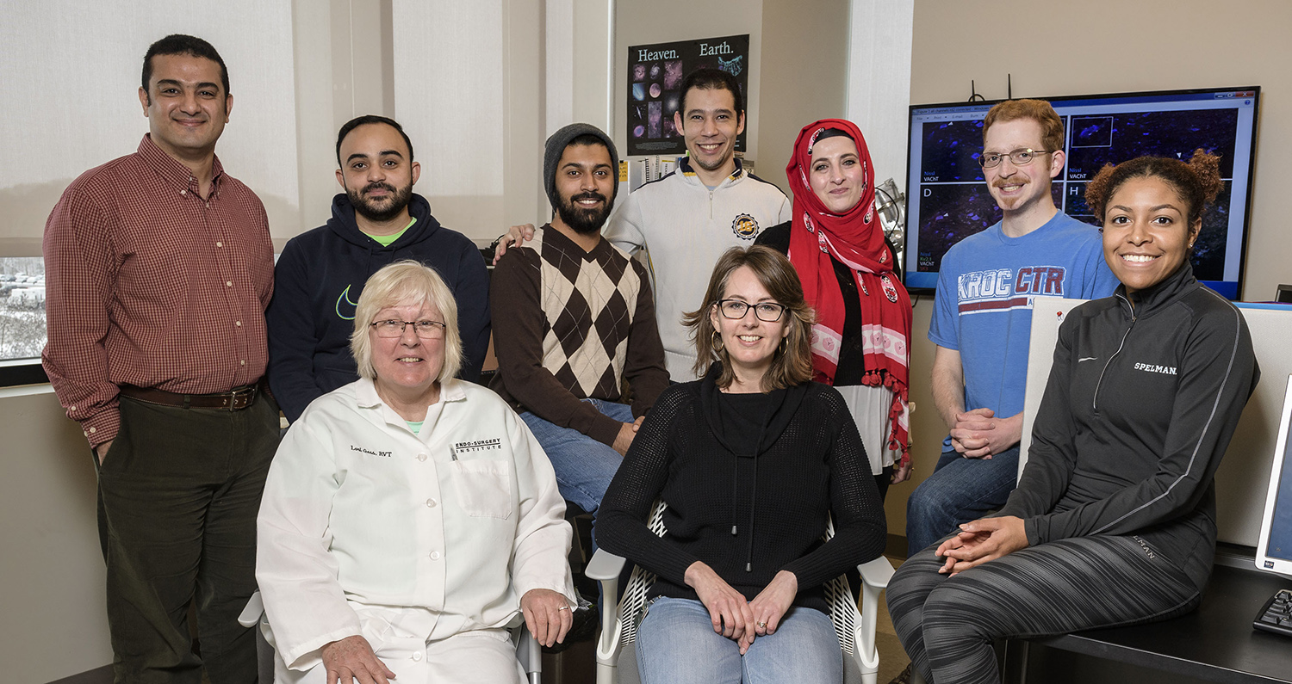
Faculty Achievements
Shedding new light on ALS

Slide 5
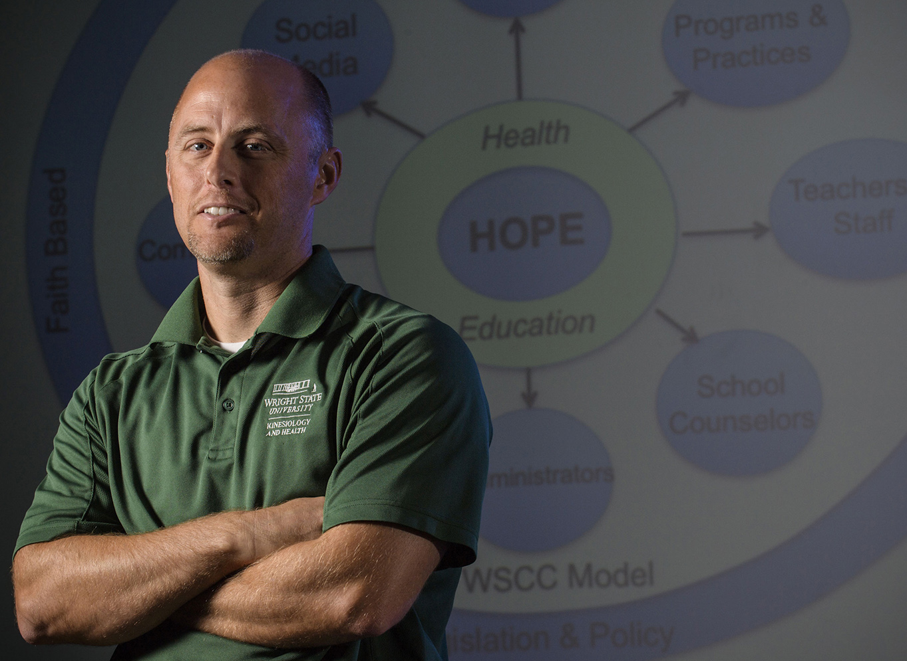
Faculty Achievements
Honored by the Ohio Department of Higher Education

Slide 6
Strategic Planning Open House
Friday, April 20
11 a.m. to 1:30 p.m.
Upper Hearth Lounge
See the progress and provide your input
Come shape the future of Wright State

Slide 7
Phase 2: Development of Strategic Plan
PHASE 1:
ENGAGEMENT (Vision, Mission, Values)
Use Inclusive Process to Develop Strategic Objectives
Use Diverse Stakeholder Groups to Develop Strategic Goals and Maps for Each Goal
Share the Vision
Project Group Meetings to Develop Goals
Steering Committee
Meetings:
Feedback
Interim work to develop a map for each goal
Steering Committee Feedback &
Plan Integration
Presentation to
the Board of
Trustees
Stakeholder
Summit
Draft Strategic Goals & Objectives
Refined Goals
Drafted Actions & Initiatives
Refined goals
with draft maps for each goal
Refined maps
and draft of integrated
strategic plan
Finalized Strategy Document
Refined Actions & Initiatives
Project Groups
for Focused Work
March
April
May
June-August
August-September
October

Slide 8
Program Effectiveness Review Update
Phase One
Received 100% of the surveys back from administrative units (total of 72)
Received 100% of the surveys back from the deans
Phase Two
Administrative units will have common goals along with individualized requirements and measures of effectiveness
Working on a continuous improvement plan for academic departments that will measure progress toward common goals and objectives

Slide 9
Program Effectiveness Review Update
Potential Measures for Academic Units
Four-year graduation rate for the first-time/full-time cohort
(goal:100% four-year graduation)
Number of credit hours earned at time of degree award
(goal:120 credit hours)
Alignment of student interests and degree offerings to state employment opportunities
Retention measurement (e.g. fall-to-fall, stay in department and stay at Wright State)
Fraction of credit hours awarded where the instructor of record was a full-time (tenure track) faculty member

Slide 10
Budget Update
Last fiscal year ended with a $24.6M deficit
Overall spending down $38.8M from same time last year
Created possibility of staying off fiscal watch entirely
Challenges remain
  Revenue shortfall from enrollment decline and change in student mix this year
  Estimated $1M shortfall in net revenue for summer enrollment
  Medical claims $5.5M over budget
Units identified $10.8M in budget reductions for remainder of year
Austerity measures reinstated
Negotiated $550,000 savings in Perkins loan repayment
Current year-end balance estimated to be $6.3M

Slide 11
Negotiations Update
Statutory framework for a negotiated agreement still in progress
Two days of fact finding held, which was not enough time for both parties to have full and complete opportunities to present positions
Delineate dates to complete fact finding and develop revised timeline

Slide 12
Upcoming Events
Friday, April 27
Lake Campus Commencement
6 p.m.
Saturday, April 28
Dayton Campus Commencement
10 a.m.

