Slide 1
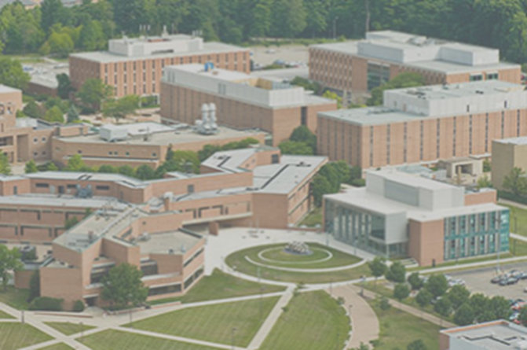
Faculty Senate Presentation
Classroom Modernization & Maintenance

Slide 2





Steering Committee - Design Team
SPGB Architects, LLC
Tools for Schools
Maraye Design Studio
Prater Engineering Associates
SMBH, Inc.
HMBA

Slide 3

Steering Committee
Brad Bubp, Senior Facilities Planner, Chair
Daniel Papay, Associate Vice President of Facilities Management and Services
Scott Moniaci, Director Engineering and Construction
James Menart, Building & Grounds
Mateen Rizki, Faculty Senate
Thomas Sudkamp, Provost, Vice President for Curriculum and Instruction
Todd Pavlack, Center for Teaching and Learning
Tim Wertz, CaTS Representative

Slide 4
Stakeholders
Craig Woolley, CaTS, Chief Information Officer
Mary Holland and Amanda Steele-Middleton, Registrar’s Office
Chris Roberts, Center for Teaching and Learning
Tom Webb, Office of Disability Services
Ron Hamilton, EH&S

Slide 5
Stakeholder Engagement
Steering Committee Representation – regular meetings
Questionnaires
Charrettes
Presentation – Council of Deans, Faculty Senate
Planning Recommendations – Feedback from Facilities, ODS, EH&S, Registrar, Technology, Colleges
Prototype Evaluation Process

Slide 6
Approach – Digesting the Classroom Study:
Manipulating Raw Survey Data
Room Style
Seating Capacity
Assessment Rating (1-4)
Size
Quantities for Renovation Estimates - $5.5m budget
Total Pool – 18 Buildings, 140 Classrooms, 149,000-sf, 6,400-Seats
1 & 2 - Rated Rooms – 10 Buildings (55%), 37 Rooms (26%), 26,800-sf (18%), 1,275-Seats (20%)

Slide 7
Goals and Objectives
Invest in the “right” rooms
Meet minimum standards for function
Meet minimum standards for comfort
Make rooms attractive and inviting
Develop new kinds of learning environments

Slide 8
Priorities
1. Correct all handicap accessibility and building code deficiencies.
2. Repurpose Oelman 112 lecture hall.
3. Improvements to 1 and 2 rated classrooms not dedicated to Colleges
in the campus core.
4. Replace poor furniture in 3 and 4 rated classrooms
5. Improvements to 1 and 2 rated rooms dedicated to Colleges in
the campus core.

Slide 9
Priorities
6. Improvements to low priority 1 and 2 rated rooms not dedicated to
Colleges in the campus core (as determined by the Office of the
Registrar).
7. Minor improvements to remaining 3 and 4 rated rooms in campus
core.
8. Improvements to 1 and 2 rated rooms outside campus core.
9. Improvements to seminar rooms.

Slide 10
Prototype Classroom Evaluation
Russ 150 and Oelman 135
Test Layout, Finishes, Furnishings, Teaching Walls, Instructional Technology, Lighting, Power and Data
  Initial Feedback
  Open House Feedback

Slide 11
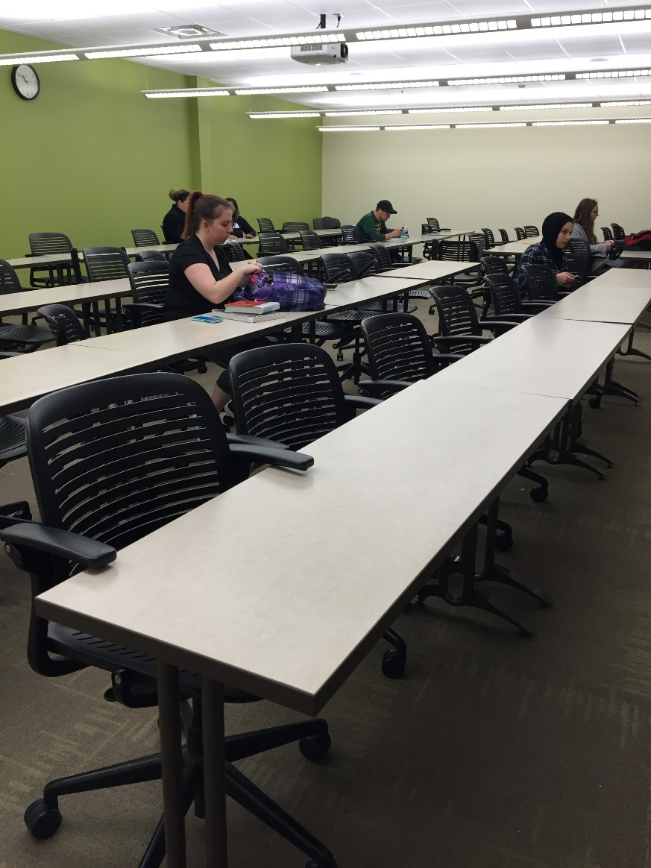
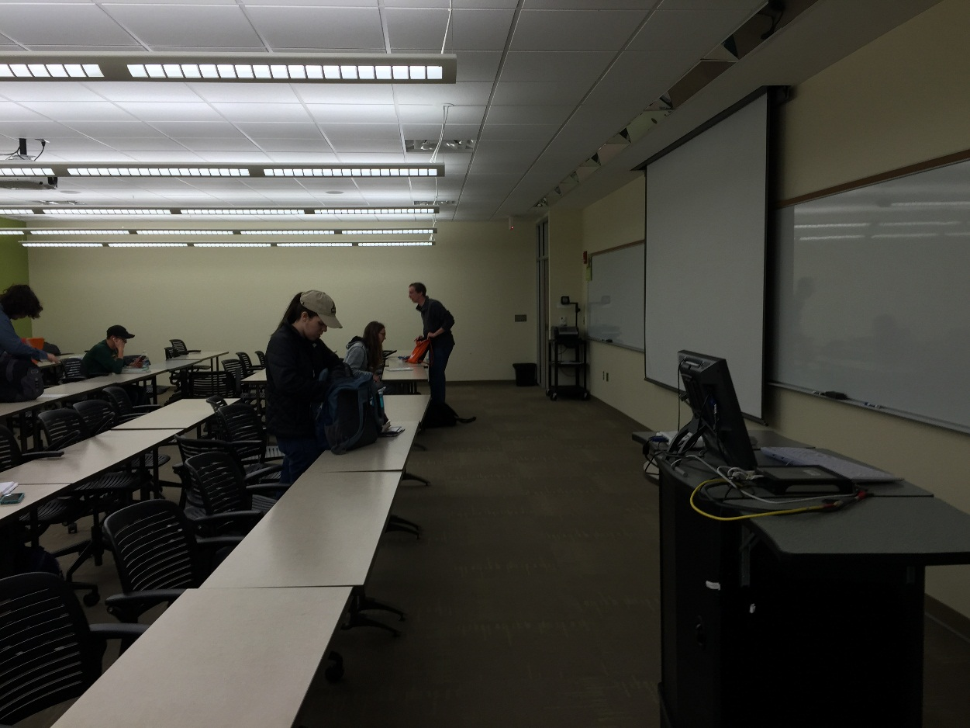
Oelman Hall – 135 Existing

Slide 12
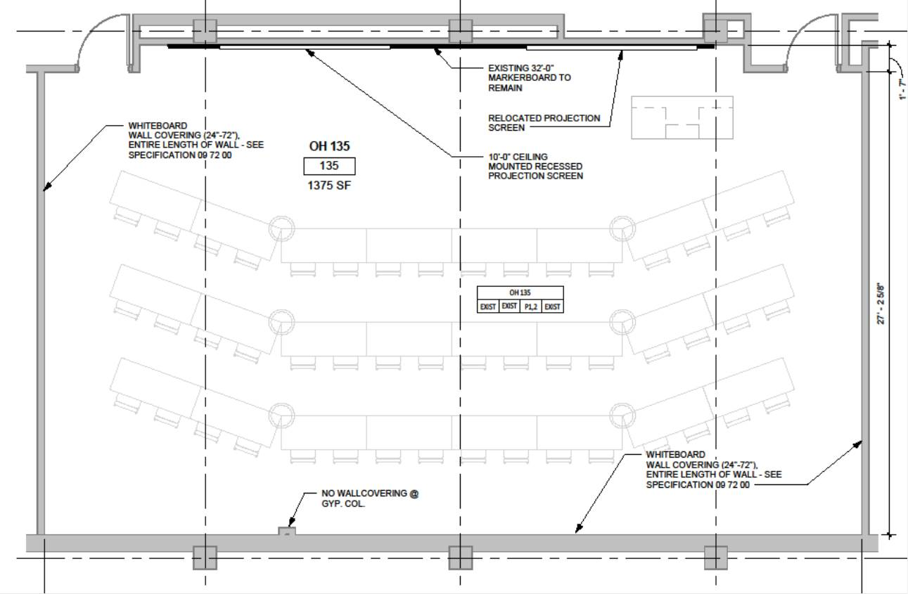
Oelman Hall - 135

Slide 13
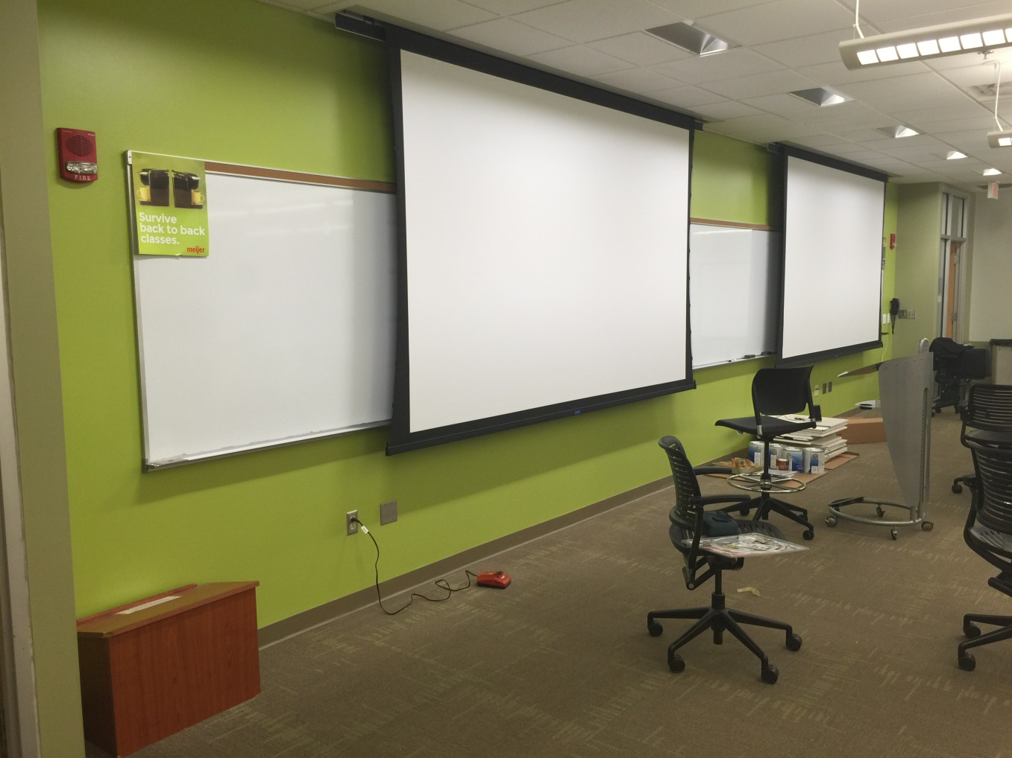
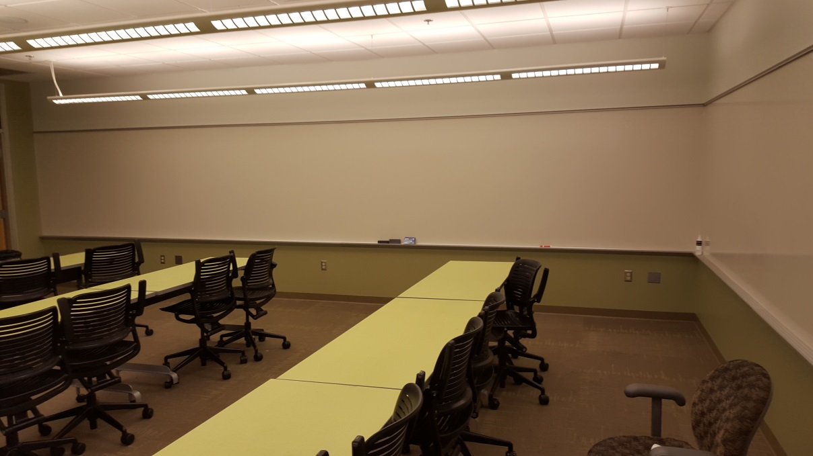
Oelman Hall - 135

Slide 14
Russ Engineering Center – 150 Existing

Slide 15
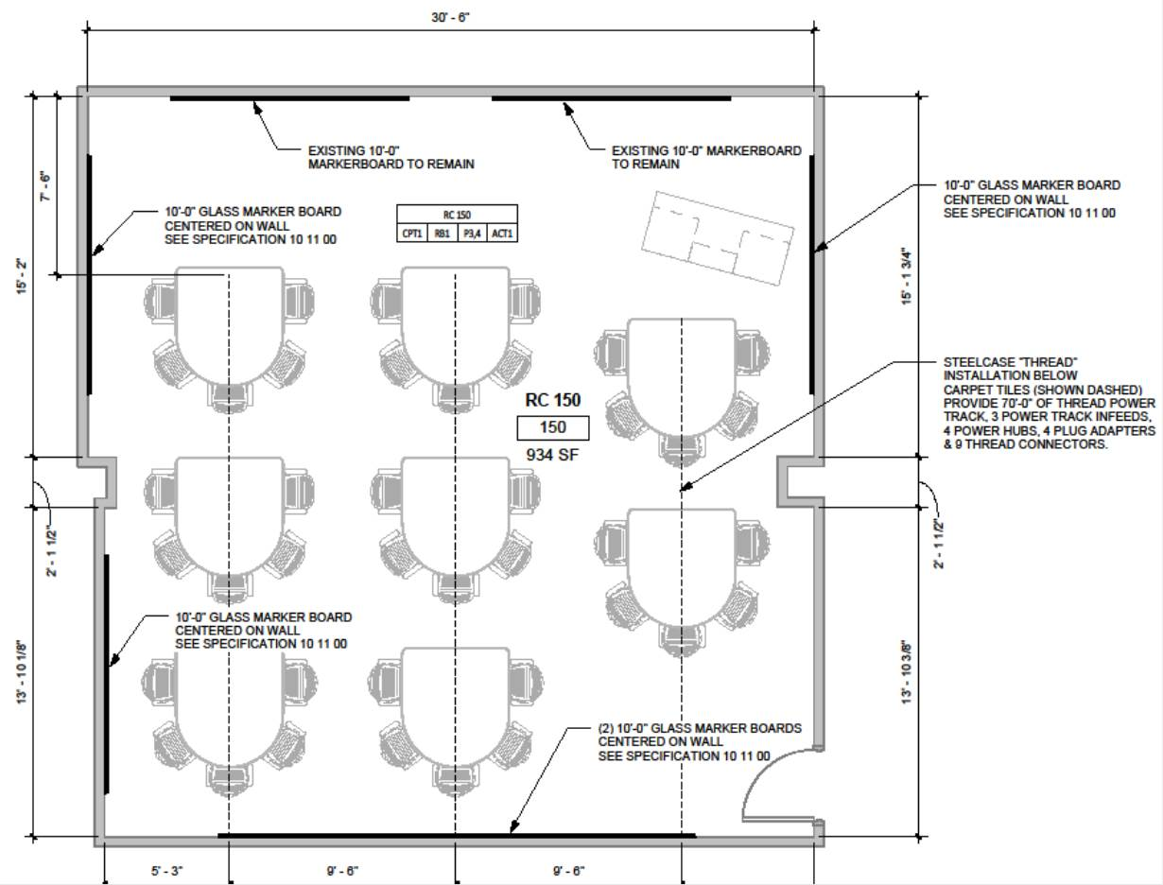
Russ Engineering Center - 150

Slide 16
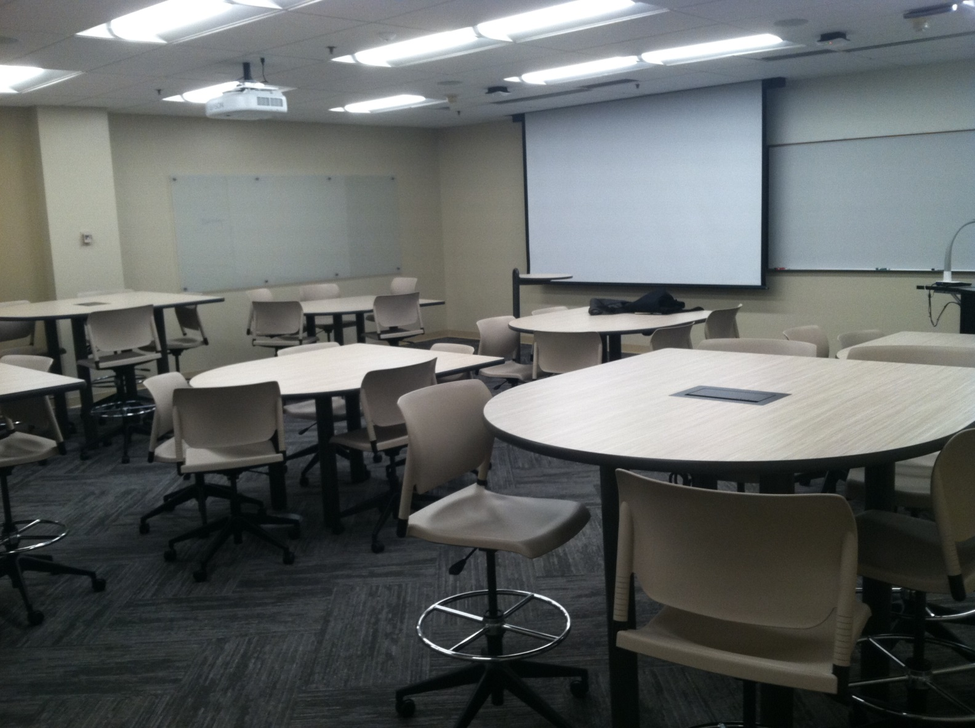
Russ Engineering Center - 150

Slide 17
Package 2
Oelman 112
  3 classrooms from 1 under-utilized lecture hall
Fawcett 101
  Upgrade finishes
  Handicap ramp

Slide 18
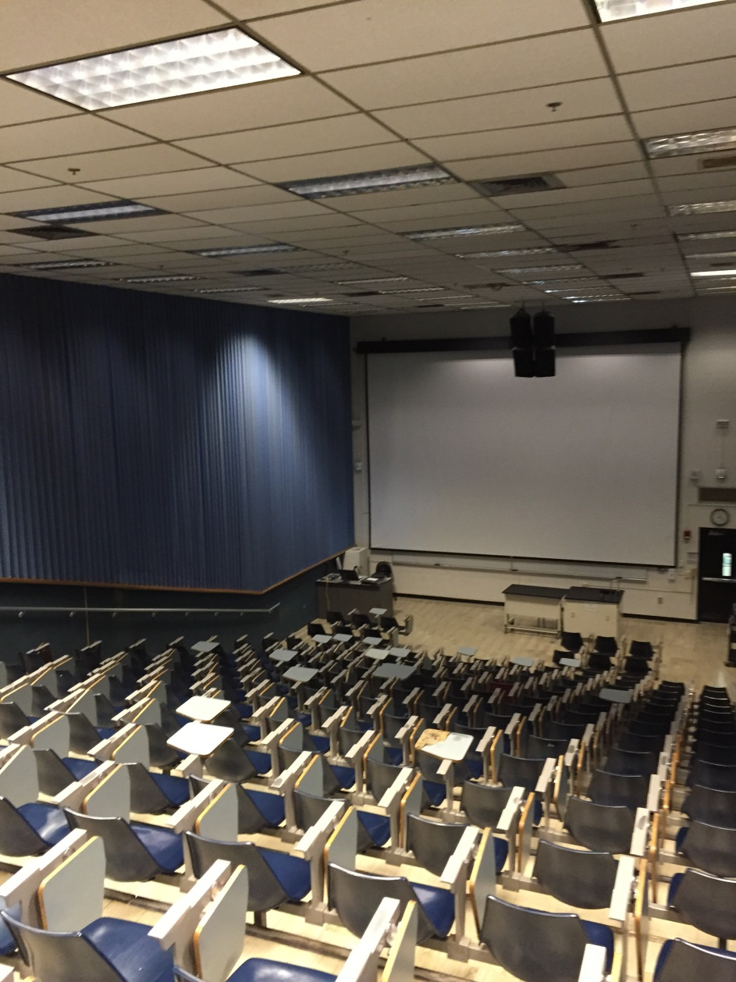
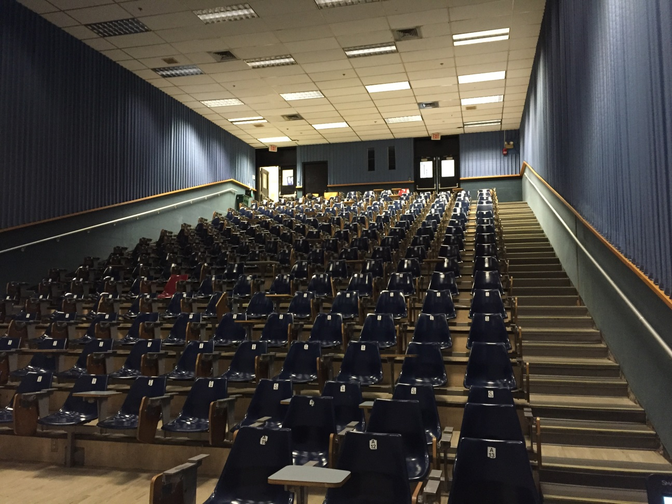
Oelman 112 Existing

Slide 19
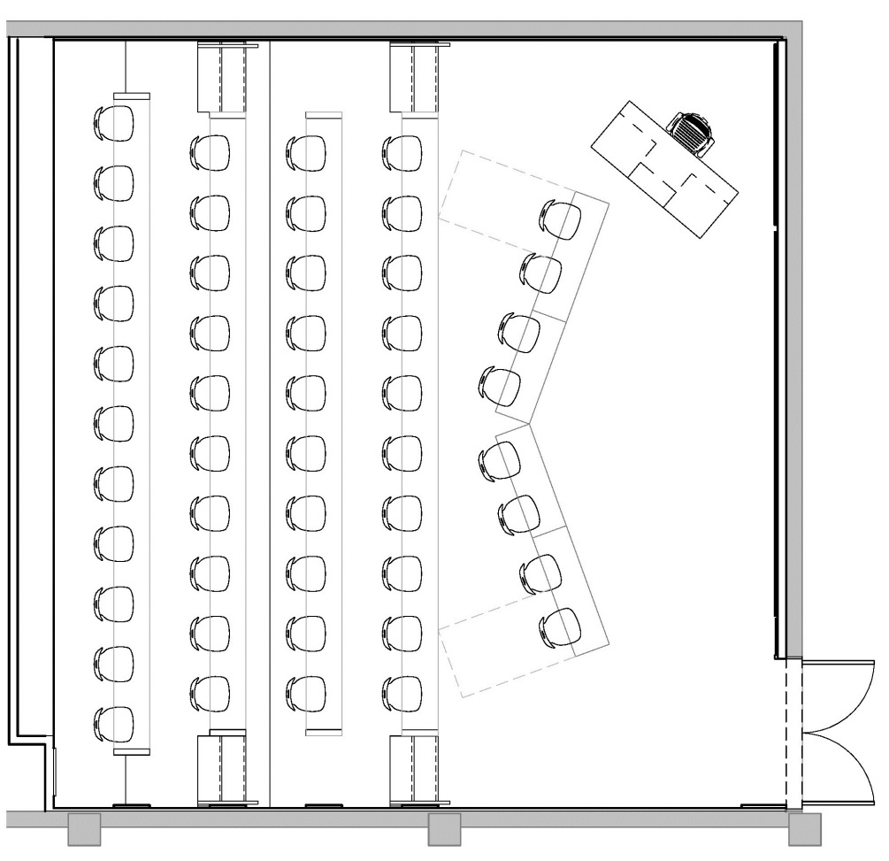
Oelman 112

Slide 20
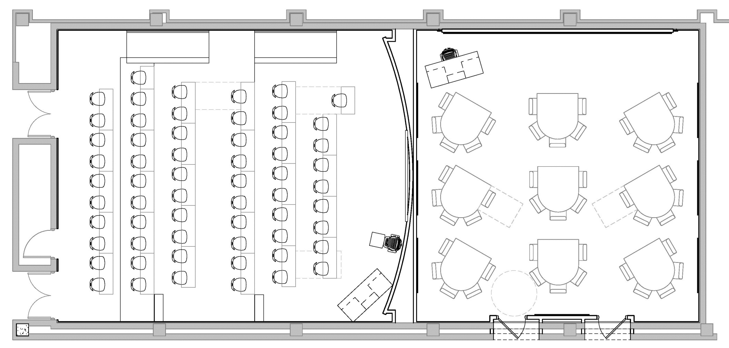
Oelman 112

Slide 21
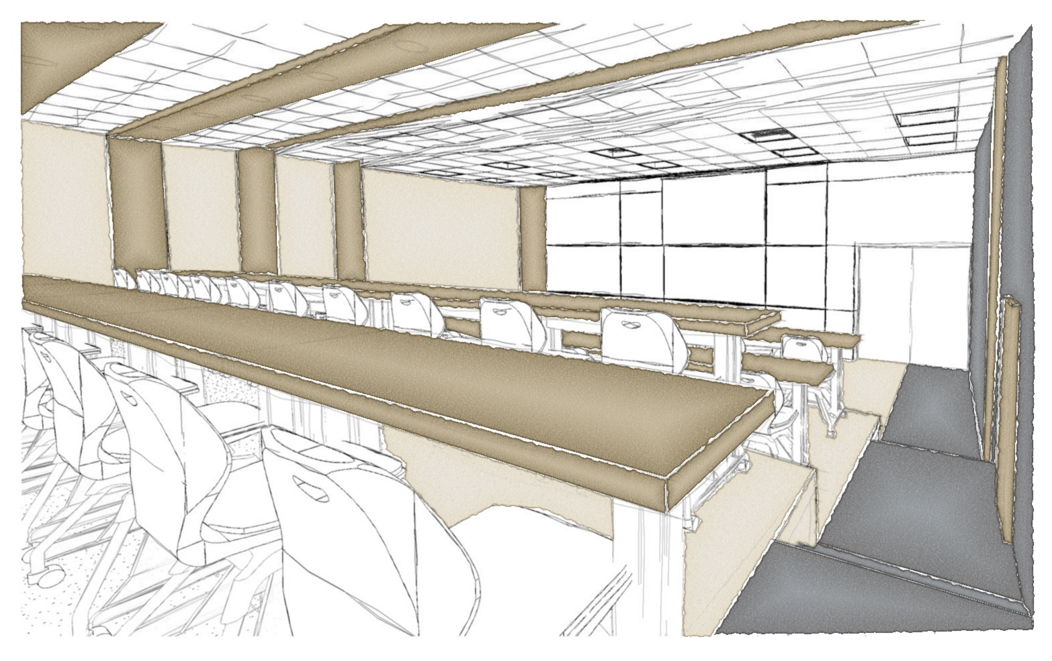
Oelman 112

Slide 22
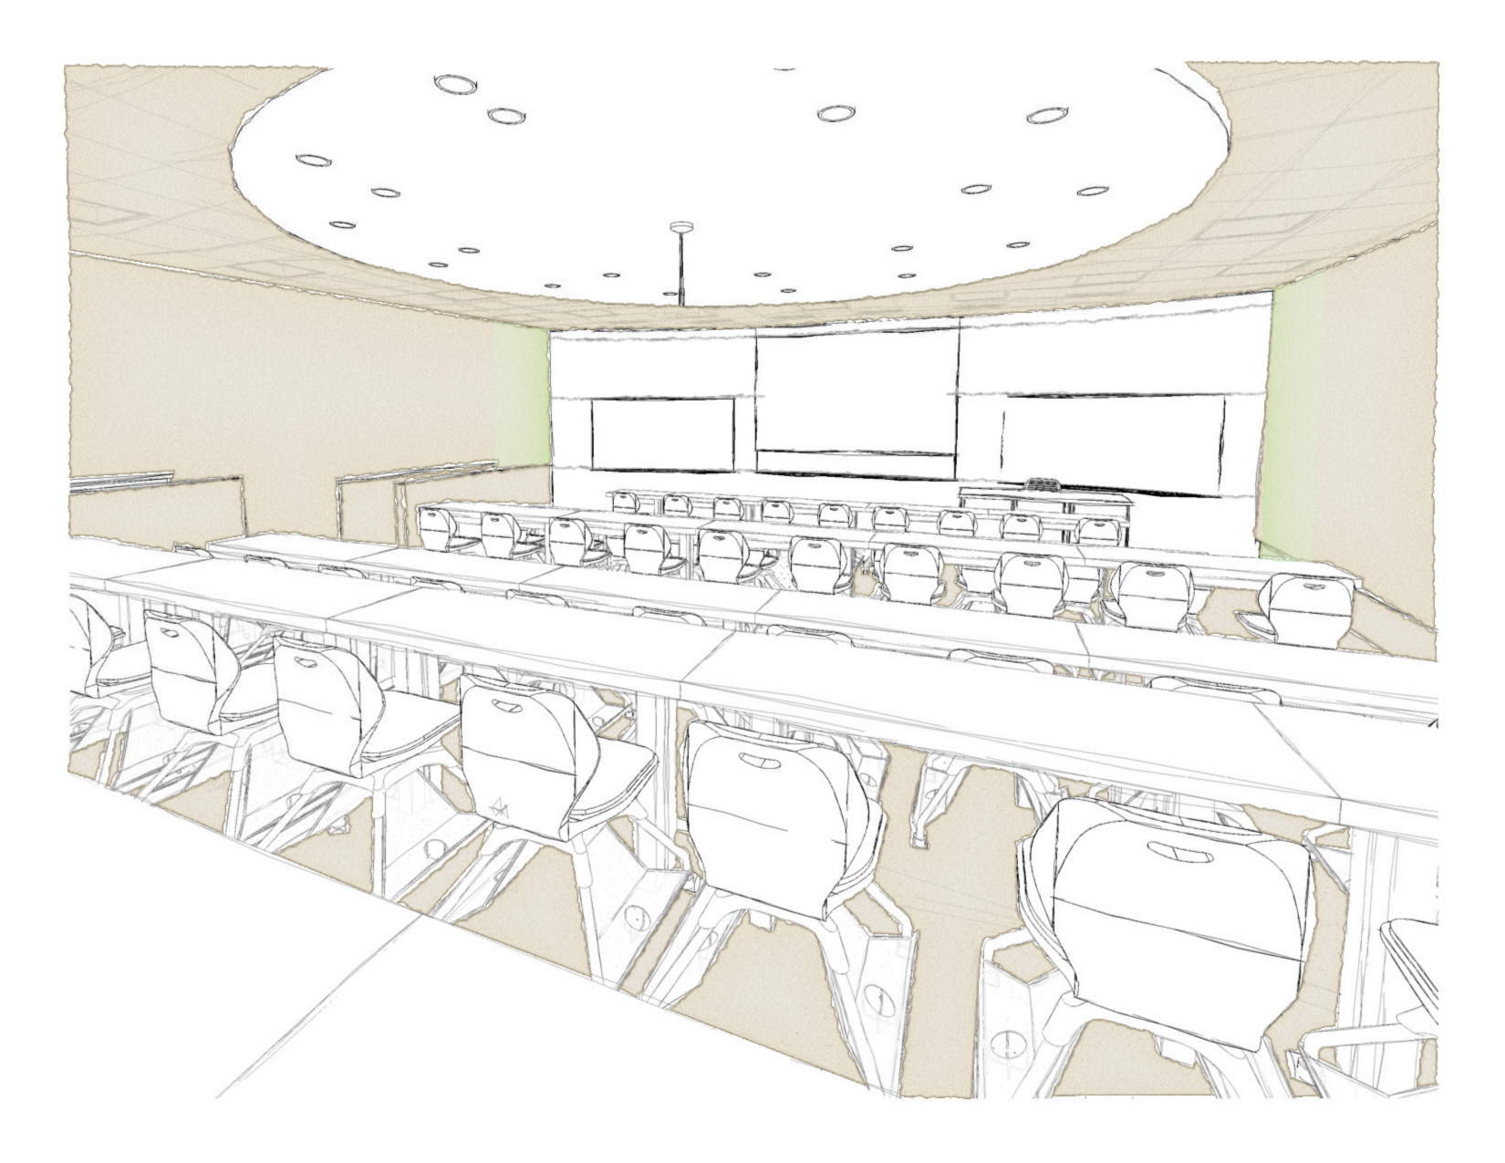
Oelman 112

Slide 23
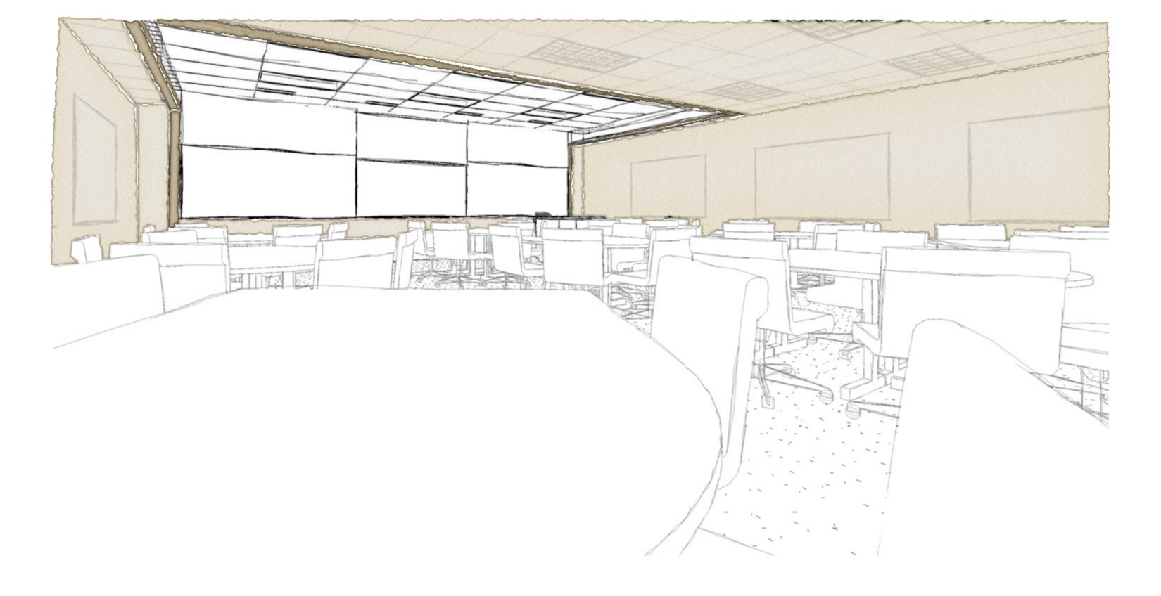
Oelman 112

Slide 24
Package 3
25 classroom renovations
15 Handicap Entrance modifications
6 classroom only Furniture Replacements
3 Combined Rooms (1 Active Learning)
3 Lecture Space Rehabilitations
  Oelman 340
  Creative Arts M252
  Medical Sciences 120

Slide 25
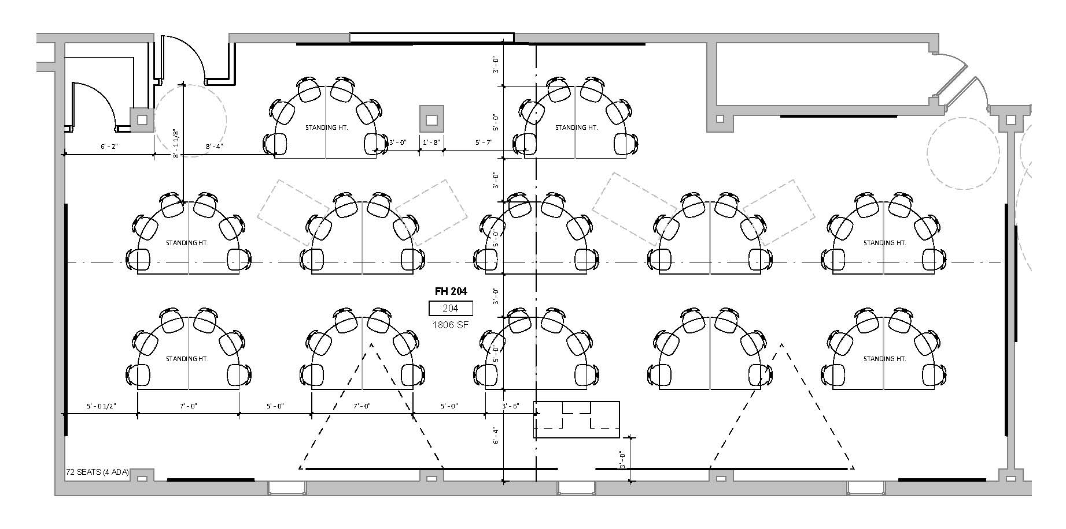
Fawcett 204/206

Slide 26
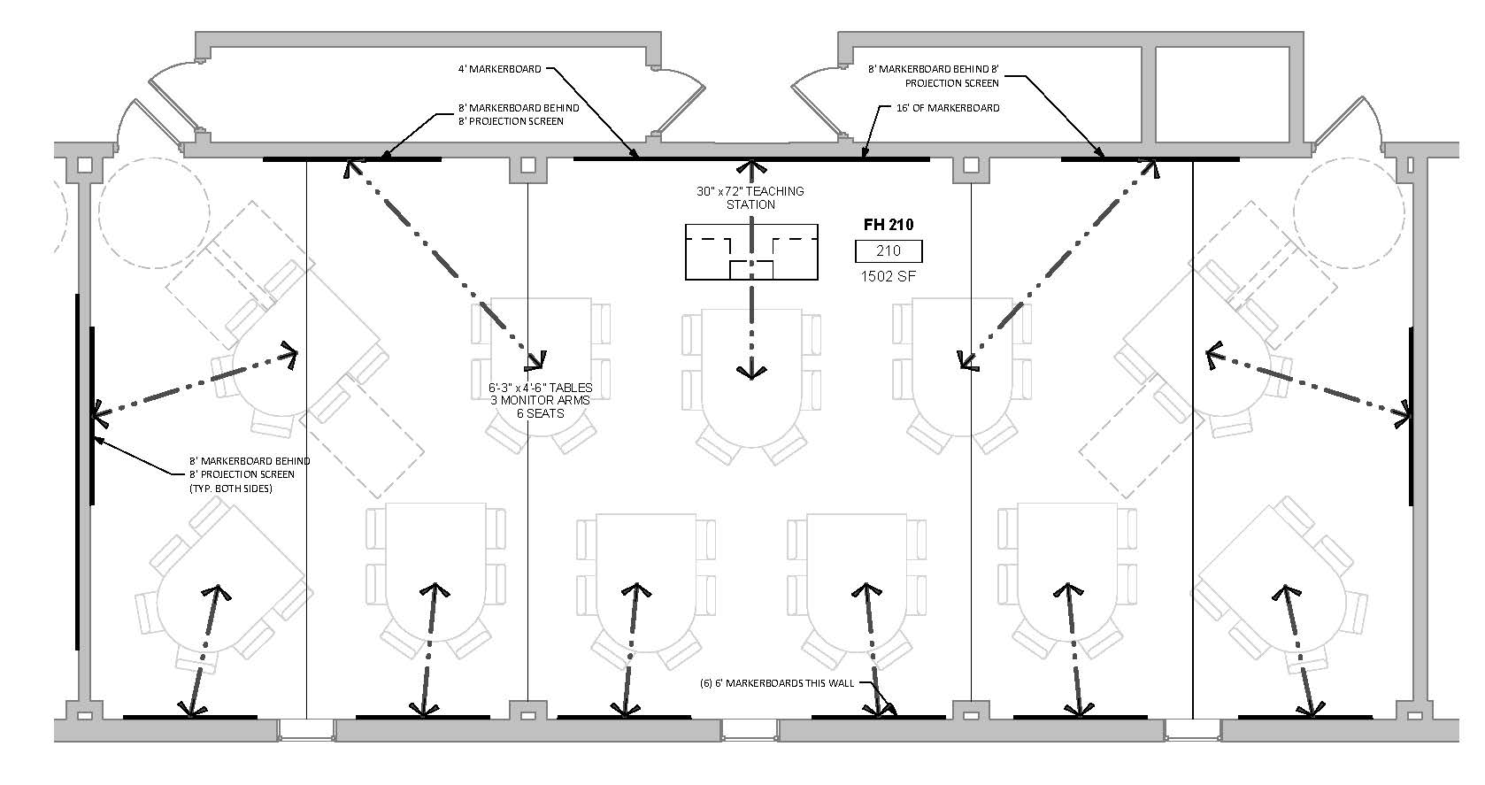
Fawcett 210/218

Slide 27
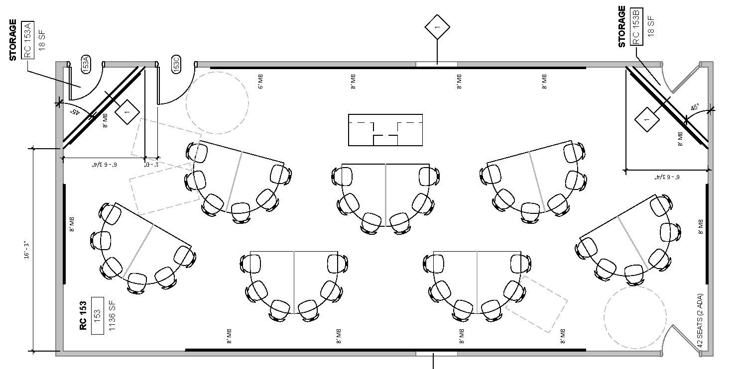
Russ 153/155

Slide 28
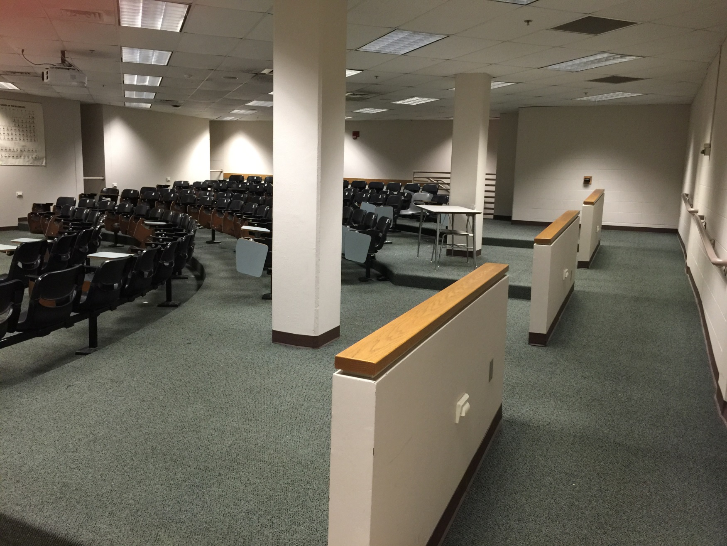
Oelman 340

Slide 29
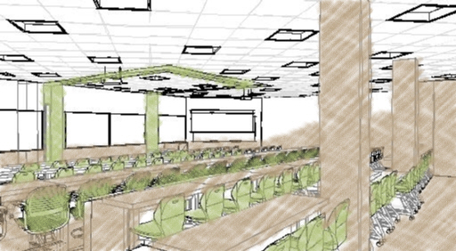
Oelman 340

Slide 30
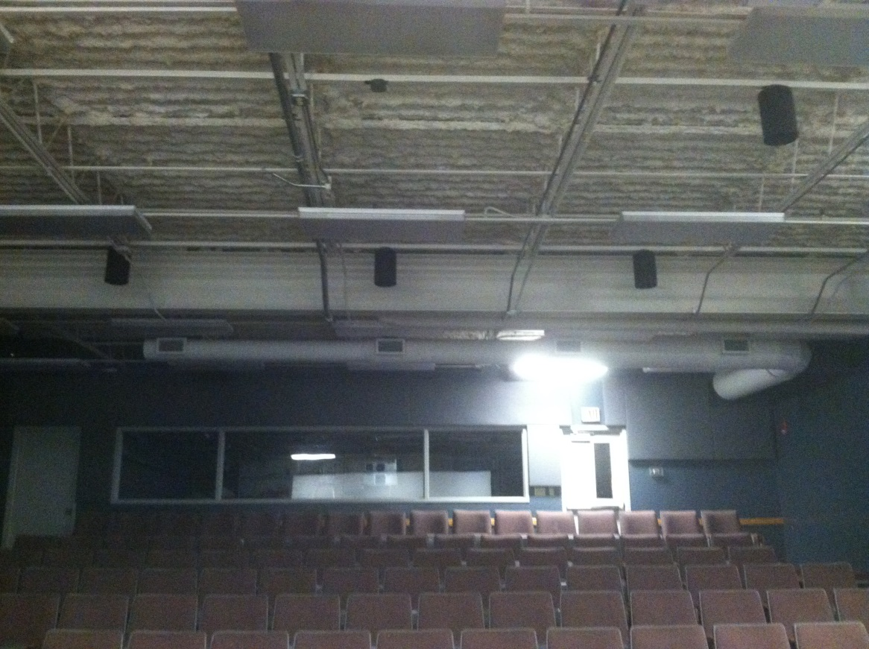
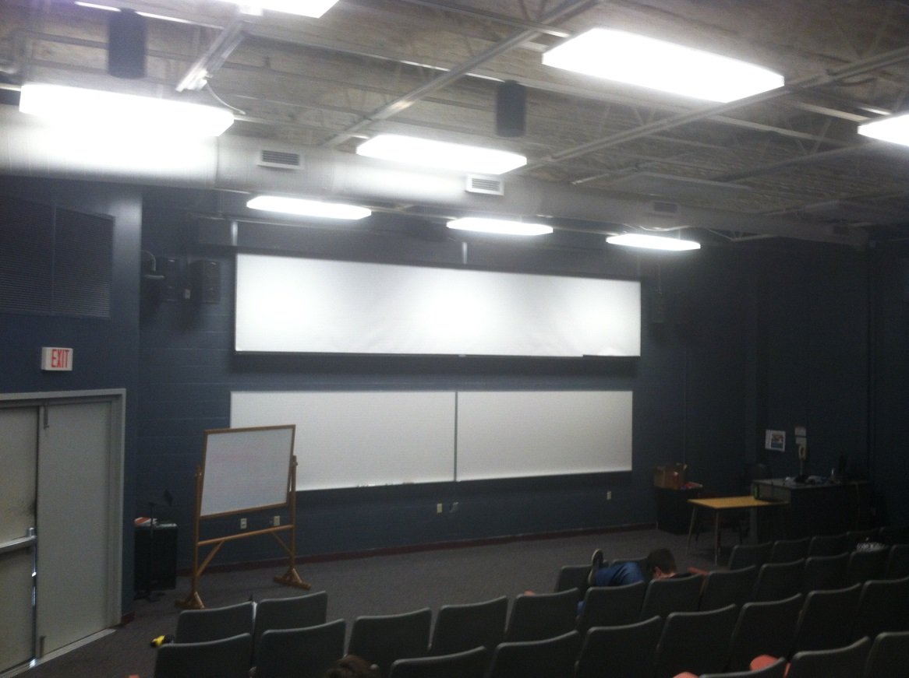
Creative Arts M252 Existing

Slide 31
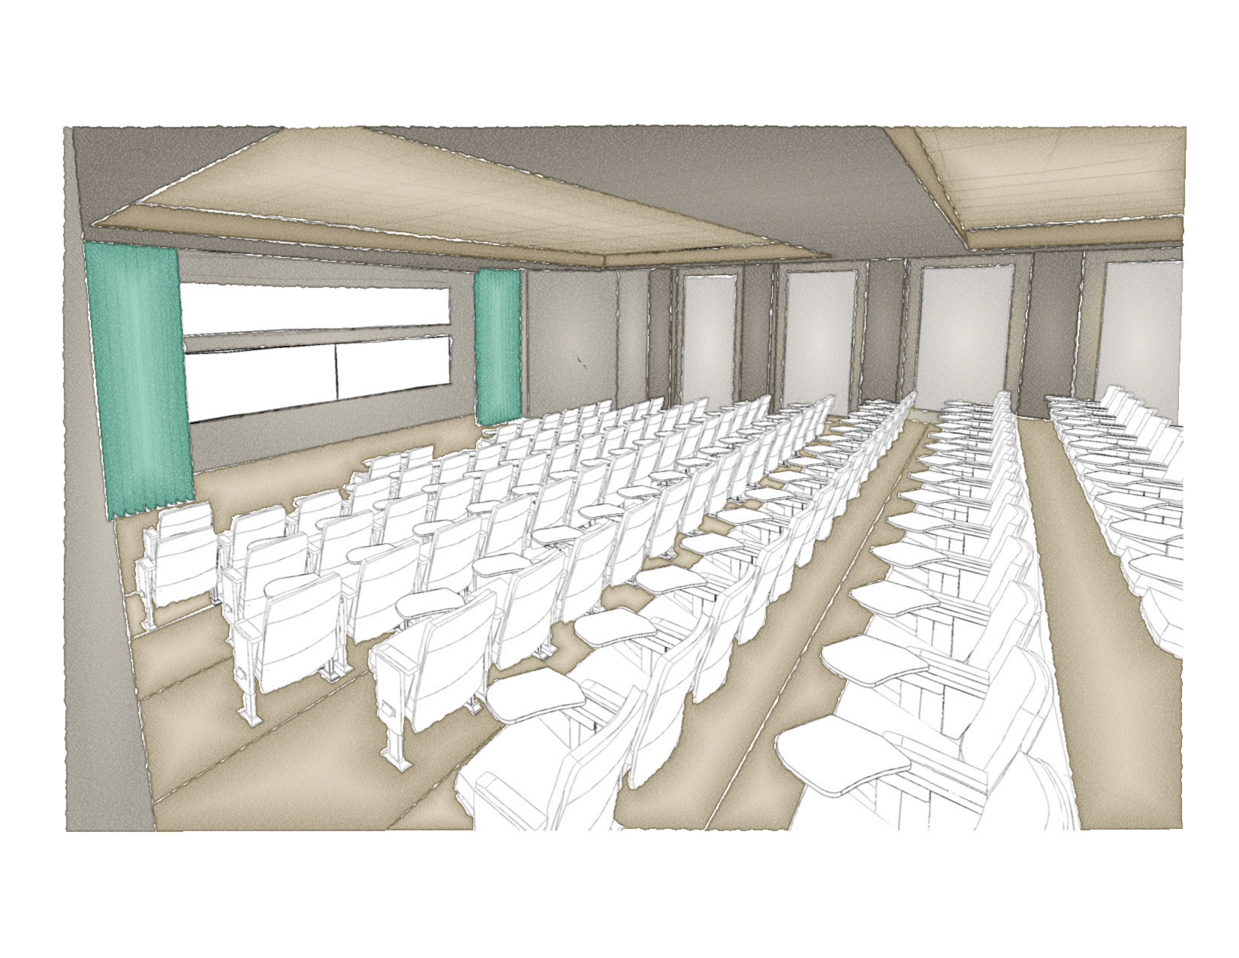
Creative Arts M252

Slide 32
Next Steps
Construct Package 2
Bid Documents for Package 3
  2nd Half of Spring Semester 2016
  Summer A 2016
  Summer B 2016
  Fall 2016
Scope Package 4 with remaining budget

Slide 33
Questions

