Slide 1
Wright State PowerPoint Templates
Please use this template to create presentations using the Wright State Brand

Slide 2
What the template includes
6 Cover Designs
2 Inside Slide Designs

Slide 3
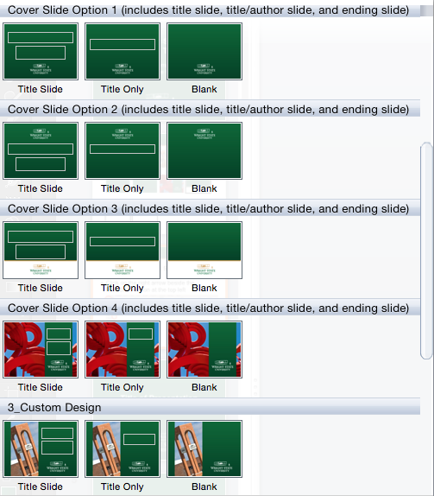
How to choose a slide design
Click on the right arrow beside the New Slide option at the top left

Slide 4
How to change a background
If you pick a slide and want to choose another available background
Click on Layout at the top left

Slide 5
Text Color
Wright State colors are recommended and only for headings (not body copy)
Included in recent color palette in PPT
Wright State Green formula
Red: 2; Green: 105; Blue: 55
HEX: 026937
Wright State Gold formula
Red: 206; Green: 160; Blue: 82
HEX: CEA052

Slide 6
Text Style and Size
Arial is Wright State’s chosen font for electronic needs
Font size and style can be changed, if needed (such as bold or italics)

Slide 7
Photos for Cover Slides
If you want a specific photo for your cover slide, please contact the Office of Marketing

Slide 8
Title of Presentation

Slide 9
Title of Presentation
Author or Date

Slide 11
Title of Presentation
Author or Date

Slide 12
Title of Presentation

Slide 14
Title of Presentation
Author or Date

Slide 15
Title of Presentation

Slide 17
Title of Presentation
Author or Date

Slide 18
Title of Presentation

Slide 20
Title of Presentation
Author or Date

Slide 21
Title of Presentation

Slide 23
Title of Presentation

